Slide 1
KSVB Clinic
Charlotte Marshall
@heyteachonline

Slide 2
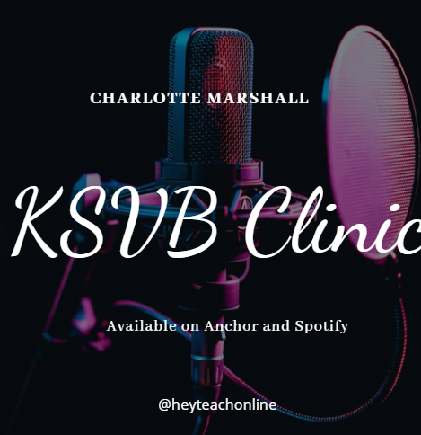
Available now!
https://podcasters.spotify.com/pod/show/charlotte-marshall0/episodes/Teaching-Specialist-Skill-3-TSS3-e20675r
This episode is looking at the KSVB TSS3 where you're invited to "Design a wide range of teaching environments to facilitate student learning and engagement"
This is the link to the supporting Padlet where you can pose questions and add further evidence from your own experiences: https://padlet.com/Charlotte_heyteach/KSVBClinic
www.ntu.ac.uk

Slide 3
