Slide 1
KSVB Clinic
Charlotte Marshall
@heyteachonline

Slide 2
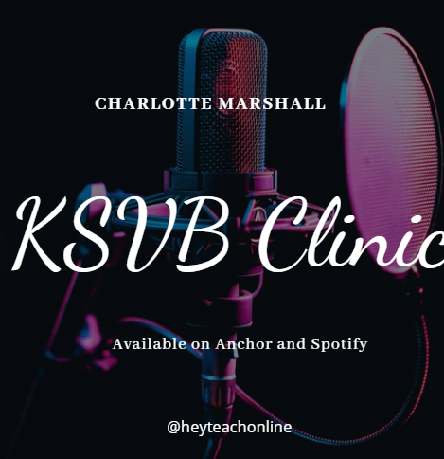
Available now!
https://anchor.fm/charlotte-marshall0/episodes/Core-Value-and-Behaviour-3-CVB3-e1uc07p
This episode is looking at the KSVB CVB3 where you're invited to consider "The need to commit to CPD in relation to relevant contemporary issues such as: student employability and graduate employment destinations, ethics and sustainability, academic integrity, legal compliance and intellectual property, respect and confidentiality, and health and safety."
This is the link to the supporting Padlet where you can pose questions and add further evidence from your own experiences: https://padlet.com/Charlotte_heyteach/KSVBClinic
www.ntu.ac.uk

Slide 3
