Slide 1






TILT Annual Learning and Teaching Conference (ALTC)
21, June 2022
Cultural identity and academic performance:
a study of Chinese overseas students.
ISHWINDER KAUR
ALDO GUTIERREZ
[Biosciences, School of Sciences and Technology]

Slide 2

SOCIAL INCLUSION AND ACADEMIC SUCCESS OF CHINESE STUDENTS IN EU HIGHER EDUCATION (SIAS CHINA-EU)
ERASMUS+ PROGRAMME 2019 KEY ACTION 2
DURATION: September-2019 to December-2022
Partner universities:
Universitat Autònoma de Barcelona (UAB, Spain) [project coordination]
Hamburg University of Technology (TUHH, Germany)
Instituto Politécnico da Guarda (IPG, Portugal)
Nottingham Trent University (NTU, UK)
Project number: 2019-1-ES01-KA203-065990

Slide 3
The internationalization of higher education
and its cross-cultural challenges
“…it is not enough for universities and other higher educational institutions only to mention internationalization issues in their mission statements; rather, regardless of their legal status and their current responsibilities in the field of internationalization, all higher education institutions should look for the most appropriate solutions in line with their needs, and develop their own governance and planning structures together with channels for cooperation”
European higher education in the world.
The European Economic and Social Committee and the Committee of the Regions
COM(2013)
Notes:
The project aims to provide tools to deal with the CHANGES BROUGHT ABOUT by the internationalization of higher education and the cross-cultural challenges associated to it.

Slide 4
SOCIAL INCLUSION AND ACADEMIC SUCCESS OF CHINESE STUDENTS IN EU HIGHER EDUCATION (SIAS CHINA-EU)
Main objective:
To enhance our professional capacity to engage respectfully and communicate effectively in a Chinese-European
cross-cultural context.

Slide 5
SOCIAL INCLUSION AND ACADEMIC SUCCESS OF CHINESE STUDENTS IN EU HIGHER EDUCATION (SIAS CHINA-EU)
Main output:
Production and dissemination of best practice guidelines and study materials specifically tailored for:
Chinese students
Home students (Spain, Germany, Portugal and UK)
Teaching staff
Administrative and service staff

Slide 6

SOCIAL INCLUSION AND ACADEMIC SUCCESS OF CHINESE STUDENTS IN EU HIGHER EDUCATION (SIAS CHINA-EU)
PLEASE SIGN THE REGISTER!

Slide 7



PART I
The internationalization of higher education
and its challenges.

Slide 8
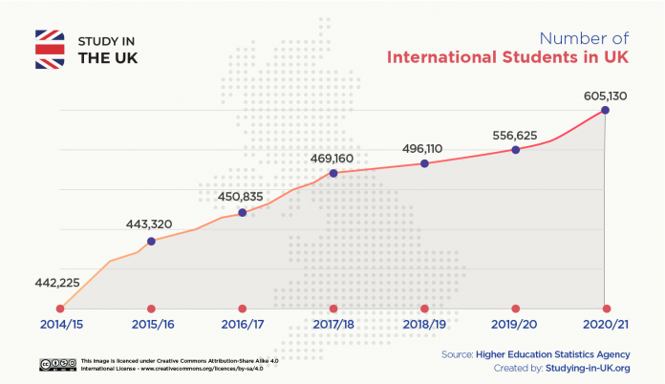

Internationalization of UK’s student population.
“Our ambition is to increase education exports to
£35 billion by 2030. International education exports
were worth almost £20 billion to the UK in 2016 and,
based on current rates of growth, could be expected
to reach an estimated £23 billion by 2020…
As part of this ambition, we want to grow the
numbers of international higher education
students studying in the UK to 600,000 by 2030.”
(UK Government, March 2019)
2019-​20: Tuition fees = £18.0 billion
2019-20:
Approx. 540,000 international students in the UK.
They made 27.5% of the total student population in the UK.
16% of all undergraduates and 40% of all postgraduates.

Slide 9
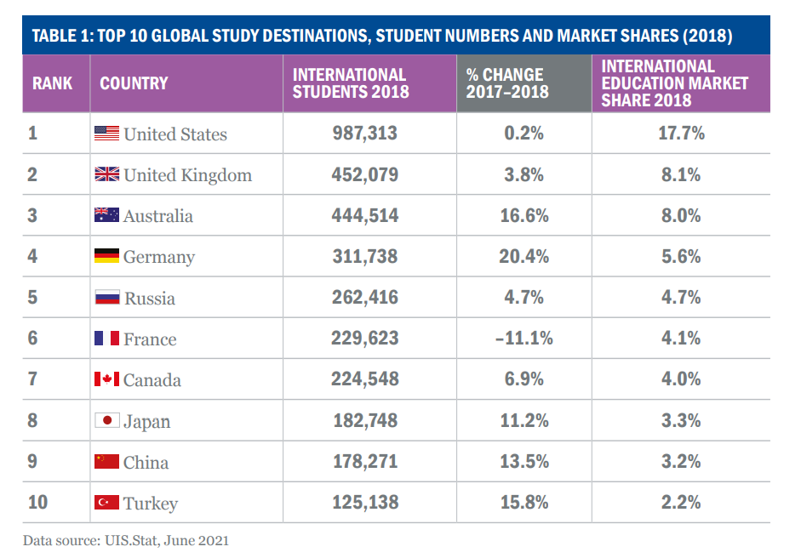
Internationalization of UK’s student population.
Source: INTERNATIONAL STUDENT RECRUITMENT: WHY AREN’T WE SECOND?
(Universities UK International, 2021)

Slide 10
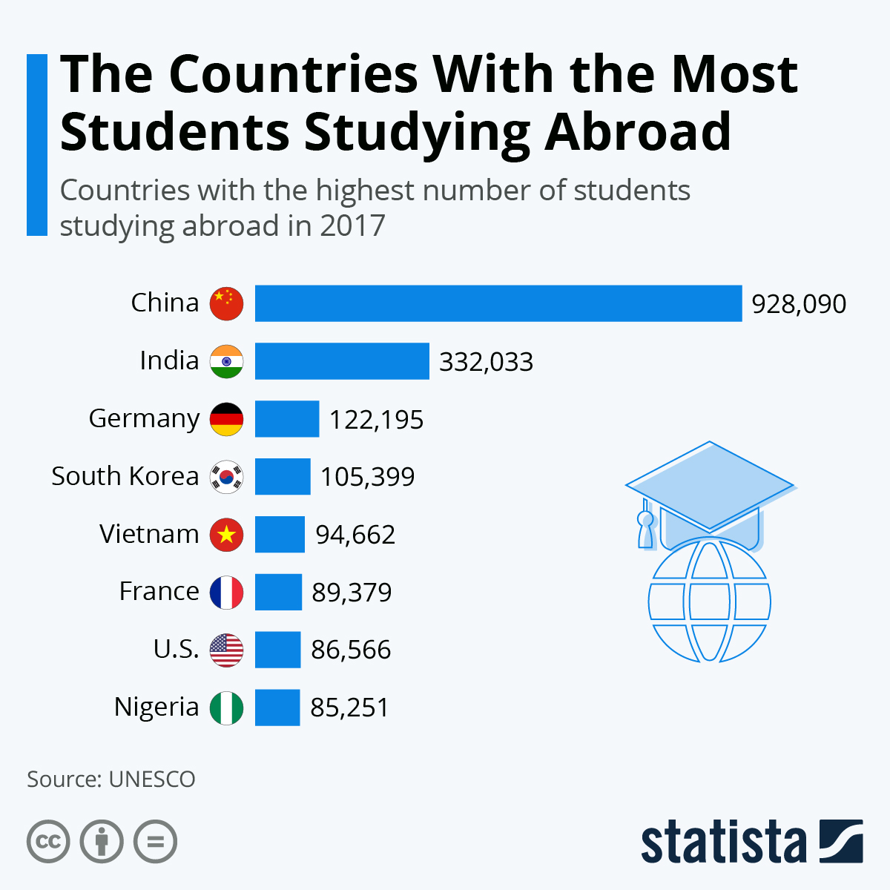
Internationalization of UK’s student population.

Slide 11
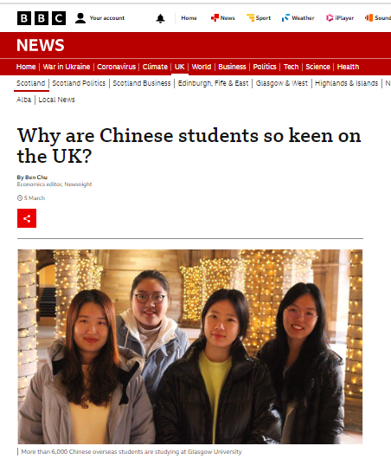
BBC website 5 MARCH 2022

Slide 12
Overseas students in the UK: First year entrants
Top 3 main countries of origin (non EU/USA)
Academic years 2006-7 to 2020-21
Overseas students at NTU
(2020-21)
CHINA
INDIA | 582
CHINA | 533
NIGERIA | 252
Portugal | 154
Spain | 133
Poland | 123
France | 94
Croatia | 90
Cyprus | 87
United States | 85
INDIA
NIGERIA
Source: Higher Education Student Data (HESA) May 2022
Nigerian students account for ≥ 80% of African students in the UK.
Total overseas students at NTU (2020-21) : ≈ 4,000 ; from 132 countries.
(≈ 11% of total NTU student population)

Slide 13
The internationalization of higher education
and its challenges.
INCLUSIVITY
Chinese student (2021):
“I really enjoy all the workshop classes mostly. I get excited to learn and experience the different materials i get to work with i really wish we could have more workshop classes in class but i found it hard to connect with the uk students.; before the pandemic i was in classes with another chinese students but now we are all separated and i am the only chinese student and lonely because not being able to truly express what i'm trying to say.; i feel alienated and embarrassed when i have an amazing idea for my project and i really want to share it with my classmates and teachers but i would spend forever trying to explain and at the end still have no idea what i'm saying. Also would use real-life reference from movies or photos and now”
Source: SIAS China-EU. Chinese students questionaries (2020-21)
Notes:
Although this increasing internationalization of higher education is something to be welcomed and celebrated, there are nevertheless, TWO MAIN CHALLENGES associated. The FIRST ONE is INCLUSIVITY. As we can see from these comments by a Chinese student who answer one of our questionaries, the ACTUAL living and learning experience of BEING a INTERNATIONAL STUDENT can be one of ISOLATION, LONELYNESS and a deep feeling of BEING ALIENATED from your OWN cultural and social ROOTS.

Slide 14
The internationalization of higher education
and its challenges.
INCLUSIVITY
Chinese student (2021):
i found it hard to connect with the uk students.;
i am the only chinese student and lonely because not being able to truly express what i'm trying to say.
i feel alienated and embarrassed
i would spend forever trying to explain and at the end still have no idea what i'm saying.
Source: SIAS China-EU. Chinese students questionaries (2020-21)

Slide 15
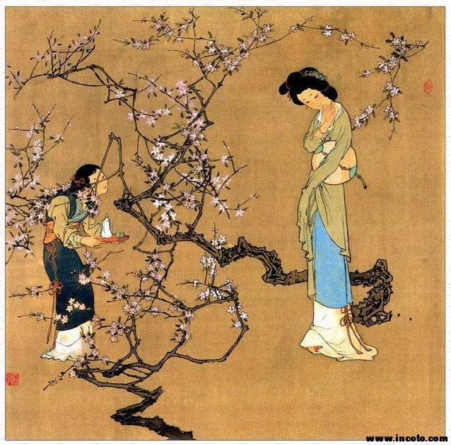
CROSS-CULTURAL ISSUES
MOVING AWAY FROM JUST AN ISSUE OF FOREIGN LANGUAGE SKILLS
TRADITIONAL CHINESE CULTURE
Overriding values:
Hierarchy and Order as a way to ensure Social Harmony
Personal values and behaviours:
Obedience
Discipline
Reticence (or modesty)
Respect for authority figures
Filial piety.
Faithfulness.
Brotherhood.
Loyalty.
Sincerity.
Notes:
In the last ten years, we have moved away from explaining international students’ DIFFICULTIES as a result of JUST their foreign language skills. Instead, there is a growing realization about the IMPORTANCE OF DEEP CROSS CULTURAL ISSUES. If we have a look at TRADICIONAL CHINESE CULTURE, we see the most important values are HIERARCHY and ORDER, as a way to ensure SOCIAL HARMONY. From these TWO CENTRAL VALUES, a number of personal values and behaviours are derived: for instance, OBEDIENCE, DISCIPLINE and RESPECT FOR AUTHORITY FIGURES. All these cultural TRAITS come together as a whole to constitute a universe on its own, something that appears to as something very DISTINTIVE, EXOTIC perhaps.

Slide 16
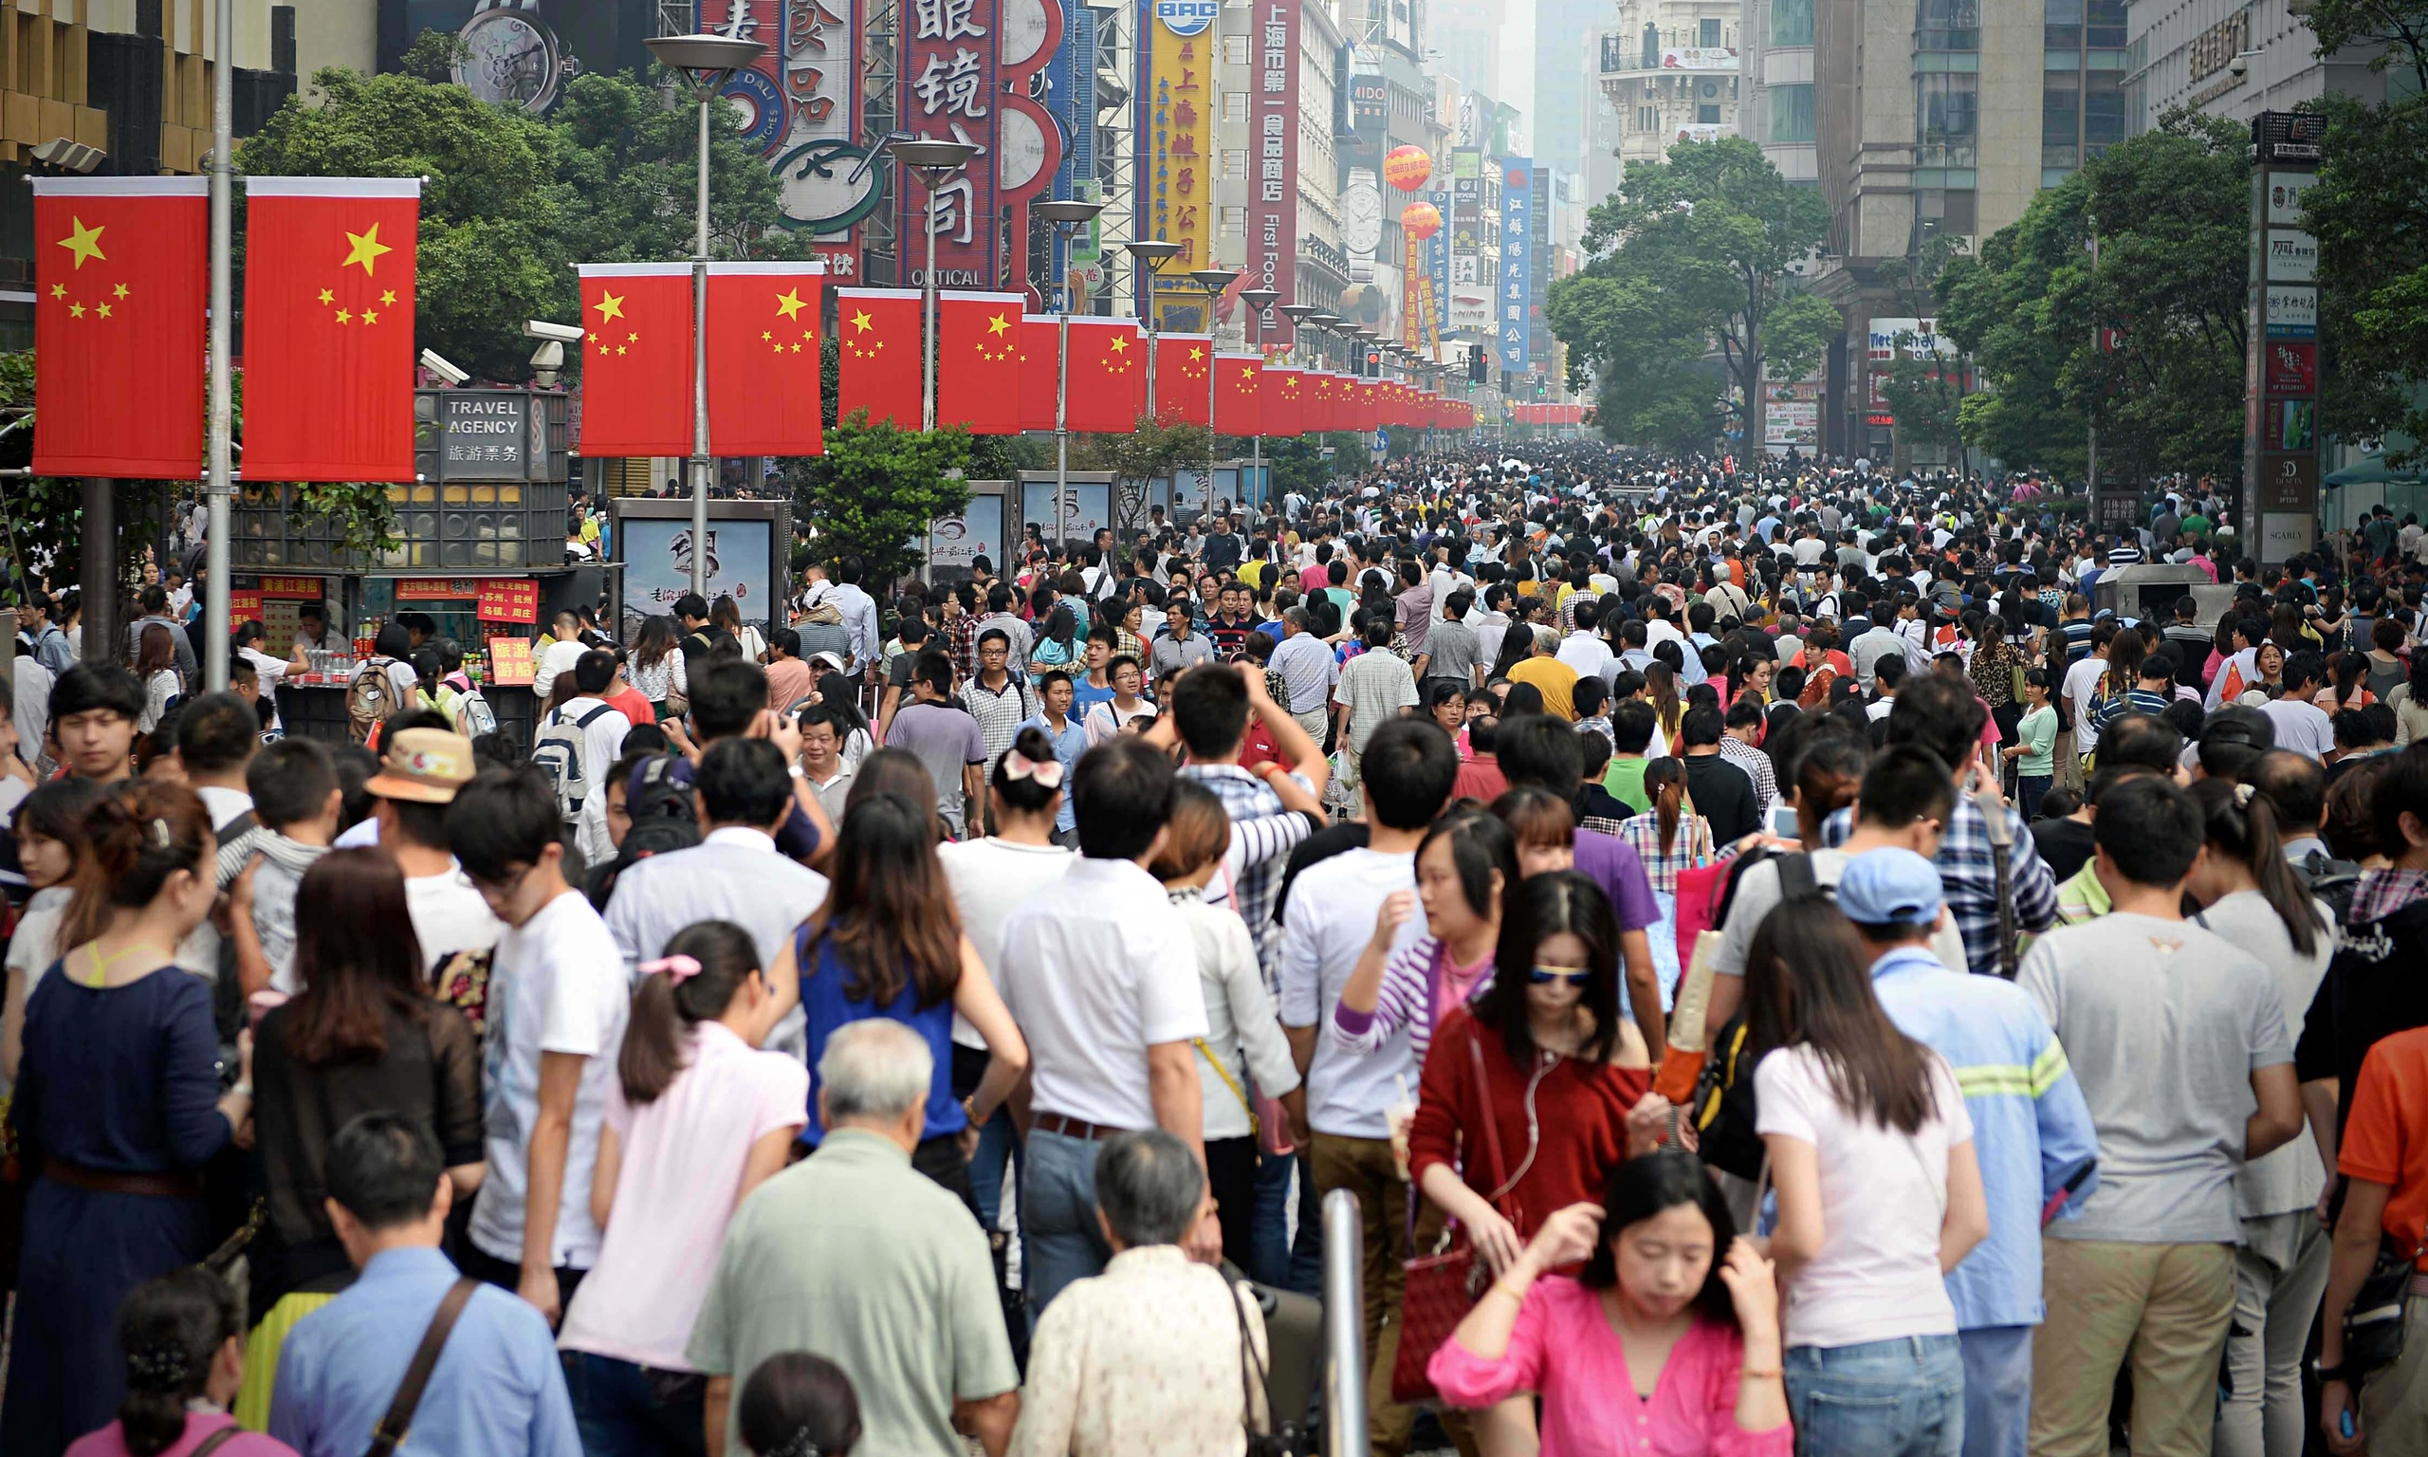
CROSS-CULTURAL ISSUES
A DIFFERENT POLITICAL CULTURE
MODERN CHINESE SOCIETY: A SOCIALIST STATE WITH A COLLECTIVIST ETHIC.
Article 1. The People’s Republic of China is a socialist state under the people’s democratic dictatorship led by the working class and based on the alliance of workers and peasants. (1982 Constitution of the People's Republic of China).
“The education in the People’s Republic of China must be aimed at socialist modernization and combine production and work, with the purpose of satisfying the needs of the socialist society through the development of morality, intelligence and good physical condition.”
(Law on Education,1995)
Notes:
In addition to this, MODERN CHINESE SOCIETY HOLDS a POLITICAL CULTURE very different, or even opposed, to the one we lived in XXI century Europe. They regard themselves as a SOCIALIST STATE with a COLLECTIVIST ETHICS, a DEMOCRATIC DICTATORSHIP under the political hegemony of a SINGLE DIRECTING POLITICAL PARTY.
Within this society, the ROLE OF EDUCATION is clearly a political one: SASTIFYING THE NEEDS OF BUILDING A SOCIALIST STATE.
State ownership of means of production. Social redistribution of SURPUS VALUE. End of politics and civil society: political hegemony of the DIRECTING SINGLE PARTY.

Slide 17

CROSS-CULTURAL ISSUES
EUROPE’S INDIVIDUAL-CENTRED CULTURE
(Protestantism, Enlightenment, classical liberalism, welfare society)
“the greatest transformation
of western consciousness…”
Isaiah Berlin (1965),
The roots of Romanticism
Caspar David Friedrich, ‘Wanderer Above the Sea of Fog, 1818
Notes:
In opposition to all this, European culture is centred around the INDIVIDUAL AND ITS FREEDOMS. Central to this is ITS REJECTION AND DISTRUST OF AUTHORITY, PRIMACY OF THE INDIVIDUAL OVER STATE.

Slide 18

CROSS-CULTURAL ISSUES
“Modern western civilization can be understood as a drive against prejudice and authority”
K. Popper (1945), The open society and its enemies.
EUROPEAN MODERN CULTURE:
THE INDIVIDUAL AND HER/HIS FREEDOM
Rejection and distrust of authority and authority figures
Primacy of the individual over the state
(limited government power over private realm)
Value independence over social norms: confrontation as a value
Self-sufficiency and self-interest over group’s interests
Diversity of lifestyles
Privacy and personal interests
Notes:
In opposition to all this, European culture is centred around the INDIVIDUAL AND ITS FREEDOMS. Central to this is ITS REJECTION AND DISTRUST OF AUTHORITY, PRIMACY OF THE INDIVIDUAL OVER STATE.

Slide 19
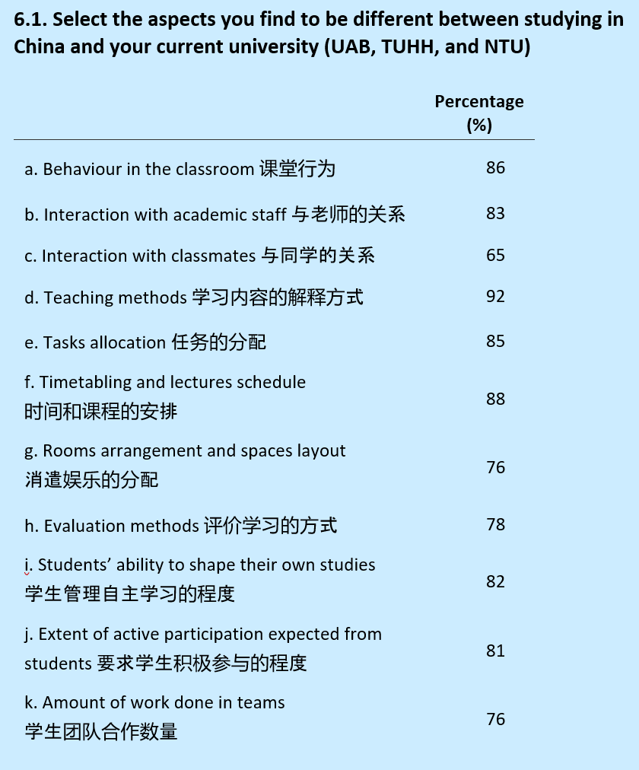
“EVERYTHING IS DIFFERENT”
It is a this intersection
that cross-cultural issues arise.
Source: SIAS China-EU.
Chinese students questionnaires
(2020-21)
Notes:
In general, we are unaware of our own cultural values and how they shape our life. It is only when we are placed in contact with a different culture that we realize different people do things in a different way. It is at this overlapping situation that CROSS-CULTURAL ISSUES arise. Then we realize that even things we would take as granted to be “NORMAL” and “NATURAL”, are not so for other people.
For Chinese students coming from a GROUP-ORIENTED culture, our INDIVIDUAL-CENTRED learning environment come across as a novelty. TEACHING METHODS, BEHAVIOUR IN THE CLASROOM and even STUDENTS’ ABILITY TO SHAPE THEIR OWN STUDIES are new experiences that may challenge their own VALUES and HABITS.
Therefore, it is important to RAISE AWARENESS of these differences in BOTH SIDES so that genuine and effective COMMUNICATION can take place, and a better and rewarding experience is achieved by ALL THE ACTORS involved (international students, national students, and teaching staff and administrative staff)

Slide 20
CROSS-CULTURAL ISSUES
It is crucial to raise awareness of these differences on both sides, so that a genuine and effective communication can take place, and a rewarding experience is achieved by all actors involved
(chinese students, home students, teaching staff and administrative & service staff).
Notes:
Therefore, it is crucial to raise awareness in both sides about these differences, so that a genuine and effective communication can take place, and a rewarding experience is achieved by all the actors involved (international students, national students, and teaching staff and administrative staff).

Slide 21
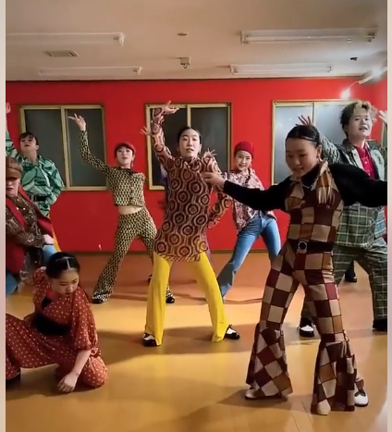
AVOIDING CULTURAL STEREOTYPES…IN JUST 1 MINUTE
No portrayal of a different culture can be either complete or objective.
Any such description is also by necessity a simplification.
Moga Almeri dance group (Japan)
Moga Almeri, Doing It To Death - Bing video
moga almeri choreograph , Doing It To Death - YouTube

Slide 22

PART II
Chinese students at NTU
Photo: NTU International’s web page

Slide 23
Chinese students at NTU
Notes:
His include the trend from UK and partner universities
Reason is simply girls doing better academically than boys

Slide 24
Chinese students at NTU:
Weight of UK’s historical and cultural links with Hong Kong
Population
Hong Kong 7.5 million
Mainland China 1,402 million

Slide 25
Nottingham School of Art & Design
Nottingham Business School
School of Arts & Humanities (Nottingham Institute of Languages and Intercultural Communication, NILIC)

Slide 26
Nottingham School of Art & Design
Nottingham Business School
School of Arts & Humanities (Nottingham Institute of Languages and Intercultural Communication, NILIC)

Slide 27
Nottingham School of Art & Design
Nottingham Business School
School of Arts & Humanities (Nottingham Institute of Languages and Intercultural Communication, NILIC)

Slide 28
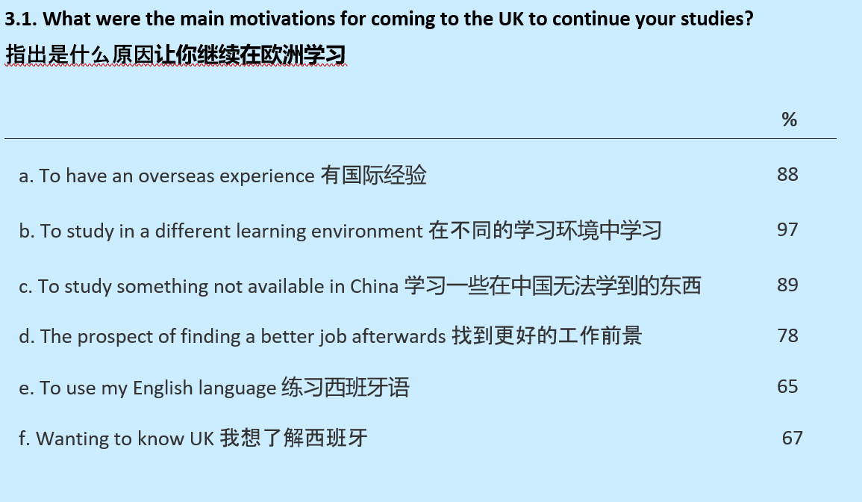
MOTIVATIONS
Source: SIAS China-EU. NTU Chinese students questionnaire (2020-21)

Slide 29
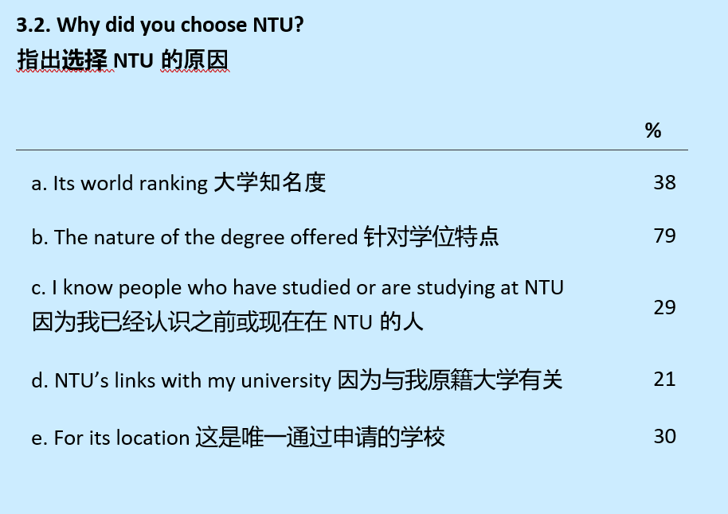
WHY NTU?
Source: SIAS China-EU. NTU Chinese students questionnaire (2020-21)

Slide 30
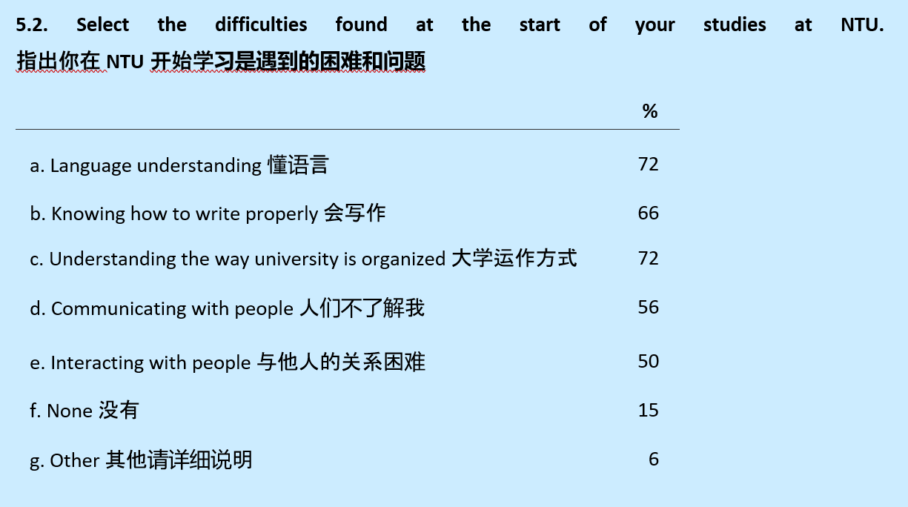
STARTING STUDIES: DIFFICULTIES
Source: SIAS China-EU. NTU Chinese students questionnaire (2020-21)

Slide 31

PART III
The SIAS China-EU project and its methodology

Slide 32
PHASE 1: LISTENING AND LEARNING
Formative workshops, team’s self-study and discussion meetings.
Elaboration and running of questionnaires for Chinese students, teaching
and administrative staff.
Design Thinking workshops (over 4 weeks).
PHASE 2: REFLECTING AND WRITING
Writing of Intellectual Outputs [from December 2021]
4 transnational presential meetings (steering committee )
Customizing and implementation workshop [Hamburg, April 2022]
PHASE 3: DISSEMINATION
Multiplier events at partners universities (UaB, IPG, TUHH, NTU)
Special session workshop at 14th annual International Conference on Education and New Learning Technologies [Palma de Mallorca (Spain) on the 4-6 July, 2022.]
Workshop at Renmin University of China (中国人民大学), Beijing
[September 2022, tbc]
Open-access website hosting all good practice guidelines and study materials
(not ready yet)
Notes:
From the very beginning, the project was conceived as a LEARNING AND LISTENING experience in first place. That was followed by a REFLECTING AND WRITING period. We are now in the final stage and starting DISSEMINATION of the intellectual outputs.

Slide 33
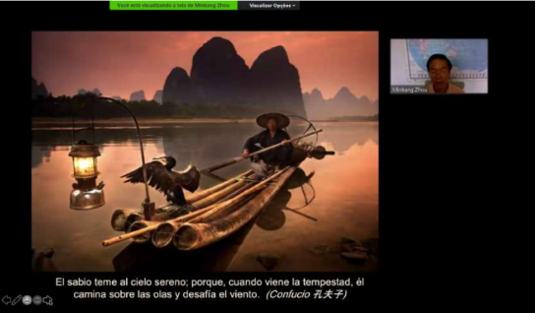
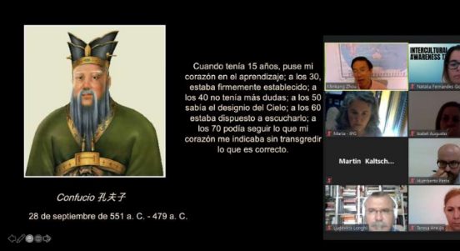
PHASE 1: LISTENING AND LEARNING
Training international workshops (on-line, 2 hours each, invited expert speakers)
Open invitations send across each partner universities.
INTERCULTURAL AWARENESS (September 2020)
Chinese culture: past and present ( Prof. Minkang Zhou Gu)
Chinese language and its cultural implications (Dr. Begoña Ruiz De Infante)
Interculturality and Internationalization in European HE (Dr. Diana Vallescar Palanca)
INCLUSIVITY IN HIGHER EDUCATION (September 2020)
Becoming an effective learning facilitator (Prof. Liz Thomas)
Welcoming Chinese students into Germany HE: a case study (Dr Antje Schöne)

Slide 34
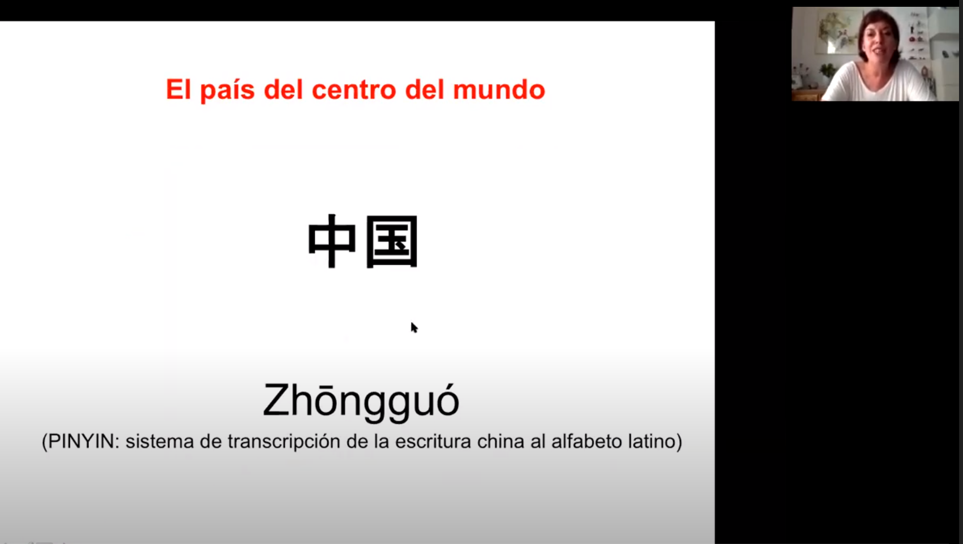
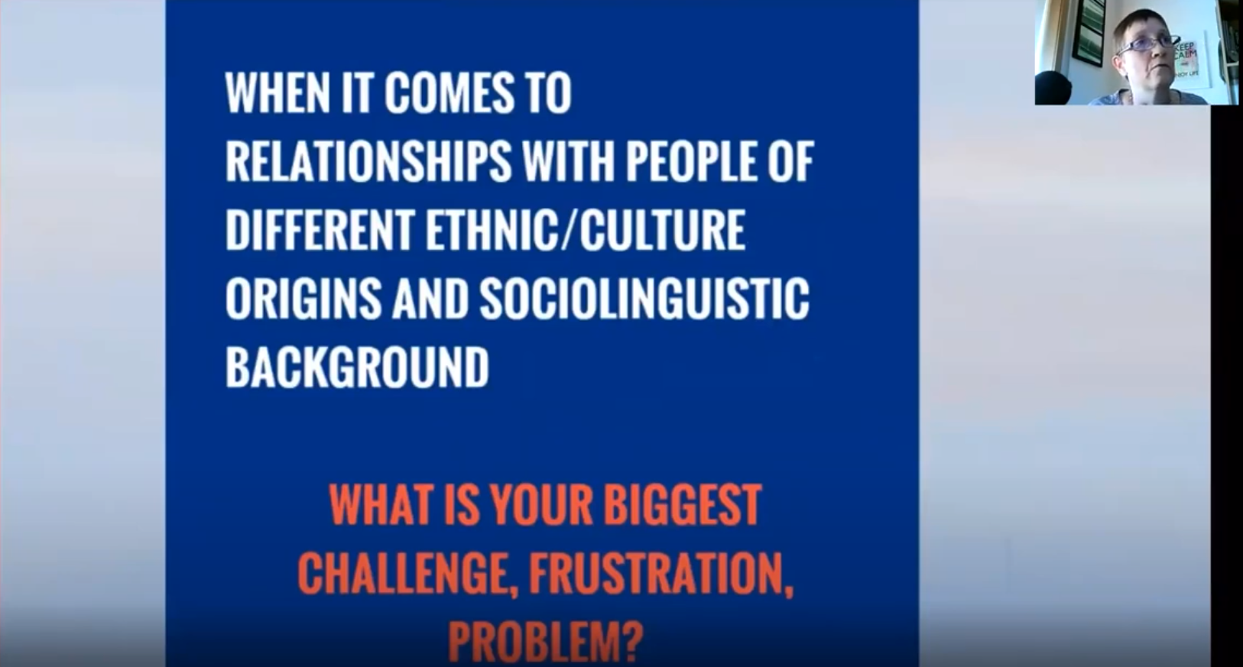
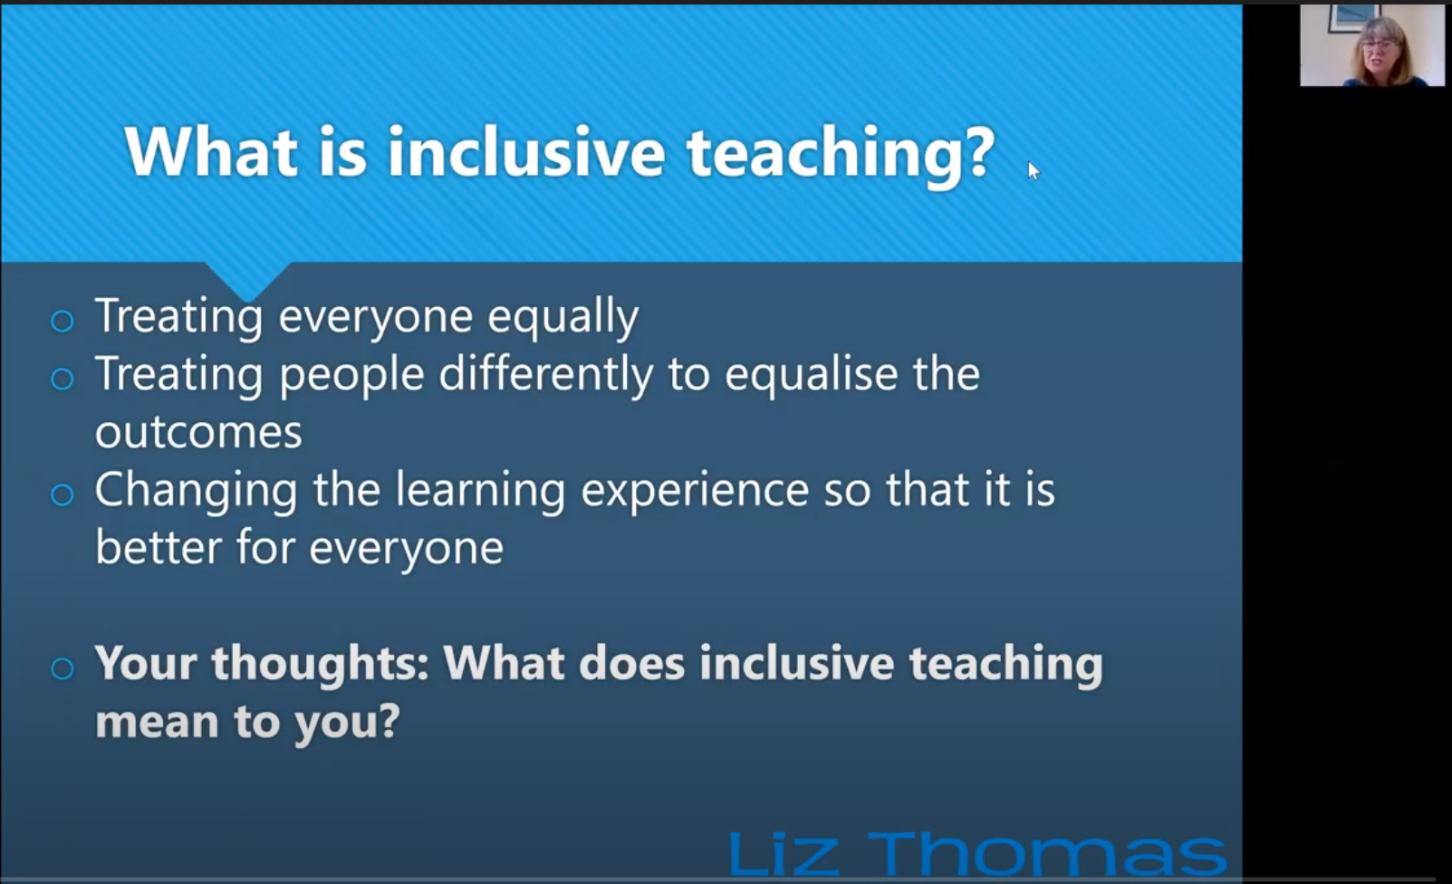
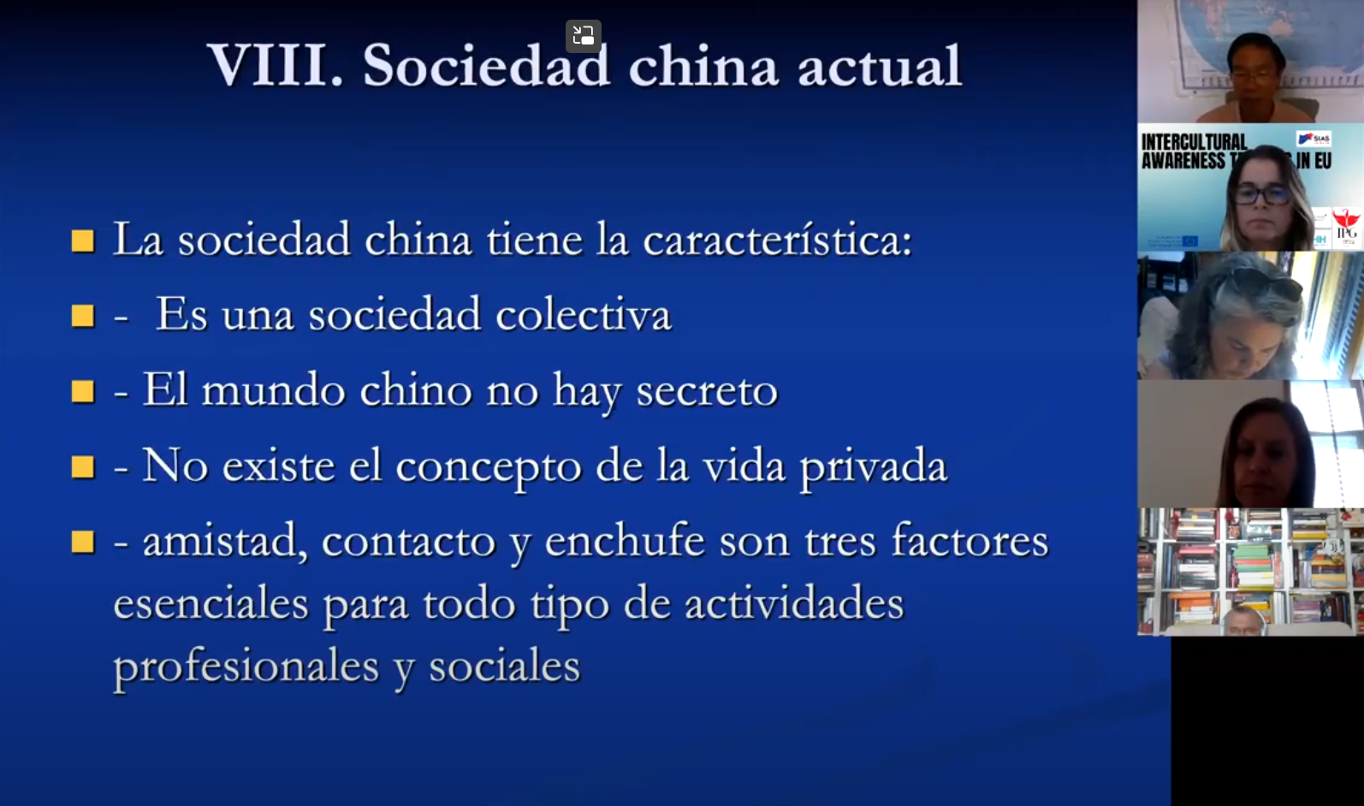
PHASE 1: LEARNING AND LISTENING
Training international workshops (on-line, 2 hours each, invited expert speakers)

Slide 35
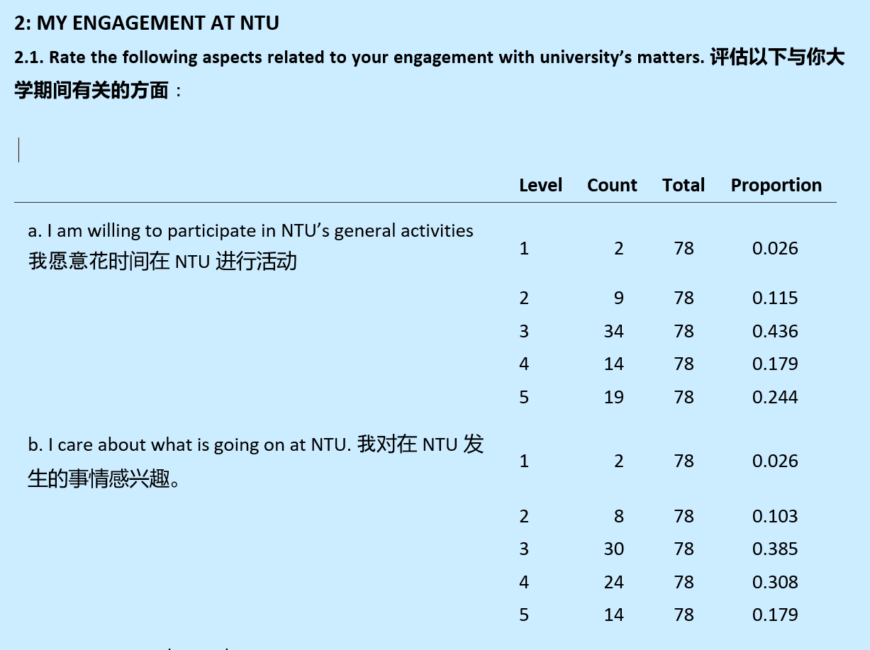
PHASE 1: LEARNING AND LISTENING
Online bilingual questionnaire about their learning experience and social inclusion issues.
[72 questions, 117 participants from NTU, 320 in total]
1- General information
2- My engagement at NTU
3- Before registration
4- Registration
5-Starting your studies at NTU
6- Your studies at NTU
7- Finishing your studies and future plans
8-Support services and social media

Slide 36
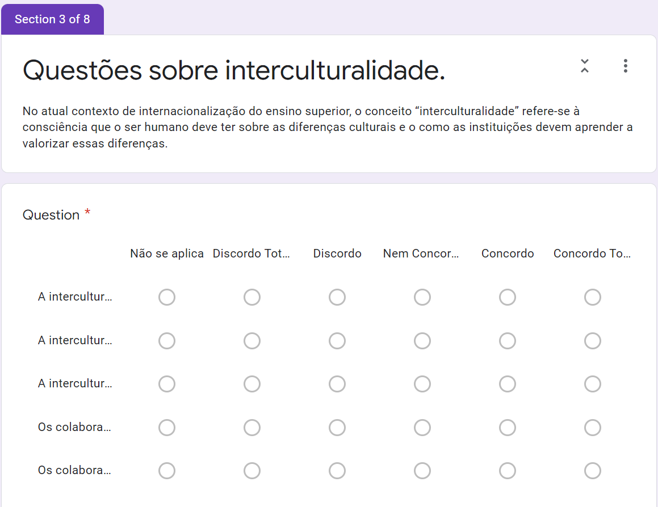
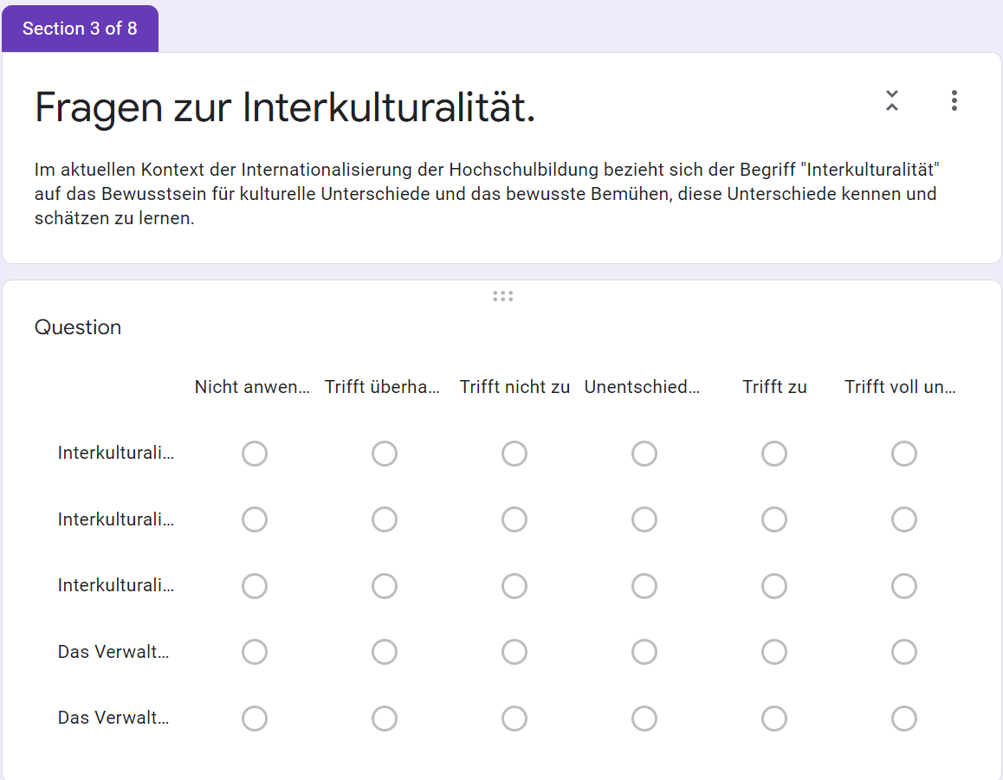
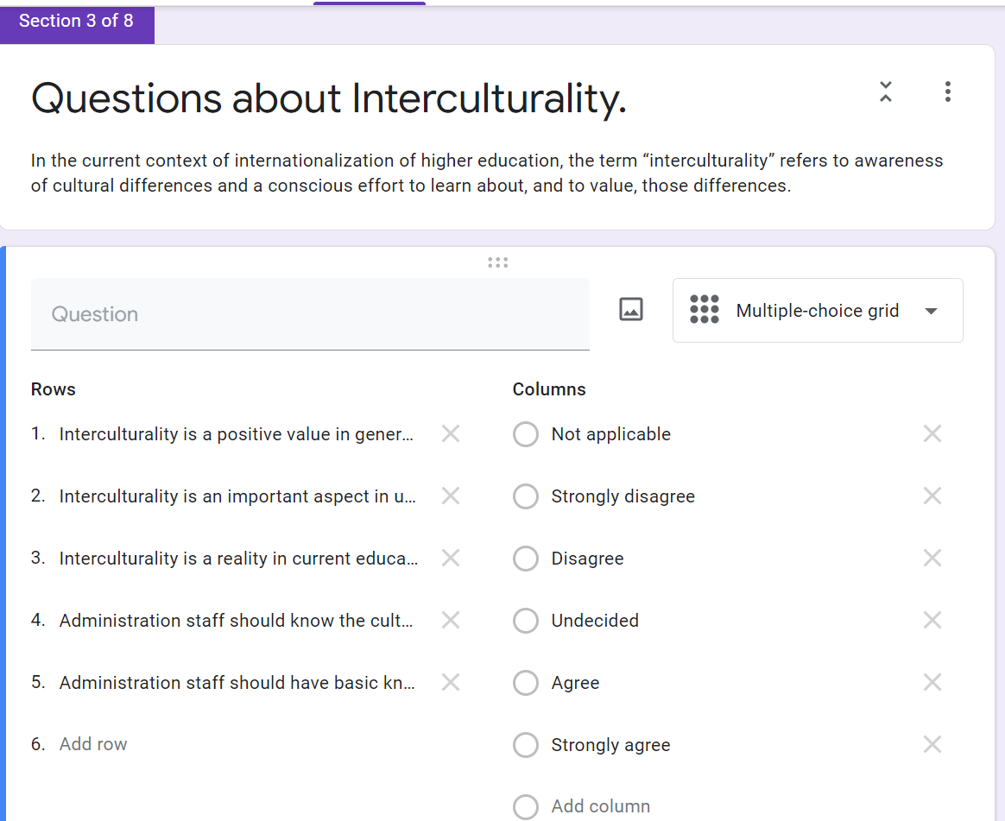
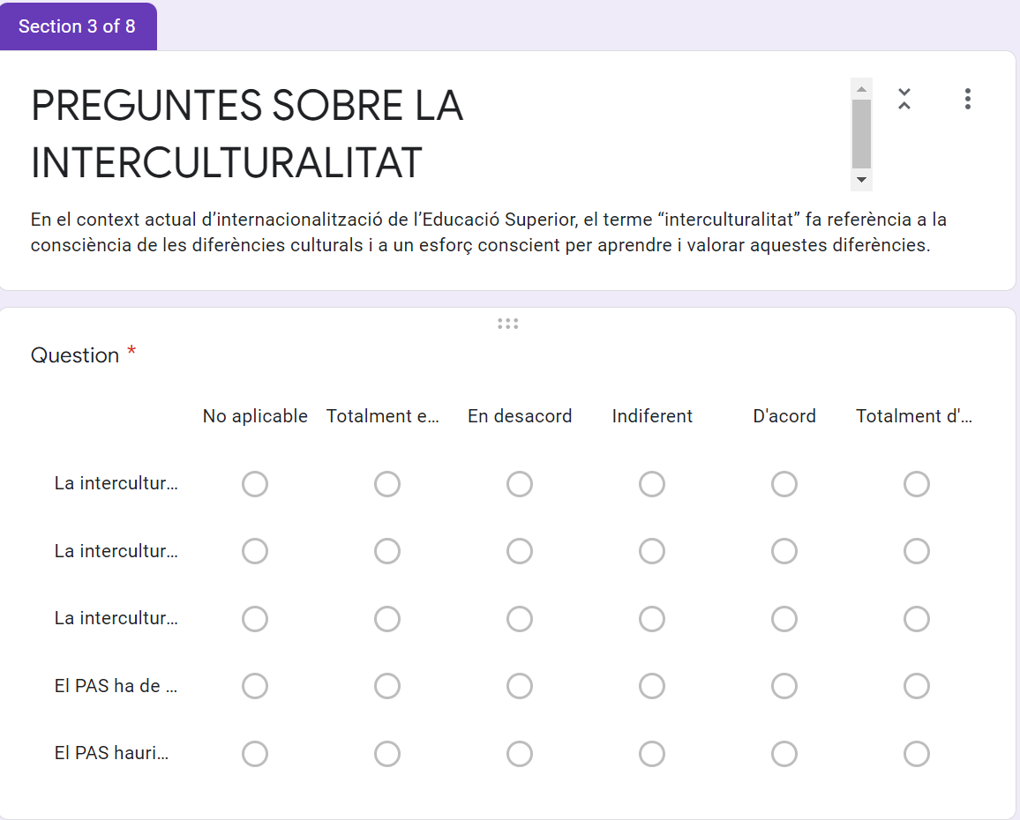
PHASE 1: LISTENING AND LEARNING
Specific questionnaires for teaching staff and administrative & service personnel.
Focus: practical issues related to INCLUSIVITY and CROSS-CULTURAL issues.
(in German, Portuguese, Catalan and English)

Slide 37
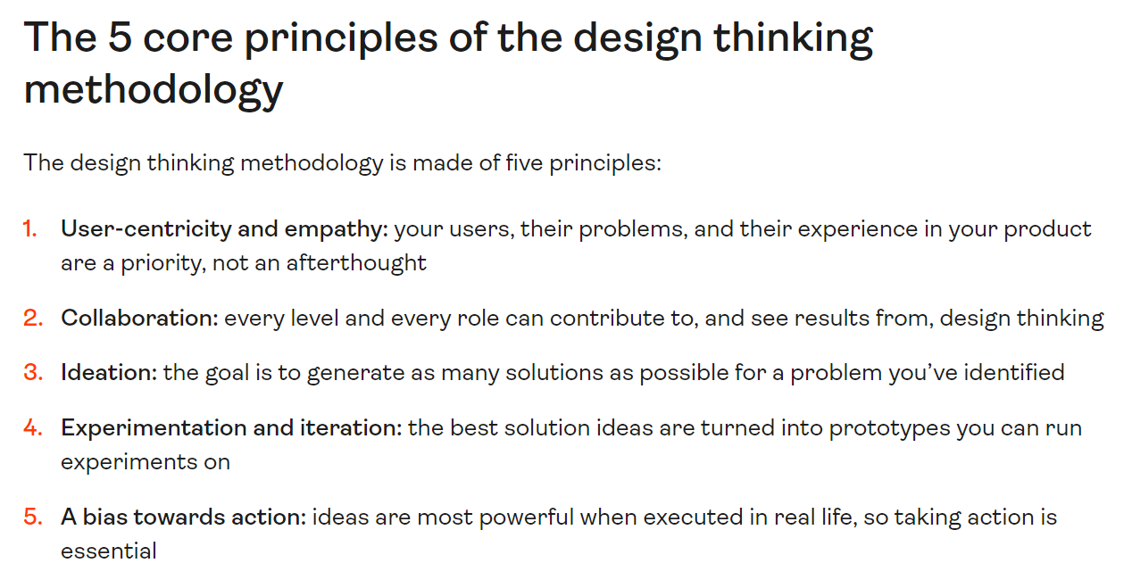
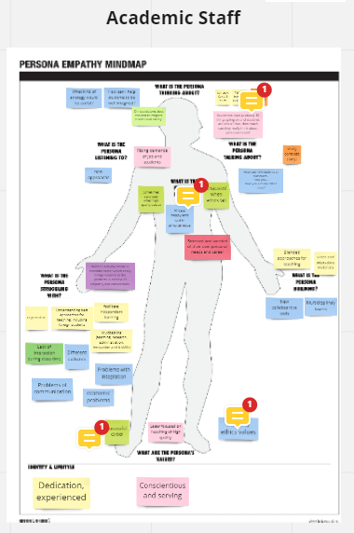
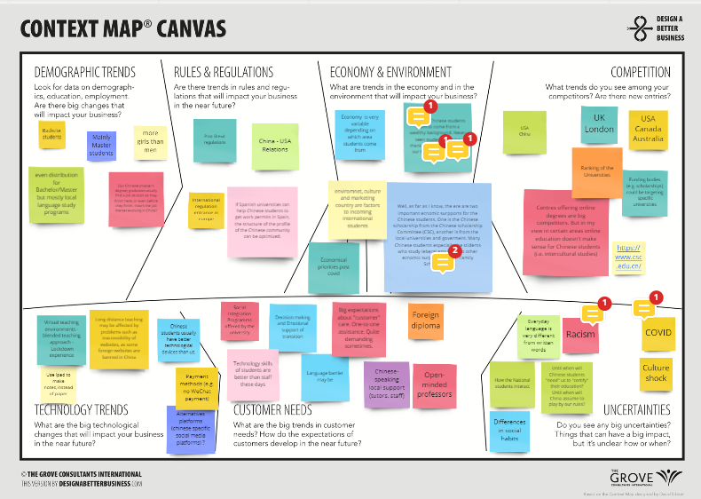
PHASE 1: LEARNING AND LISTENING
DESIGN THINKING workshops (over 4 weeks). November-December 2020 (online)
USER-CENTRED AND EMPATHY-DRIVEN

Slide 38
PHASE 2: REFLECTING AND WRITING
Main output:
Production and divulgation of best practice guidelines and study materials specifically tailored for:
Chinese students
Home students (Spain, Germany, Portugal and UK)
Teaching staff
Administrative and service staff

Slide 39
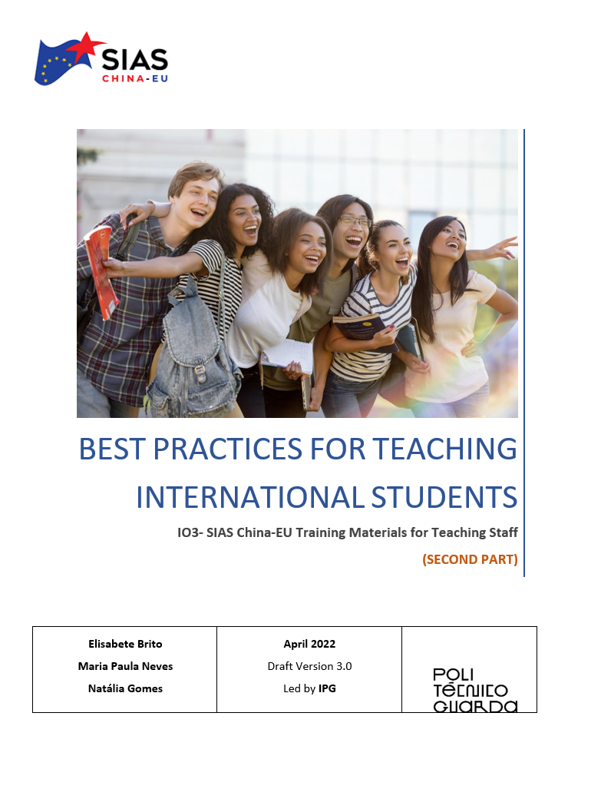
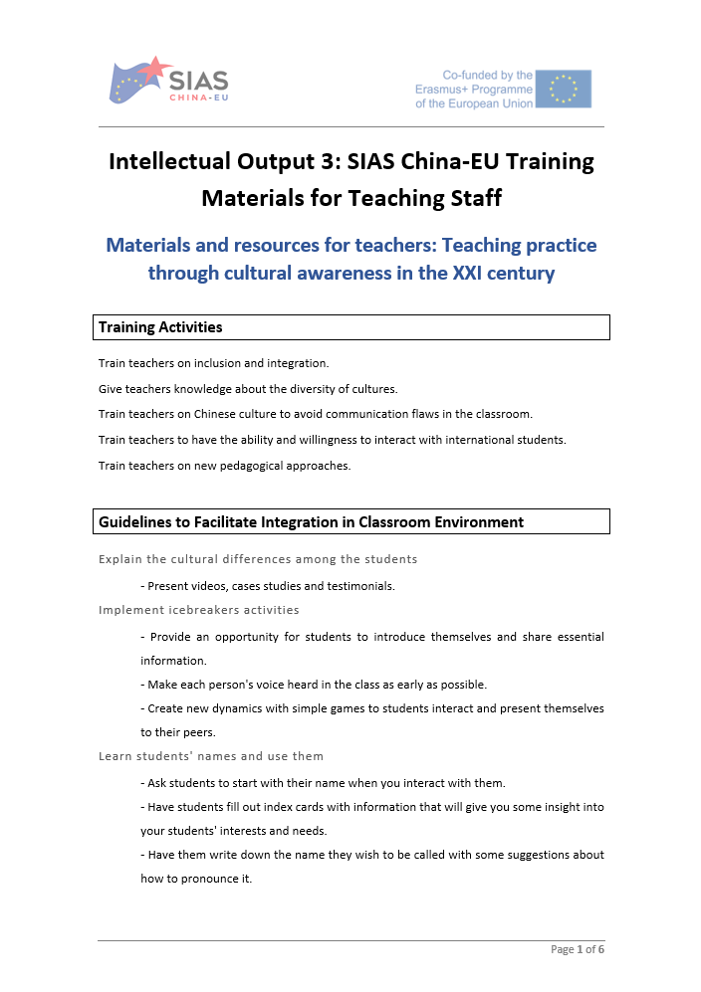
PHASE 2: REFLECTING AND WRITING
Writing of Intellectual Outputs

Slide 40
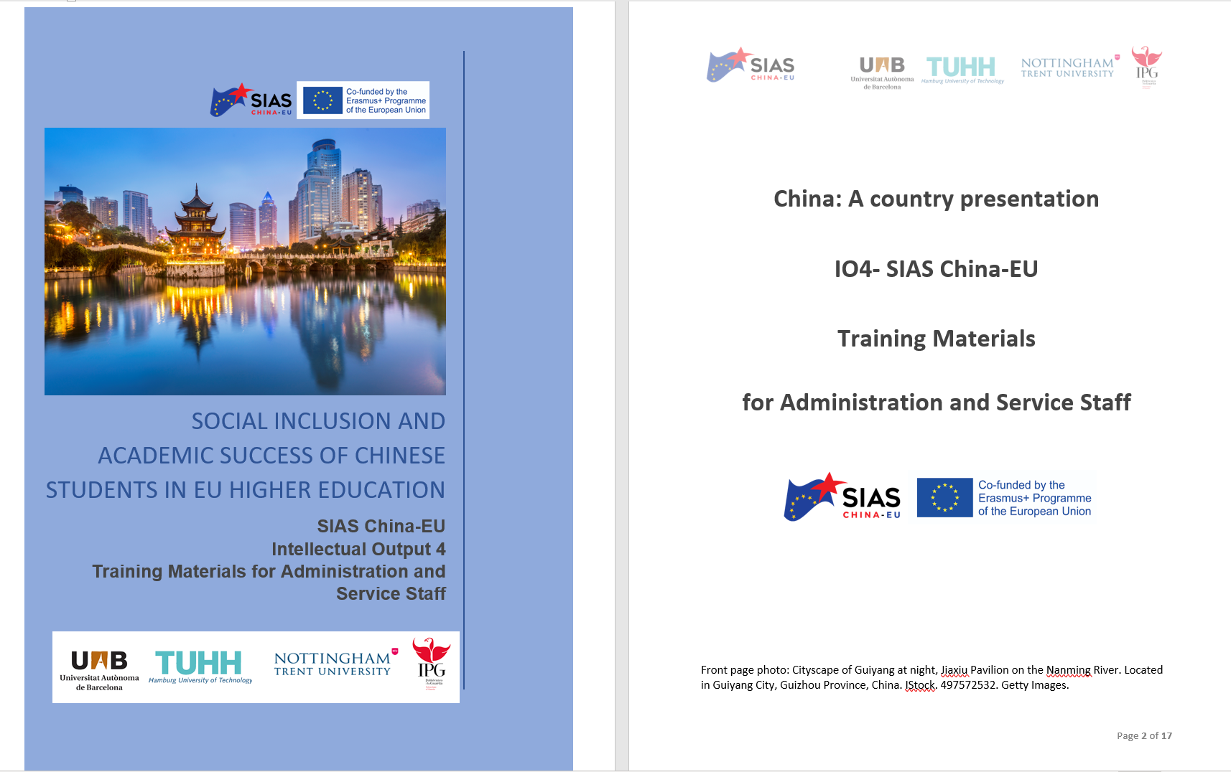
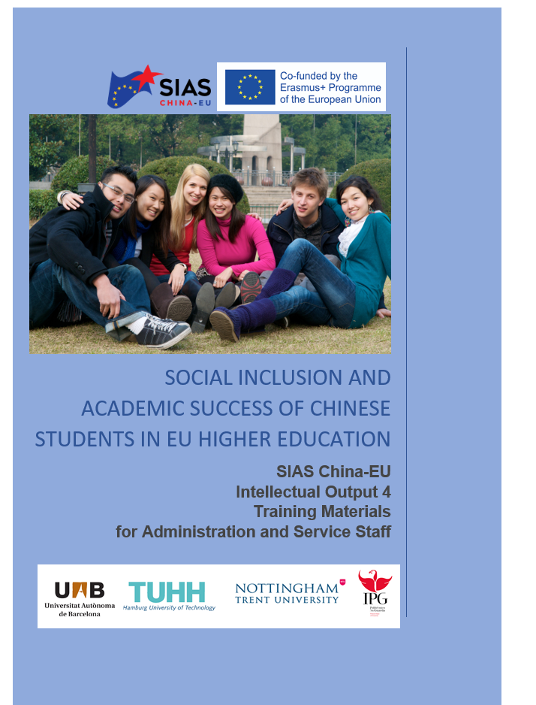
PHASE 2: REFLECTING AND WRITING
Writing of Intellectual Outputs

Slide 41
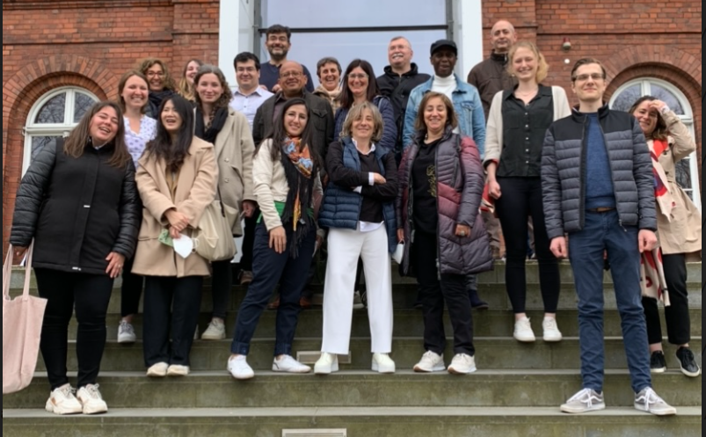
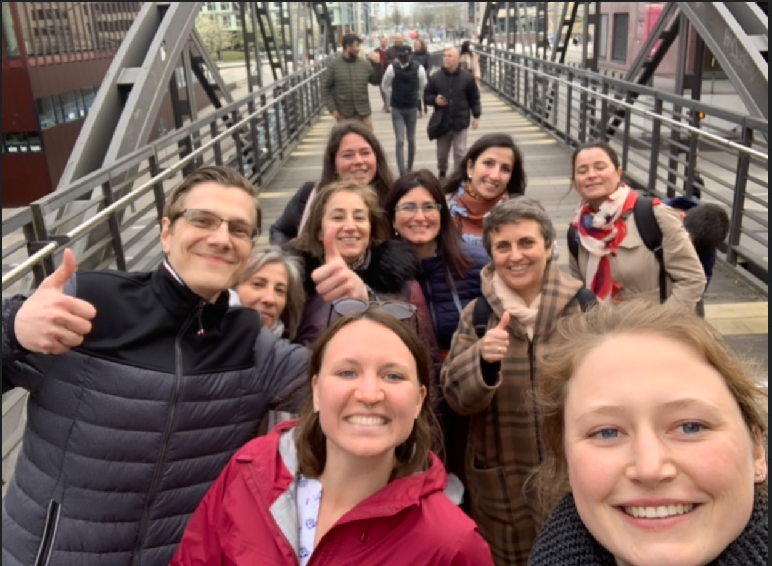
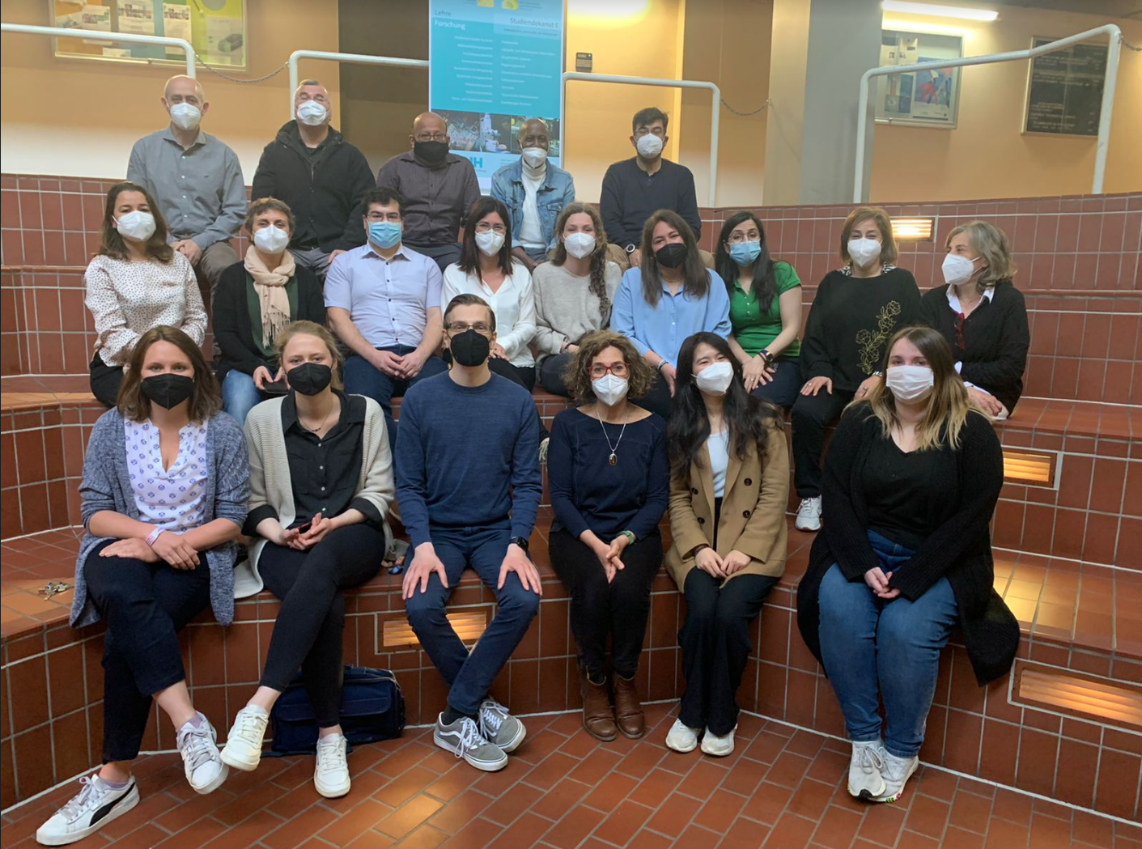
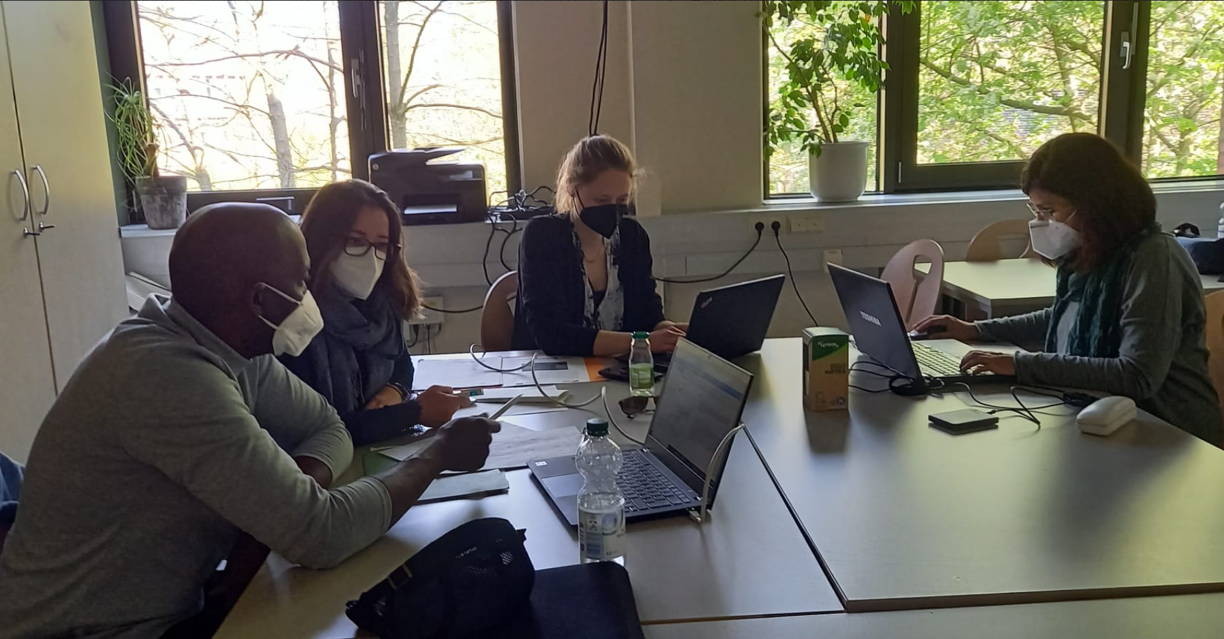
PHASE 2: REFLECTING AND WRITING
Customizing and implementing of Intellectual Outputs
[4-day workshop, Hamburg, April 2022]

Slide 42
PHASE 3: DISSEMINATION
Multiplier events at partners universities (UaB, IPG, TUHH, NTU)
Special session workshop at 14th annual International Conference on Education and New Learning Technologies [Palma de Mallorca (Spain) on the 4-6 July, 2022.]
Workshop at Renmin University of China (中国人民大学), Beijing [September 2022, tbc]
Open-access website hosting all good practice guidelines and study materials (not ready yet).

Slide 43
The internationalization of higher education and its challenges.
A PERSONAL DIMENSION
Although the immediate need for cross-cultural awareness derives from the internationalization of higher education, this is also a personal process.
Often a genuine understanding of a different culture supposes the willingness to see some of our most important cultural tenets in a different light.
The results of this personal process again go beyond purely professional skills: understanding others brings a new understanding of ourselves.

Slide 44
The internationalization of higher education and its challenges.
TAKEAWAY POINTS
The internationalization of the higher education sector in Europe has brought about
the need for concerted institutional effort to develop cross-cultural professional skills
in order to ensure overseas students can have a successful academic experience.
Any institutional drive to raise cross-cultural awareness is more likely to succeed if
it stresses personal dimensions. Empathy is required to ensure a genuinely
inclusive environment.
Although the young Chinese generation is bound to have a more globalized
worldview, and be familiar with western culture, cultural clashes are still likely to occur. These cross-cultural issues can affect students ability to engage with academic studies and their overall sense of belonging.
The SIAS CHINA-EU project aims to contribute to better cross-cultural awareness
and communication by designing and disseminating best practice guidelines and
pedagogical material.

Slide 45
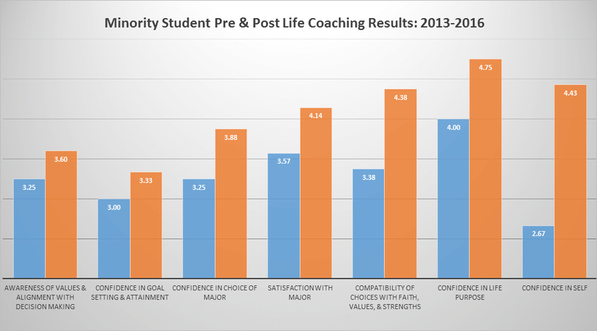
GOING FORWARD:
Mindset coaching intervention
Apply the SIAS CHINA-EU methodology to BAME students at NTU
Erin M et al. The Impact of Life Coaching on Undergraduate Students: A Multiyear Analysis of Coaching Outcomes. International Journal of Evidence Based Coaching and Mentoring 2018, Vol. 16(2), pp. 69-83.
A study from Indiana Wesleyan University

Slide 46
SOCIAL INCLUSION AND ACADEMIC SUCCESS OF CHINESE STUDENTS IN EU HIGHER EDUCATION (SIAS CHINA-EU)
ACKNOWLEDGMENTS
NTU GLOBAL:
Stephen Williams
Julie Page
Maggie Laurikova
NTU INTERNATIONAL:
Helen Gibbard
Scarlett Peng
Linjing Guo
NTU Business Intelligence:
Linda Stoakley
Joshua Sutton
Ian Sipson
Biosciences department:
Luigi de Girolamo
Beverley Peel

Slide 47
SOCIAL INCLUSION AND ACADEMIC SUCCESS OF CHINESE STUDENTS IN EU HIGHER EDUCATION (SIAS CHINA-EU)
Project coordinator: Marta Fuentes Agustí (UAB)
Project manager: María Eugenia Suárez Ojeda (UAB)
UAB (SPAIN) | TUHH (GERMANY) | IPG (PORTUGAL) | NTU (UK)
Anabel Galan Mañas | Chris Drawer | Elisabete Brito | Aldo Gutierrez (c)
Cristina Blasi Casagran | Martin Kaltschmitt | Maria M. A. Alves Simões | Anastasios Stavrou
Eduardo Doval Dieguez | Natalie Mayer (c) | Maria Paula Martins das Neves | Felix Dafhnis Calas
Ludovico Longhi | Sinah Kammler (c) | Natália Fernandes Gomes (c) | Ishwinder Kaur
Maria Carmen Espín García | Theresa Siegmund | Noel de Jesus Mendonça Lopes | Martha Longdon
Montserrat Plans Ponsa |  |  | Noura Alom
Shiyi Chen |  |  | Sergio Colombo

Slide 48

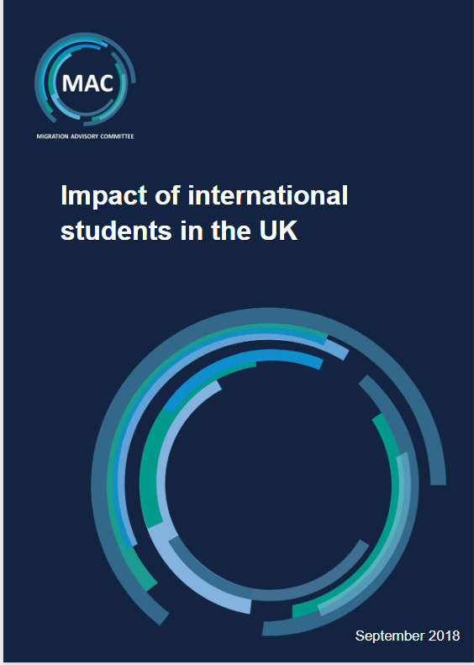
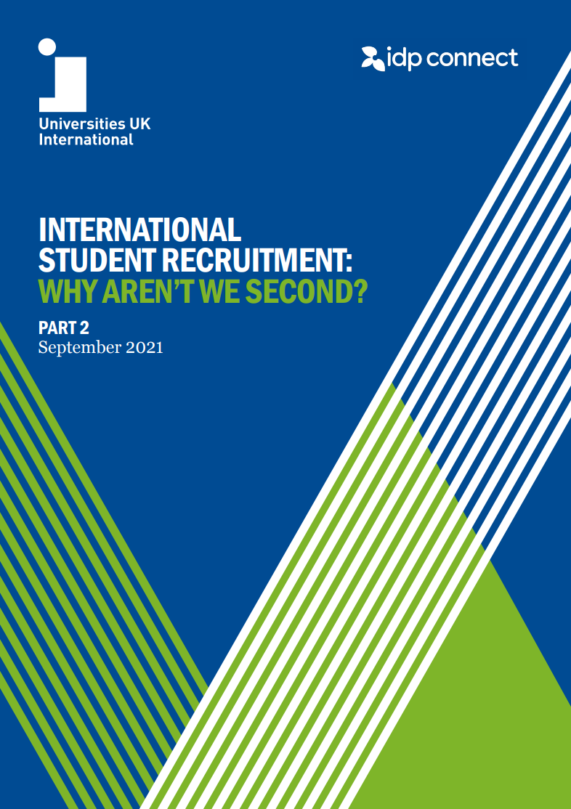

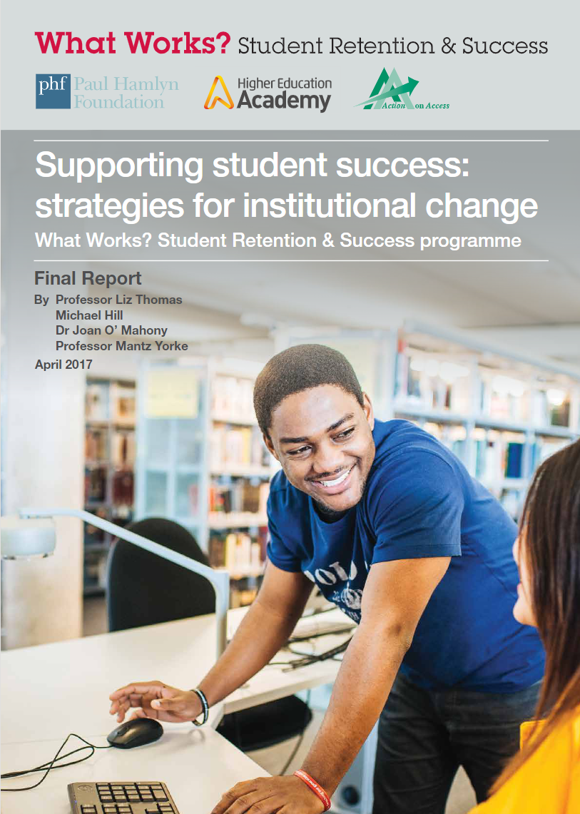

Basic literature sources:

