Slide 1
Medicine (MBChB)

Slide 2
Clinical neuroanatomy: Basal ganglia ,the Limbic System, Corticospinal pathway and Somatosensory pathway
Dr Hayder Lazim
MBChB, MSc, PhD, FHEA
lazimh@edgehill.ac.uk

Slide 3
Learning outcomes
By the end of this lecture, you should be able to describe:
The anatomical structure, functions, and clinical significance of the basal ganglia
The anatomical structure, functions, and clinical significance of the limbic system
The corticospinal pathway
The somatosensory pathway

Slide 4
Basal nuclei (Ganglia)

Slide 5
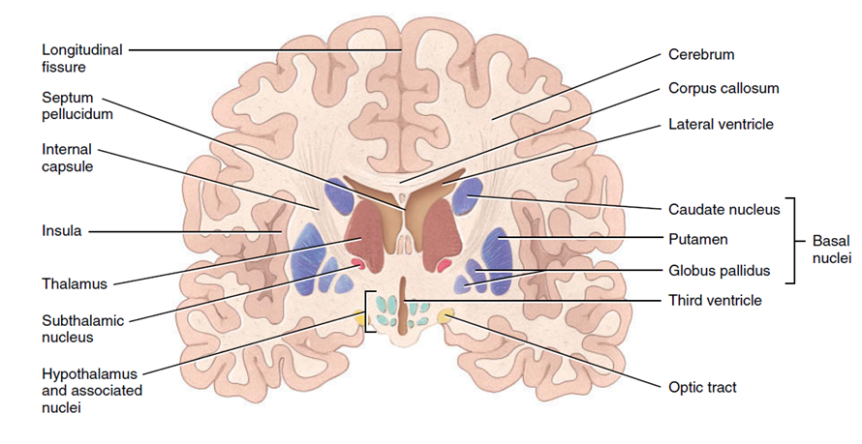
Basal nuclei
Collection of grey matter nuclei located deep within the white matter of the cerebral hemispheres.
Three main components of the basal ganglia
The caudate nucleus (=tail)
Putamen (= shell)
Globus pallidus (globus = ball; pallidus = pale)

Slide 6
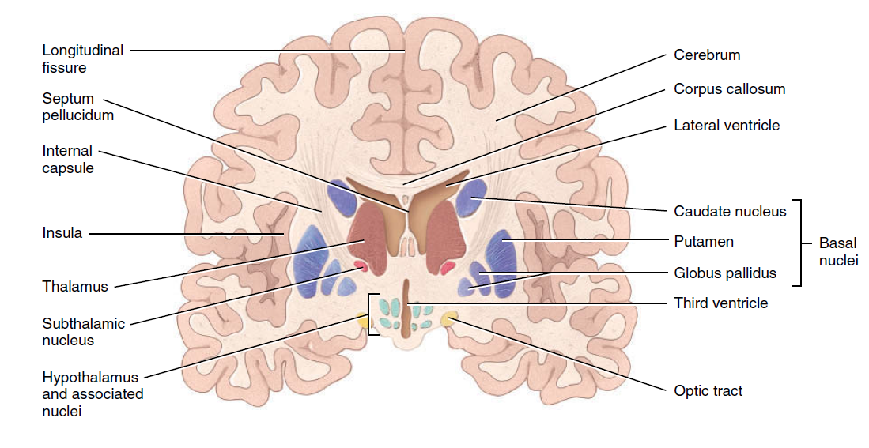
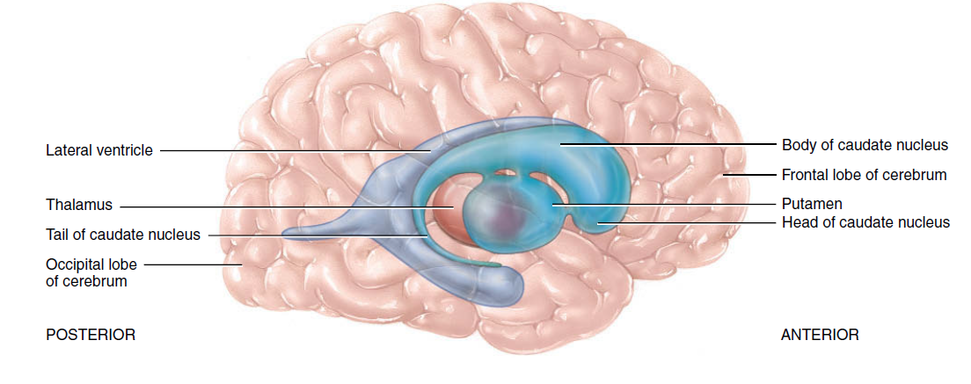
Basal nuclei (cont.)
Two of the basal nuclei lie side by side, just lateral to the thalamus:
The globus pallidus - closer to the thalamus
Putamen - closer to the cerebral cortex.
Together - the lentiform nucleus (= shaped like a lens).
The caudate nucleus has a large “head” connected to a smaller “tail” by a long comma-shaped “body.”
The lentiform and caudate nuclei are known as the corpus striatum (corpus= body; striatum = striated).

Slide 7
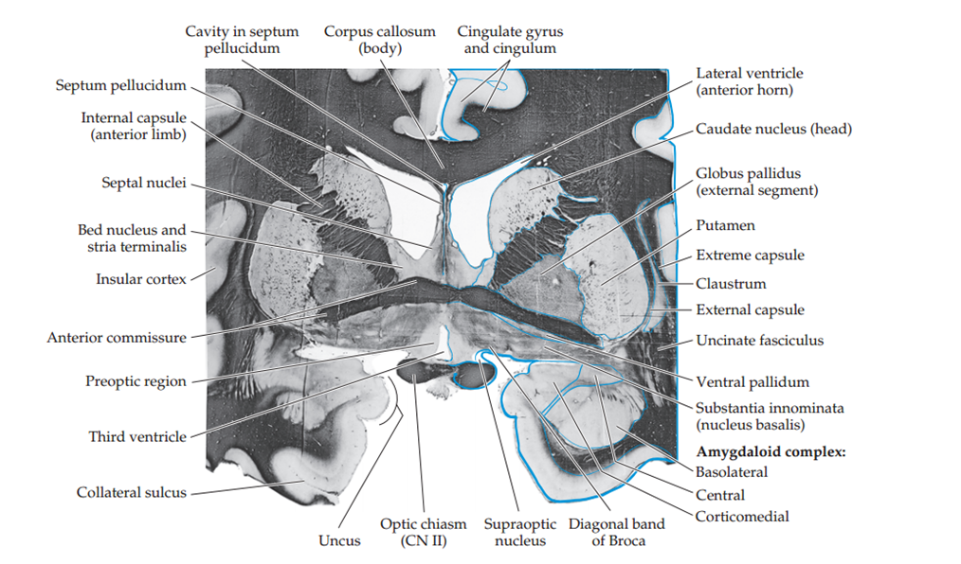
Basal nuclei (cont.)
Corpus striatum refers to the striated (striped) appearance of the internal capsule as it passes among the basal nuclei.
Nearby structures that are functionally linked to the basal nuclei are:
The substantia nigra of the midbrain - axons from the substantia nigra terminate in the caudate nucleus and putamen
The subthalamic nuclei of the diencephalon- the subthalamic nuclei interconnect with the globus pallidus.

Slide 8
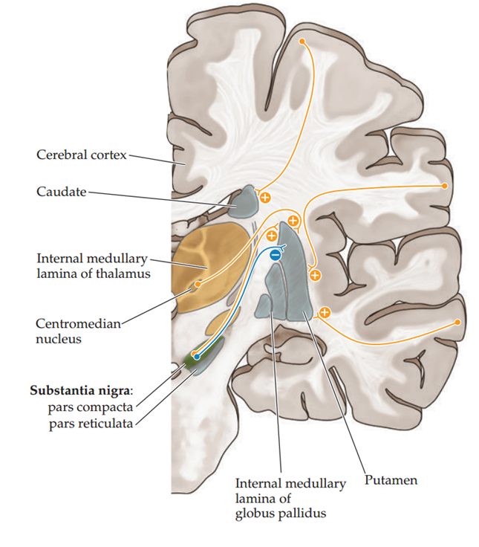
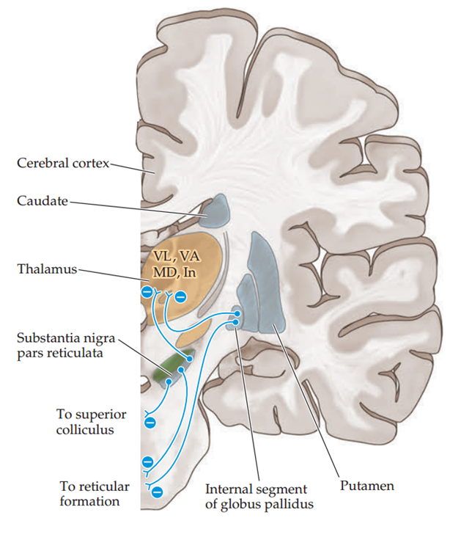
Input, Output, and Intrinsic Connections of the Basal nuclei
The main input to the basal ganglia comes from entire cerebral cortex to the striatum
The putamen is the most important input nucleus of the striatum for motor control pathways.
Most cortical inputs to the striatum are excitatory and use glutamate as the neurotransmitter
Provide output to motor parts of the cortex via the medial and ventral group nuclei of the thalamus. Are inhibitory and use the neurotransmitter gamma-aminobutyric acid (GABA)
In addition, the basal nuclei have extensive connections with one another

Slide 9
Function of the basal nuclei
A major function is to help regulate initiation and termination of movements:
Activity of the neurons in the putamen precedes or anticipates body movements
Activity of the neurons in the caudate nucleus occurs prior to eye movements.
The globus pallidus helps regulate the muscle tone required for specific body movements.
The basal nuclei also control subconscious contractions of skeletal muscles.
Examples include automatic arm swings while walking and true
laughter in response to a joke

Slide 10
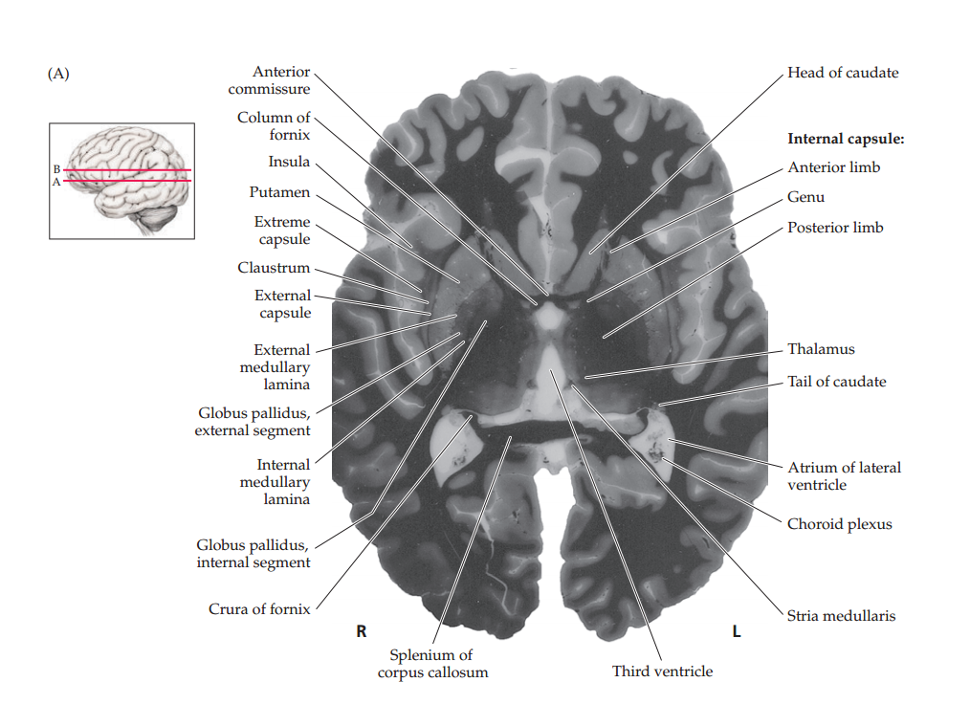
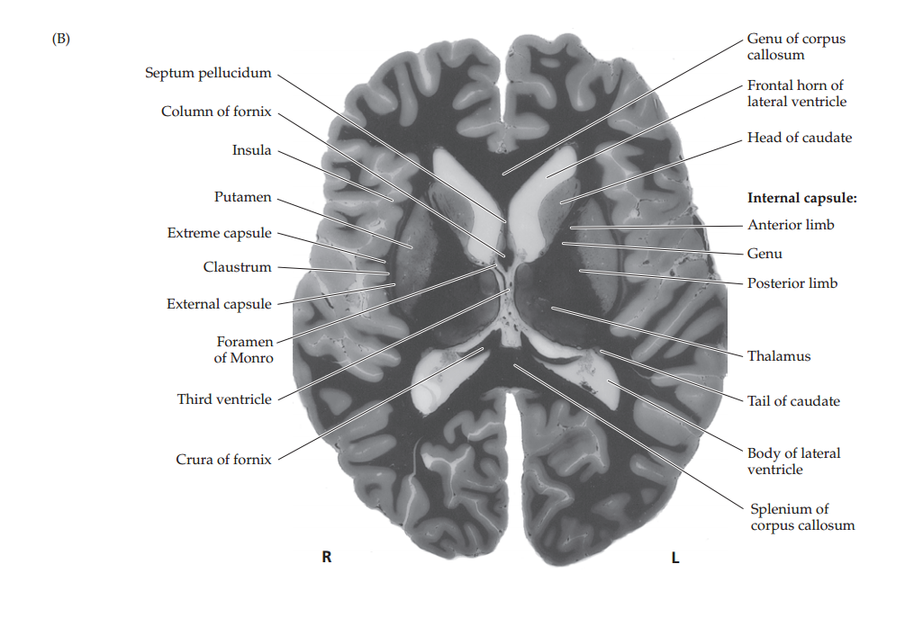
Basal nuclei
Notes:
Horizontal Brain Sections through Basal Ganglia and Thalamus Myelin is stained dark. The spatial relationships between the basal ganglia, thalamus, internal capsule, ventricles, and other structures can be seen. (A) and (B) progress from inferior to superior.

Slide 11
Movement Disorders
Hyperkinetic movement disorders - Huntington’s disease- uncontrolled involuntary movements produce a random pattern of jerks and twists.
Hypokinetic movement disorders - Parkinson’s disease -rigidity, slowness, and marked difficulty initiating movements.

Slide 12
Movement Disorders
Ranking of Common Movement Disorders by Movement Speed
Bradykinesia, hypoknesia
Rigidity
Dystonia
Athetosis
Chorea
Ballismus
Tics
Myoclonus
Tremor
Slow
Fast
Notes:
Bradykinesia means “slowed movements”;
Hypokinesia “decreased amount of movements”;
Akinesia “absence of movement
Rigidity is Increased resistance to passive movement of a limb
In dystonia the patient assumes abnormal, often distorted positions of the limbs, trunk, or face that are more sustained or slower than in athetosis
Athetosis is characterized by writhing, twisting movements of the limbs,face, and trunk that sometimes merge with faster choreic movements, giving rise to the term choreoathetosis
The word Chorea means literally “dance” and is applied to movement disorders characterized nearly continuous involuntary movements that have a fluid or jerky, constantly varying quality
Ballismus Movements of the proximal limb muscles with a larger-amplitude, more rotatory or flinging quality than chorea
Tics A sudden brief action that is preceded by an urge to perform it and is followed by a sense of relief
Myoclonus is a sudden, rapid muscular jerk that can be focal, unilateral, or bilateral.
Tremor Rhythmic or semirhythmic oscillating movements

Slide 13
Parkinson Disease
Severe degeneration of the basal ganglia (corpus striatum) involving the dopaminergic nigrostriatal pathway
Pathogesis: loss of dopaminergic-pigmented neurons in the substantia nigra
Symptoms:
Rigidity: cogwheel, plastic
Bradykinesia and akinesia
Resting tremor
Postural abnormalities: postural fixation, equilibrium, righting
Autonomic-neuroendocrine symptoms
Cognitive-affective symptoms and dementia

Slide 14
Parkinson Disease (Cont.)
Clinical manifestations
Treatment
Wide-eyed, unblinking, staring expression with immobile facial muscles
Frequent drooling
Slow gait
Short, shuffling steps
Flexed and abducted arms held stiffly at the side
Slightly forward bending trunk
Drug therapy: levodopa, anticholinergic drugs, antihistamines, amantadine
Surgery
Rehabilitation
Physiotherapy and speech therapy
Occupational therapy, physical therapy, language, and swallowing therapy

Slide 15
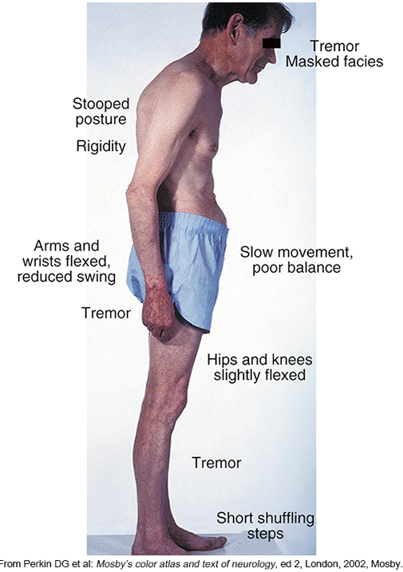
Parkinson Disease (Cont.)
Stooped Posture of Parkinson Disease
Copyright © 2019, Elsevier Inc. All rights reserved.

Slide 16
Parkinson Disease (Cont.)
Reduced Fluorodopa in Parkinson Disease. Positron emission tomography scan showing reduced fluorodopa uptake in the basal ganglia consistent with neurodegeneration (right) compared with a normal control (left).
Copyright © 2019, Elsevier Inc. All rights reserved.

Slide 17
Limbic system

Slide 18
Limbic system
Limbus means “border” or “edge” in Latin
The structures of the limbic system regulate emotions, olfaction, memory, drives, and homeostasis.
Limbic functions can be divided into the following four basic categories:
Olfaction | Olfactory cortex
Memory | Hippocampal formation
Emotions and drives | Amygdala
Homeostasis; autonomic and neuroendocrine control | Hypothalamus

Slide 19
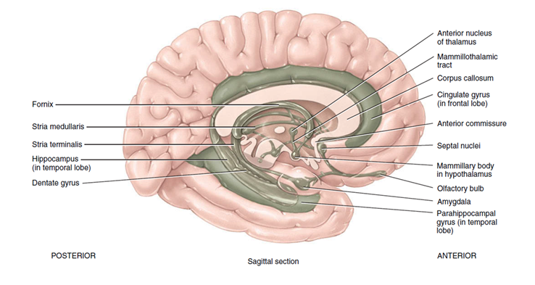
Components of the limbic system
The cingulate gyrus
The hippocampus
The dentate gyrus
The amygdala
The septal nuclei
The thalamus
The mammillary bodies of the hypothalamus
The olfactory bulbs

Slide 21
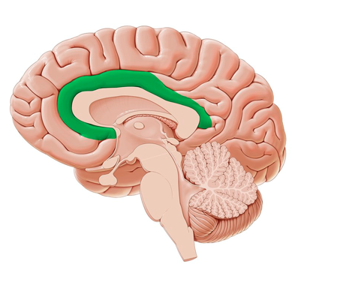
Cingulate gyrus
Located in the medial side of the brain next to the corpus callosum.
Its frontal part links smells and sights with pleasant memories of previous emotions.
This region also participates in our emotional reaction to pain and in the regulation of aggressive behaviour.

Slide 22
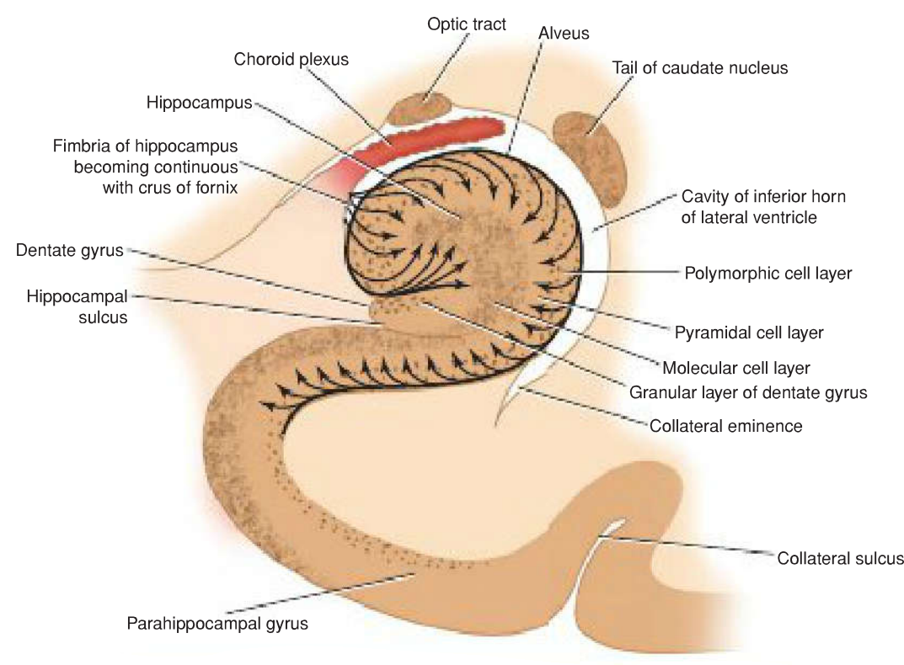
Hippocampus
Hippocampus (=seahorse)
Curved elevation of grey matter that extends throughout the entire length of the floor of the inferior horn of the lateral ventricle
The hippocampal formation consists of the hippocampus, the dentate gyrus, and the parahippocampal gyrus.

Slide 23
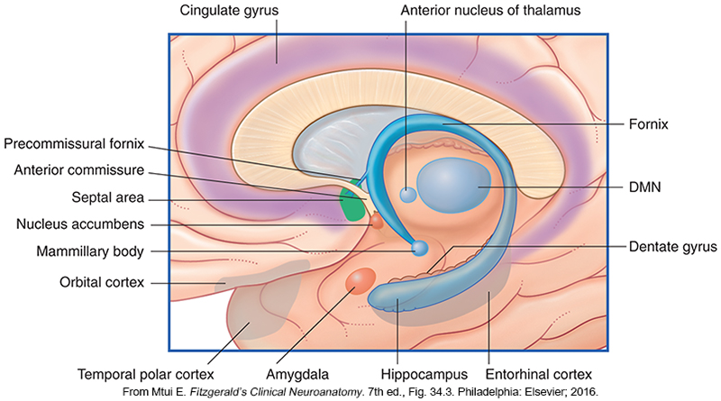
Amygdaloid Nucleus
So named because it resembles an almond.
Is a nuclear complex that lies in the anteromedial temporal lobe.
It overlaps the anterior end of the hippocampus and lies dorsal to the tip of the temporal horn of the lateral ventricle
Composed of three main nuclei: the corticomedial, basolateral, and central nuclei
Serves important functions in emotional, autonomic, and neuroendocrine circuits of the limbic system.

Slide 24
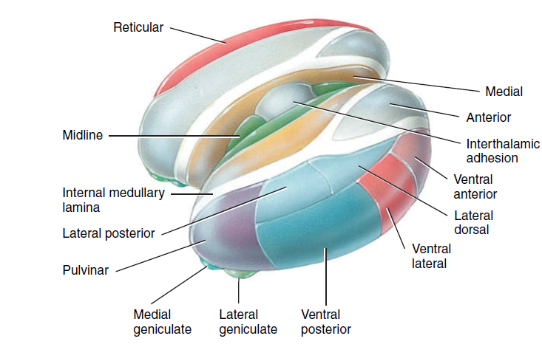
Thalamus
Paired oval masses of gray matter
About 3 cm in length and makes up 80% of the diencephalon.
The interthalamic adhesion (intermediate mass) joins the right and left halves of the thalamus in about 70% of human brains
A vertical Y-shaped sheet of white matter called the internal medullary lamina divides the gray matter of the right and left sides of the thalamus. It consists of myelinated axons that enter and leave the various thalamic nuclei.
Axons that connect the thalamus and cerebral cortex pass through the internal capsule, a thick band of white matter lateral to the thalamus

Slide 25
Function of the thalamus
Is the major relay station for most sensory impulses
In addition, the thalamus contributes to motor functions
The thalamus also relays nerve impulses between different areas of the cerebrum and plays a role in the maintenance of consciousness.

Slide 26
Hypothalamus
Is a small part of the diencephalon located inferior to the thalamus.
The hypothalamus controls many body activities and is one of the major regulators of homeostasis.
Sensory impulses related to both somatic and visceral senses arrive at the hypothalamus.
monitor osmotic pressure, blood glucose level, certain hormone concentrations, and the temperature of blood.

Slide 27
Functions of Hypothalamus
Control of the ANS.
Production of hormones.
Regulation of emotional and behavioral patterns.
Regulation of eating and drinking.
Control of body temperature.
Regulation of circadian rhythms and states of consciousness.

Slide 28
Corticospinal pathway

Slide 29
Locations of major sensory and motor tracts
Sensory tracts are indicated on one half and motor tracts on the other half of the cord, but actually all tracts are present on both sides.
Copyright © 2014, 2012, 2009, 2006, 2003, 2000. © Gerard J. Tortora, L.L.C., Bryan Derrickson, John Wiley & Sons, Inc. All rights reserved.

Slide 30
Lateral and Medial Descending Motor Systems
Neuroanatomy through Clinical Cases, Second Edition Copyright © 2010 by Sinauer Associates, Inc

Slide 31
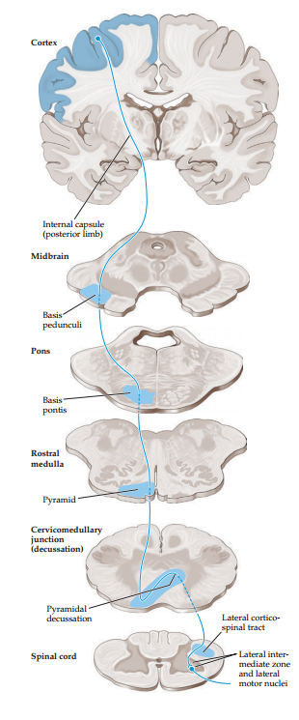
Lateral corticospinal tract
This pathway controls movement of the extremities
lesions along its course produce characteristic deficits that often enable precise clinical localization.
Neuroanatomy through Clinical Cases, Second Edition Copyright © 2010 by Sinauer Associates, Inc
Notes:
1. Axons from the cerebral cortex enter the upper portions of the cerebral white matter, or corona radiata and descend toward the internal capsule
2. The internal capsule continues into the midbrain cerebral peduncles
3. Next descend through the ventral pons, where they form somewhat scattered fascicles. These collect on the ventral surface of the medulla to form the medullary pyramids
4. The transition from medulla to spinal cord is called the cervicomedullary junction, which occurs at the level of the foramen magnum. At this point about 85% of the pyramidal tract fibers cross over in the pyramidal decussation to enter the lateral white matter columns of the spinal cord, forming the lateral corticospinal tract
5. A somatotopic representation is present in the lateral corticospinal tract, with fibers that control the upper extremity located medial to those that control the lower extremity
6. Finally, the axons of the lateral corticospinal tract enter the spinal cord central grey matter to synapse onto anterior horn cells

Slide 32
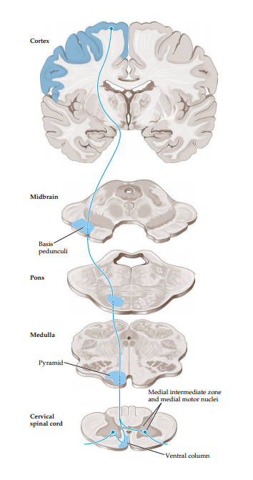
Anterior corticospinal tract
The remaining ~15% of corticospinal fibers continue into the spinal cord ipsilaterally, without crossing, and enter the anterior white matter columns to form the anterior corticospinal tract
Neuroanatomy through Clinical Cases, Second Edition Copyright © 2010 by Sinauer Associates, Inc

Slide 33
Somatosensory Pathways

Slide 34
Somatosensory Pathways
Refers to bodily sensations of touch, pain, temperature, vibration, and proprioception (limb or joint position sense).
There are two main pathways for somatic sensation
The posterior column–medial lemniscal pathway conveys proprioception, vibration sense, and fine, discriminative touch .
The anterolateral pathways include the spinothalamic tract and other associated tracts that convey pain, temperature sense, and crude touch.

Slide 35
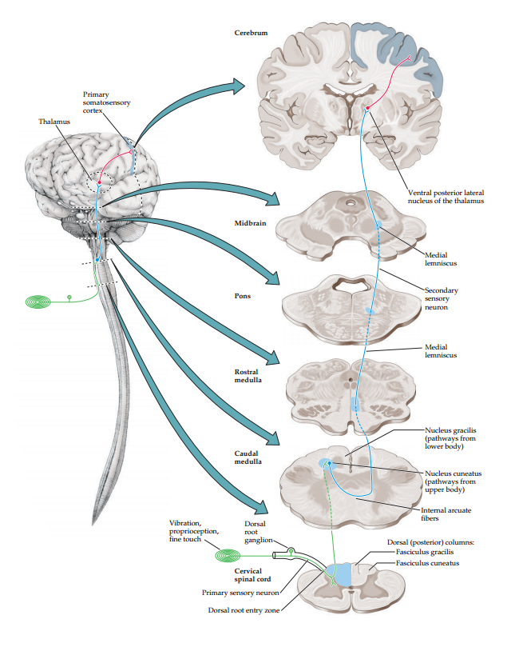
Posterior Column–Medial Lemniscal Pathway
Neuroanatomy through Clinical Cases, Second Edition Copyright © 2010 by Sinauer Associates, Inc
Notes:
1.Large-diameter, myelinated axons carrying information about proprioception, vibration sense, and fine touch enter the spinal cord via the medial portion of the dorsal root entry zone as we can see in the figure. Many of these axons then enter the ipsilateral posterior columns to ascend all the way to the posterior column nuclei in the medulla. In addition, some axon collaterals enter the spinal cord central grey matter to synapse onto interneurons and motor neurons.
2.The medial portion, called the gracile fasciculus (gracile means “thin”) carries information from the legs and lower trunk. The more lateral cuneate fasciculus (cuneate means “wedge shaped”) carries information from the upper trunk above about T6, and from the arms and neck.
3.The first-order sensory neurons that have axons in the gracile and cuneate fasciculi (also called fasciculus gracilis and fasciculus cuneatus) synapse onto second-order neurons in the nucleus gracilis and nucleus cuneatus, respectively.
4.Axons of these second-order neurons decussate as internal arcuate fibers and then form the medial lemniscus on the other side of the medulla.
5.The medial lemniscus initially has a vertical orientation and then comes to occupy a progressively more lateral and inclined position as it ascends in the brainstem.
6 The next major synapse occurs when the medial lemniscus axons terminate in the ventral posterior lateral nucleus (VPL) of the thalamus. The neurons of the VPL then project through the posterior limb of the internal capsule in the thalamic somatosensory radiations to reach the primary somatosensory cortex in the postcentral gyrus.

Slide 36
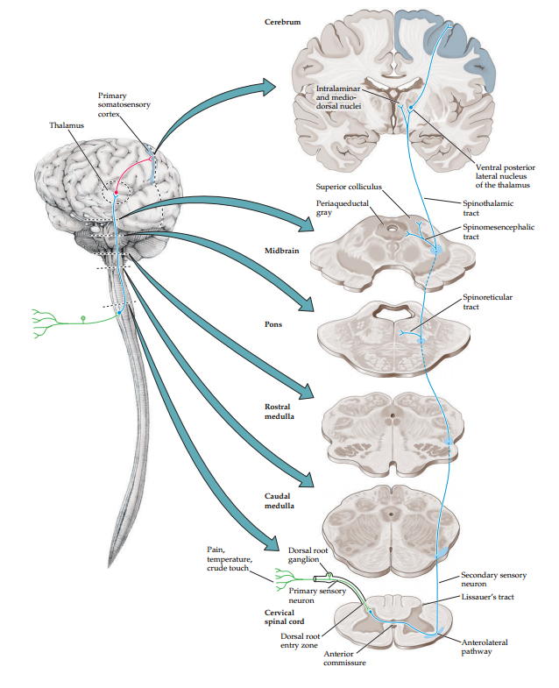
Anterolateral Pathways
Neuroanatomy through Clinical Cases, Second Edition Copyright © 2010 by Sinauer Associates, Inc
Notes:
1. The anterolateral pathways consist of three tracts: the spinothalamic, spinoreticular, and spinomesencephalic tracts.
2. Smaller-diameter and unmyelinated axons carrying information about pain and temperature sense also enter the spinal cord via the dorsal root entry zone. However, these axons make their first synapses immediately in the gray matter of the spinal cord.
3. Some axon collaterals ascend or descend for a few segments in Lissauer’s tract before entering the central grey.
4. Axons from the second-order sensory neurons in the central gray cross over in the spinal cord anterior (ventral) commissure to ascend in the anterolateral white matter. It should be noted that it takes two to three spinal segments for the decussating fibers to reach the opposite side, so a lateral cord lesion will affect contralateral pain and temperature sensation beginning a few segments below the level of the lesion.
5. When they reach the medulla, the anterolateral pathways are located laterally, running in the groove between the inferior olives and the inferior cerebellar peduncles.They then enter the pontine tegmentum to lie just lateral to the medial lemniscus in the pons and midbrain.

Slide 37
Your turn! Identify the following structures

Slide 38
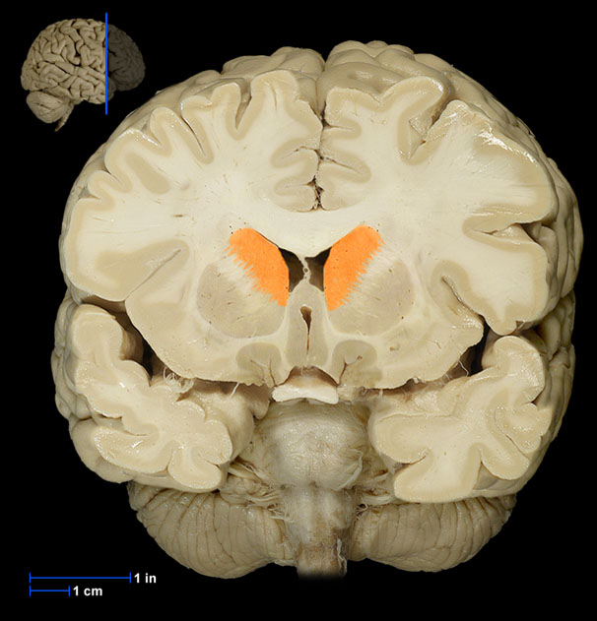
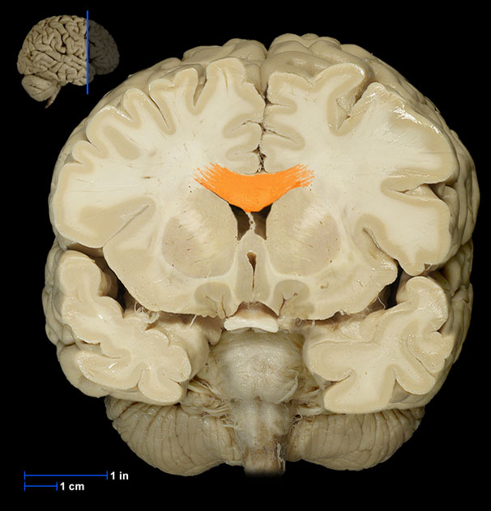
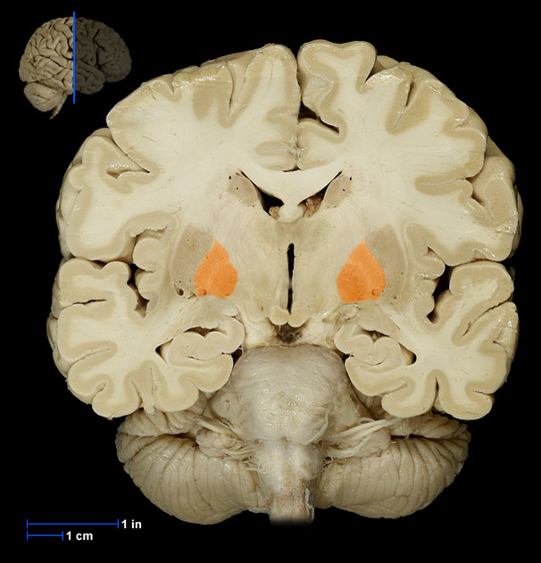
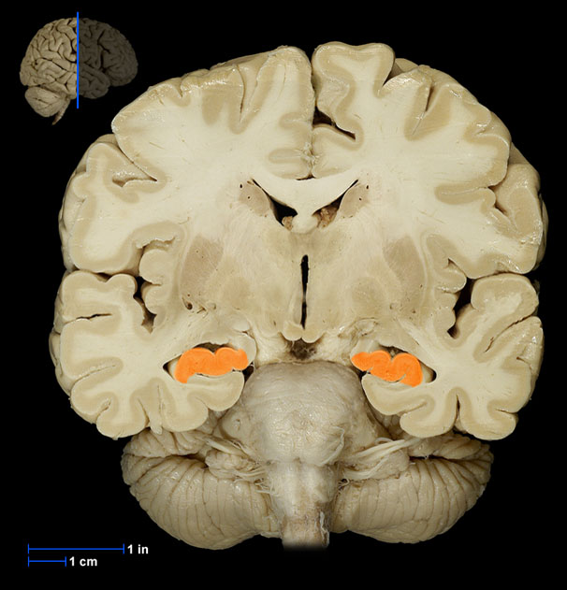
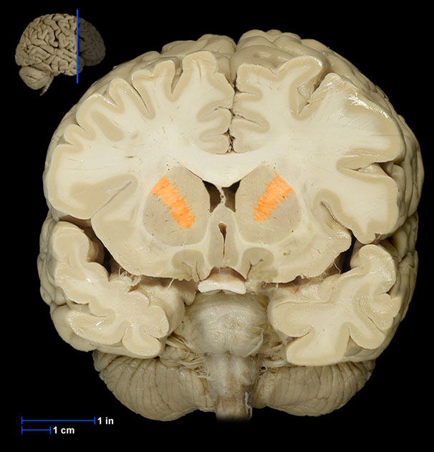
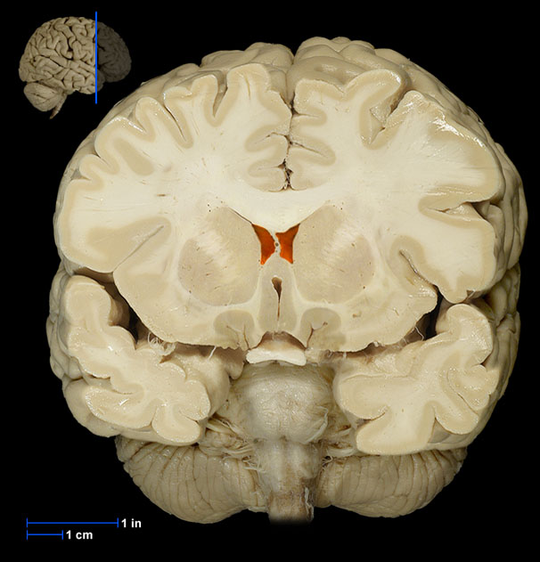
Notes:
Coronal section
Caudate nucleus
Corpus callosum
Globus pallidus
Hippocampus
Internal capsule
Lateral ventricles

Slide 39
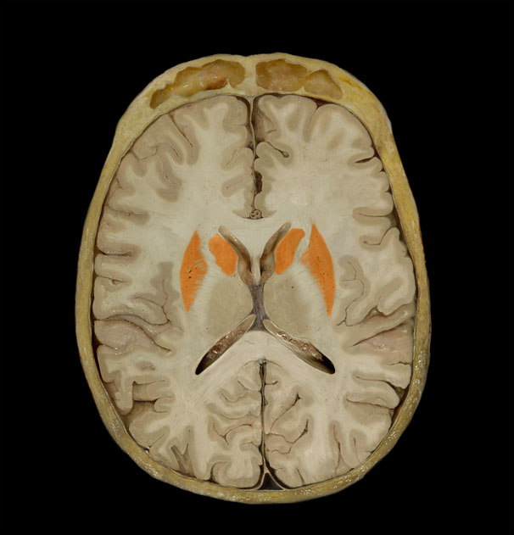
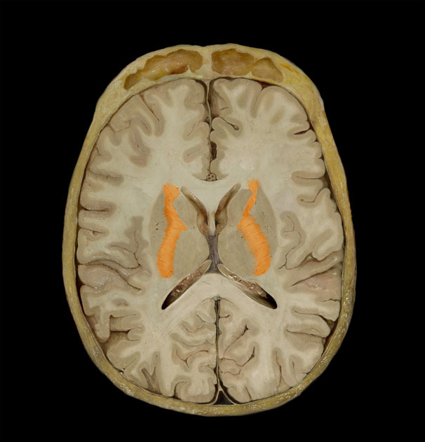
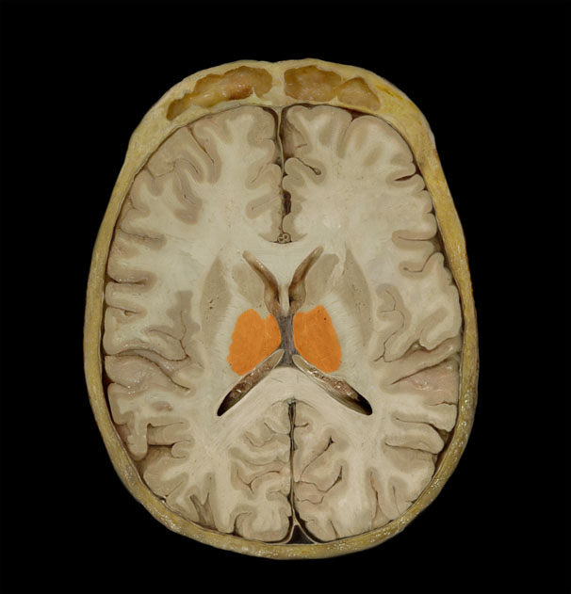
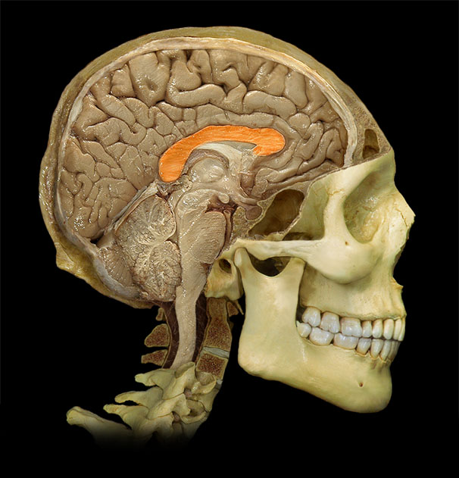
Notes:
Putamen (coronal section)
Putamen (coronal section)
Basel nuclei (transverse section, superior view )
Internal capsule (transverse section, superior view )
Thalamus (transverse section, superior view )
Corpus callosum (lateral view)

Slide 40
Lecture Content
We:
Understand the anatomical structure, functions, and clinical significance of the basal ganglia
Understand the anatomical structure, functions, and clinical significance of the limbic system
Understand the corticospinal pathway
Understand the somatosensory pathway

