Slide 1
KSVB Clinic
Charlotte Marshall
@heyteachonline

Slide 2
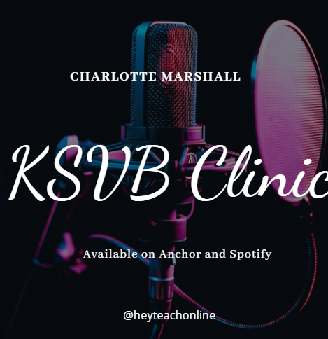
Available now!
https://anchor.fm/charlotte-marshall0/episodes/Core-Skill-2-CS2-e1r8bdj
This episode is looking at the KSVB CS2 where you're invited to consider "CS.2. Use varying teaching styles depending on the learning environment and students’ needs.”
This is the link to the supporting Padlet where you can pose questions and add further evidence from your own experiences: https://padlet.com/Charlotte_heyteach/KSVBClinic
www.ntu.ac.uk

Slide 3
