Slide 1
KSVB Clinic
Charlotte Marshall
@heyteachonline

Slide 2
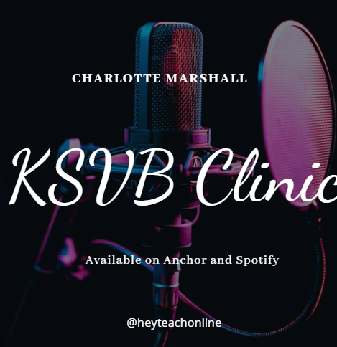
Available now!
https://anchor.fm/charlotte-marshall0/episodes/Teaching-Specialist-Knowledge-1-TSK1-e1phavl
This episode is looking at the KSVB TSK1 where you're invited to consider "Current subject and pedagogic research which support the development of advanced practice in the learning environment."
This is the link to the supporting Padlet where you can pose questions and add further evidence from your own experiences: https://padlet.com/Charlotte_heyteach/KSVBClinic
www.ntu.ac.uk

Slide 3
