Slide 1
Top Ten Tips for accessible, engaging video microlectures
Dr Ellie Davison

Slide 2
Provide Modifiable Versions of the Resources
Colour combinations
Fonts
Alt texts
Screen readers

Slide 3
Enable Flexible Engagement – when / where
Released in advance
Time / place
Support available (watch slots / learning schedules)

Slide 4
Necessitate viewing
Don’t repeat video content in sessions
Use face-to face time to expand, apply, evaluate, synthesise, debate….

Slide 5
Face time?
Relationship building
Focus on the content
Intros and outros (ease of editing)
Reusable

Slide 6
Internationalise
Avoid colloquialisms
Don’t assume cultural knowledge
Provide key terminology

Slide 7
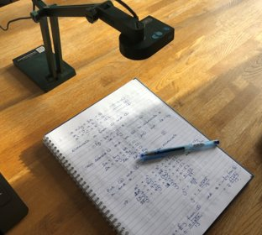
Added value
Reason to watch?
‘Live’ experiences

Slide 8
Enable flexible engagement - how
On a phone!
Bookmarked sections or playlists
Speed
Quality vs. bandwidth

Slide 9
Embed Understanding Checks
Quizzes
Deliberate pauses
Engagement checks
Signposting

Slide 10
Micro lectures
Concentration span
Overburden

Slide 11
Accuracy of captions
Visual impairment
Cognitive connections
Accents / language
Transcripts

