Slide 1
Building Your Teaching Philosophy using Lego Serious Play
Danielle Hinton – HEFi E. d.m.hinton@bham.ac.uk Tw. @hintondm

Slide 2
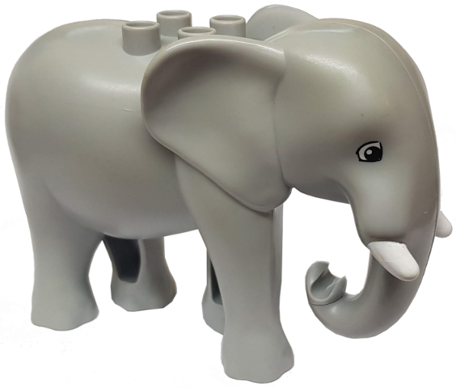
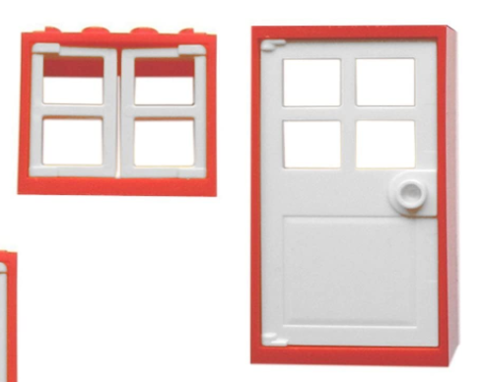
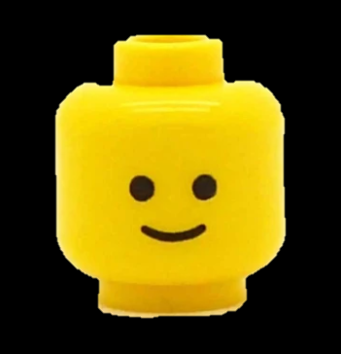
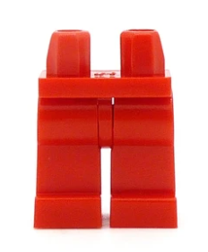
Bricks becomes Language & a World

Slide 3
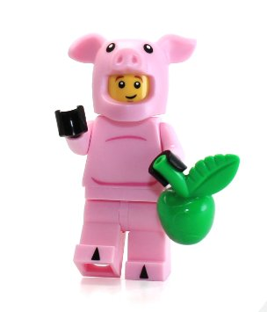
Warmup Activities
Thinking with your hands

Slide 4
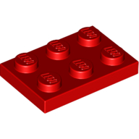
Build a Duck
Using the 6 pieces build a duck
Notes:
Aim:
Confidence building, showing that not all models have to look the same.
No right or wrong answer.
Outcome:
Building confidence
Did you feel comfortable / apprehensive building in front of others, did you ask for help or get ideas from others?
Timing: 9 mins
Explain = 2 mins
Build = 2 mins
Facilitator discussion = 3 mins
Reflection time = 2 mins

Slide 5
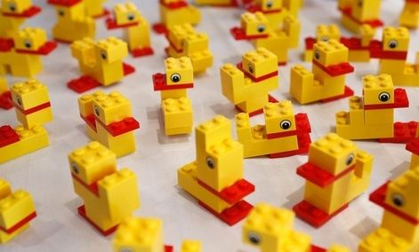
Share
My name is… I come from… Here is my duck

Slide 6
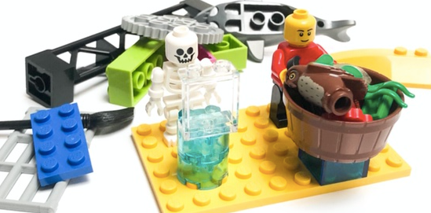
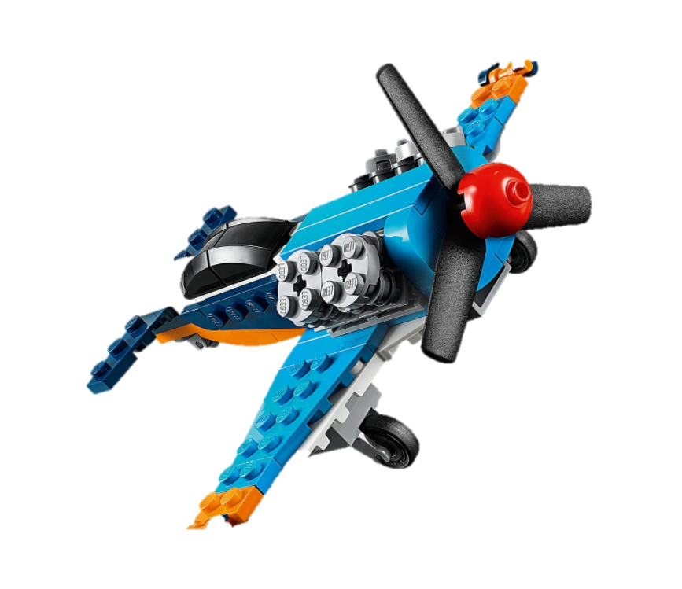
LEGO® SERIOUS PLAY® Steps
The Challenge – Question
Build a model – Metaphor
Sharing – Give meaning – Tell your story
Questions & reflections – Listen with your eyes
https://www.linkedin.com/pulse/simple-unconscious-power-lego-serious-play-guy-stephens-/

Slide 7
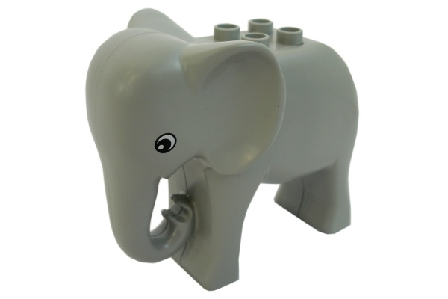
Thinking in Metaphors
What might these two bricks be used to represent?
Notes:
Elephants
Long memory
Elephant in the room – That big problem that everyone ignores
Intelligence
Awareness
Great capacity
Emotional
elephant-headed god Ganesh is the remover of obstacles
White elephant – unwanted gift
Clumsy
Wild
Pink elephant – hallucinations
Blue
blue 'sad'; 'depressed, melancholy'; 'sad, somber or glum’;
to feel blue 'to feel sad’;
blues music
sky
water
royal

Slide 8
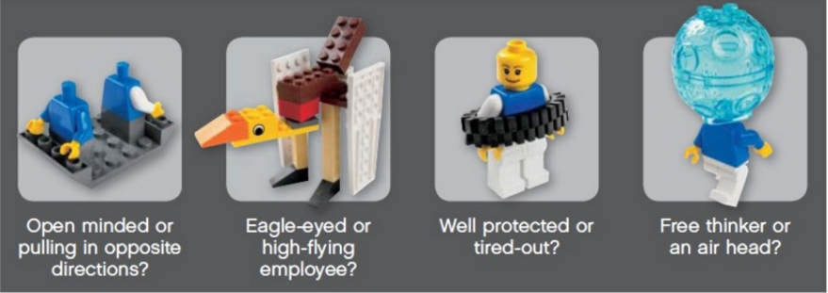
You can Remember Metaphors more Easily
Lego Serious Play kit handbook excerpt

Slide 9
Participants’ Etiquette
The Lego model is the answer
There are no wrong answers
Think with your hands
Listen with your eyes
Everyone participates – building and sharing 100%
What is important is what participants can share/ describe through the model.
If the participant says that a model represents something specific, then that is what it is
Reflect on and be inspired by the bricks & peer’s stories

Slide 10
Let’s Get Started
Remember:
Don’t have a meeting with yourself

Slide 11
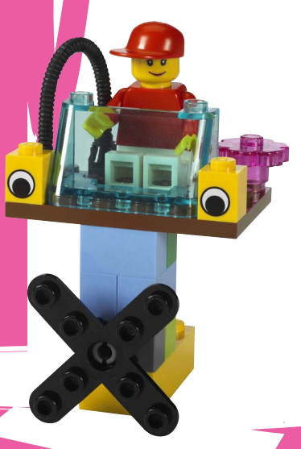
Task 1
The Challenge – Build a Nightmare Student
Build a model – Metaphorically
Sharing – Give meaning (tell your story)
Questions & reflections – Listen with your eyes

Slide 12
Reimagine
Spend 2 mins re-examining your Nightmare Student model – how might you re-describe the model in terms of your Dream Student
Share
(Reflect and analyse what you’ve identified as key characteristics. How these might appear in your emerging Teaching Philosophy? This is just the start…)

Slide 13
Dream ‘PGCHE’ Student
Open dialogue
Critically reflective
Engages with active learning
Aware & active in EDI values & beliefs
Explores the literature of other disciplines
Makes connections with peers (social Learning)
Actively questions
assumptions

Slide 14
Nightmare ‘PGCHE’ Student
Doesn’t / can’t / won’t ask for help
Research focused
Doesn't question assumptions
Imposter syndrome and EDI barriers lurk
Closed off from the literature of other disciplines
Doesn’t make connections with peers
It’s social science & I’m STEM!

Slide 15
Dream / Nightmare Teacher

Slide 16
Task 2
Build a model or models that reflect your Values and Beliefs in terms of
Facilitation of learning (relevant approaches and environments)
Inclusive approaches
Supporting and guiding learners
How you respect (individuals & communities) learners
Equity of opportunity to reach full potential
Share our story
Reflection and questions

Slide 17
Teacher Values and Beliefs
Build
Share the story
Reflect and question

Slide 18
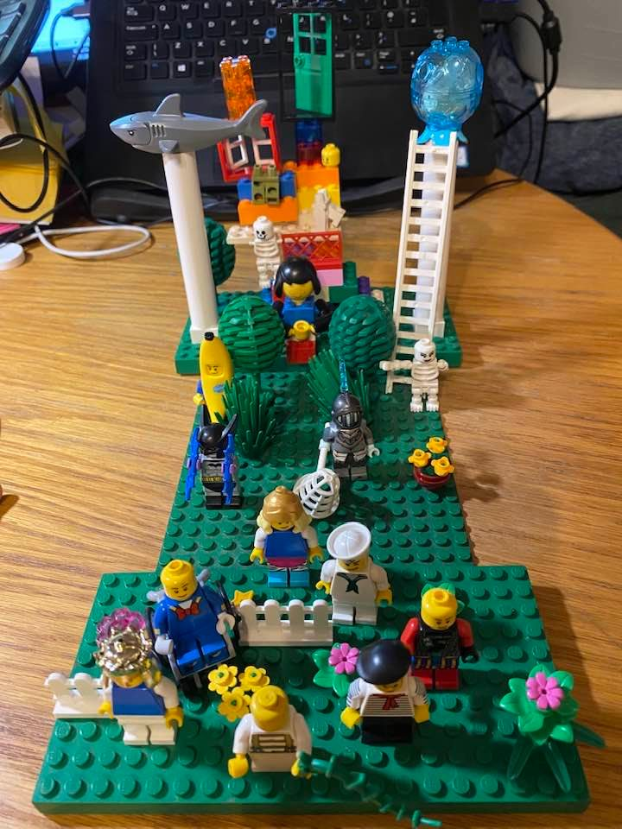
Danielle’s Teaching Philosophy
Lifelong learning open doors
Learning is full of emotions
Open Educational Resources (OERs) - sharing
Identity is complex and changing
Scaffolding learning & Setting Expectations
Always reflecting & working to break down barriers
Watching out for / locking away the imposter syndrome skeleton
Significant learning is hard won
Grow kind and compassionate practice
Situational lenses are essential to good learning design
Equality, Diversity and Inclusion (EDI)
Celebrate what the student brings and their journey
Student centred pedagogies

