Slide 1
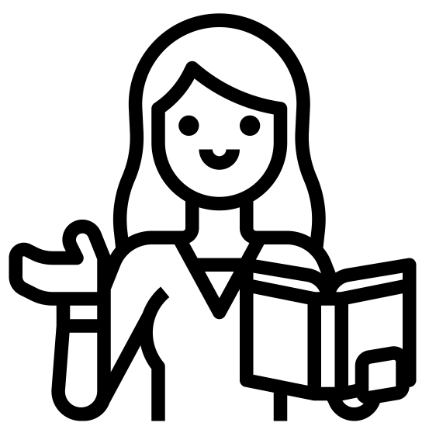
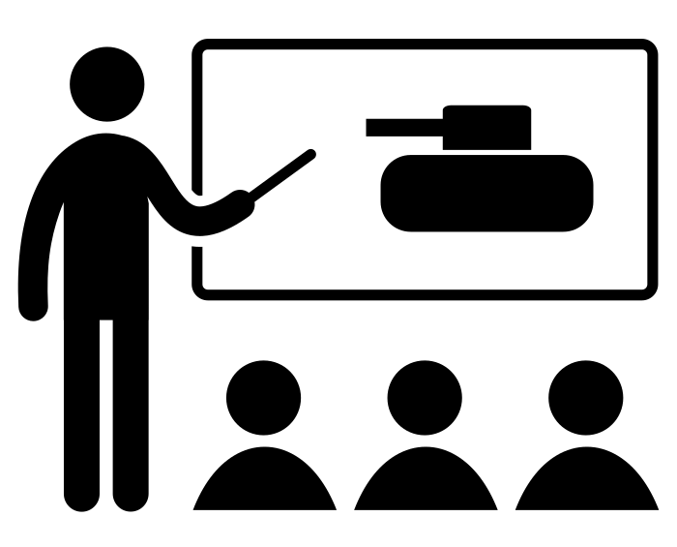
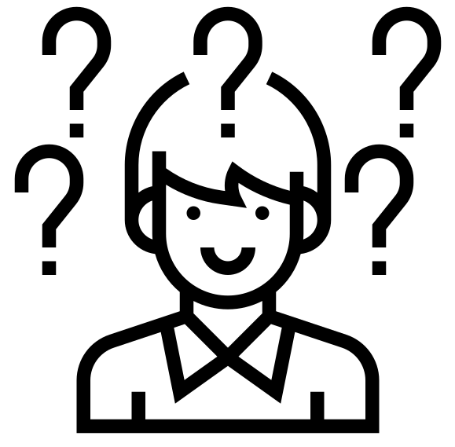
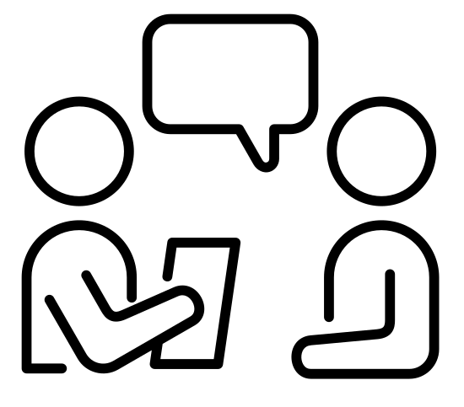
For further details, find me on Twitter @JenHistoryCW11
What happens when History teachers talk?
Teacher perspectives of informal virtual teaching communities for professional learning
Jenny Hall, History teacher and MA graduate – Edge Hill 2022
For the History Teacher Book Club, follow @historybookgrp
Context
Traditionally, Continued Professional Development (CPD) for teachers is taught in-school during short sessions, with limited follow-up time to process and apply the learning, and a lack of subject-specific opportunities. This is best summed up in Enser (2021) where he describes the “tales of woe” from teachers experiencing poor CPD. As a teacher for nearly 20 years, I wanted to explore alternative options, especially via virtual communities, to discover if there were different routes for teachers to gain excellent CPD, with a particular focus on subject specific development.
Case Study
In April 2019, a group of history teachers on Twitter formed an online History Teacher Book Club (HTBC) with the specific aim to read historical scholarship, debate its perspectives and consider how it could be used in the classroom. This research focuses on a case study of the History Teacher Book Club, an online, Twitter-based group for History teachers wanting to develop their subject knowledge and skills. It aims to explore how changing the nature of CPD for teachers to incorporate informal online teaching communities can potentially enhance classroom performance in a way that is accessible, enjoyable, and beneficial, whilst overcoming barriers such as time and confidence. The case study records the narratives of four members of the History Teacher Book Club to explore their perspectives and opinions.
Introduction
Providing current CPD for teachers is statutory however
this provision presents issues for both organisers and teachers:
Most internal CPD focuses on non-subject-specific pedagogy that is appropriate to the whole staff body but can be too generic to adequately apply.
CPD cannot be considered a ‘one-size-fits-all’ approach, indeed how teachers best learn can impact on the effectiveness of the delivery.
It is common practice to be inspired by a CPD session but then fail to return to the new learning once the training is over and a busy teaching schedule resumes.
For new pedagogical ideas to become embedded in classroom teaching, it is not enough to simply attend a CPD session and discuss in a small department. Teachers would benefit from belonging to a professional community of practice, to encourage debate and trial ideas.
Increasingly these collaborative communities are developing online rather than in person. Blended learning within teaching at all levels is now a common necessity as evidenced by the EEF report into remote learning (2021) which exemplifies different approaches to distance learning via online technology.
The History Teacher Book Club delivers a form of virtual collaborative professional learning. It provides members with new resources, raises awareness of historical material, and has created a community of colleagues who discuss learning opportunities and share ideas for transforming lessons. This online group is both distinctly separate from, and dissimilar to, an individual subject department in that it is external, optional, and multi-school. It focuses on the need of history teachers to engage with current historical research and with other history teachers regularly and flexibly.
Methodology
A narrative approach was adopted to hear the stories of those teachers involved and learn from their experiences. To ensure that the data collected was manageable yet meaningful for analysis, a questionnaire was distributed to members of the HTBC, using targeted questions to narrow down comparative subjects. The final participants had all been teaching history in the UK for over 11 years across key stages 3-5, making their experiences comparable.
The final interviews were semi-guided to avoid closed questions and allow for relevant topics to be prompted but not directed. The discussion was structured around three key themes - professional development, online learning, and teacher learning communities. Once completed, the interviews were turned into transcripts and then subjected to thematic data analysis alongside comparative analysis.
Findings
Professional Development
Data findings were overwhelmingly positive. The participants had joined the HTBC to gain more subject knowledge, to engage more with current scholarship . All felt that this forum was providing access to these requirements. The participants found the collaborative discussions beneficial in both building a deeper and broader subject knowledge but also in providing the confidence to disseminate that knowledge in the classroom. One participant felt that not all knowledge was easily transferrable directly into the classroom.
Online learning
Despite being entirely online, the HTBC attracted teachers of all ages and experience, with many saying this was a preferred format and that they would be less likely to attend a similar in-person group. Major positives were around flexibility to allow members to opt in and out based on time pressures, as well as the wide scope of members to connect with – way beyond those in local networks.
Teacher Learning Communities
The narratives share largely positive experiences of having an extended department of colleagues who can provide support and ideas beyond the face-to-face interactions within a school. Building up a community of regular participants creates a confidence to share views and to collaborate beyond the group.
Where next?
After recognizing the potential benefits that this style of online, collaborative CPD can provide, some recommendations would be to:
Broaden the scope of this research e.g., consider a less homogeneous group of participants with more diversity and on a larger scale to see if the results are similar.
Encourage the DfE to place a greater emphasis on gathering teacher voice around methods of CPD for use in schools.
Introduce a specific curriculum for CPD, with consideration of intent, implementation & impact as required within teaching subjects.
Wider development and encouragement for external teaching communities and discussion around how they can be embedded into a teaching career.
Extend the research outside of the discipline of History and compare the narratives of other subject teachers to determine whether other subjects could benefit too.
Teacher A: “I don’t think it would be possible to do it on department level.”
Teacher B: “It gives me the confidence that I know what I’m doing.”
Teacher C: “It has helped it being online because you get a greater variation of people who are engaging with it.”
Teacher D: “I feel really invigorated by the discussion about history.”
- - - - - - - - - - - - - - - - - - - - - - - - - - - - - - - - - - - - - - - - - - - - - - - - - - - - - - - - - - - - - - - - - - - - - - - - - - - - - - - - - - - - - - - - - - - - - - - - - - - - - - - - - - - - - - - - - - - - - - - - - - - - - - - - - - - - - - - - - - - - - - - - - - - - - - - - - - - - - - - - - - - - - - - - - - -
References:
EDUCATION ENDOWMENT FOUNDATION, 2021. Exemplifying findings from the EEF’s rapid evidence assessment on remote learning. Available from Rapid Evidence Assessment (educationendowmentfoundation.org.uk)
ENSER, M., 2021, Inset days: We need to put the C, P and D back into CPD Times Education Supplement 27 August Available from: School Inset days: how to make CPD effective all year round (tes.com)
All images from https://thenounproject.com

