Slide 1
Patient and Care giver involvement in nurse education in a nursing college in India
This presentation depicts the journey that emphasises the value of using naturalistic opportunities to enhance coproduction between service users, carers and professionals.
The work was underpinned by the educational theories of Paolo Freire.
Notes pages are attached to slides give a complete overview of this presentation

Slide 2
Exploring the involvement of patients and care givers in nurse education in India presented at Authenticity to Action conference 29-31 March 2021.
Toni Bewley

Slide 3
My initial Literature search led to the choice of literature review
Integrative literature review
Good for topics of which little is known
May not explore every aspect of the topic searched but focuses on main areas
From this subsidiary questions were evolved

Slide 4
Research Question and Aims and outcomes
Research Question
How are patients and care givers lived experiences relevant to student nurses education ?
Aims and Outcomes
To determine the barriers and facilitators of including patient and care givers in the development and delivery of nurse education in India
To describe the impact of patient and care giver involvement in nurse education for patients

Slide 5
Exploring the involvement of patients and care givers in student nurse education in a college in India
The Research design was a qualitative exploratory case study methodology using an appreciative values focus
Data collection methods included 2 World Café focus groups & incorporated art- based methods with a participant group of 16 student nurses ( years 2-4) (11 female , 5 male gender)
This was followed by 5 semi structured interviews (student nurses' years 2-4 all female gender)
Plus 82 participant responses to a single question from student nurses (year 1)
As well as 48 selected photographs
The work was underpinned by the educational theories of Paolo Freire
Data was analysed using inductive content analysis and reviewed by a critical friend

Slide 6
My first visit to India
With a grand welcome
Nurse educators
Notes:
This research heralded from my award of National Teaching Fellow in 2017. As I have been Chair of the Service User and Carer group in the Faculty of Health, Social Care and Medicine since 2015, my interest in the coproduction of educational programmes with users of the services is evident. My first visit to India initiated thoughts for my final research question for my doctorate .In health and social care over the past two decades ‘Service User’ and ‘Carer’ have been the preferred terms as used by the Department of Health and the NHS. A ‘Service User’ equating to someone who has experienced health or social care services and a ‘Carer’ meaning an unpaid and usually family member or partner who delivers health and social care services to another person. Co production stems from the 1970’s in USA when foot patrolling police were taken off car parks in favour of car patrols. Hence the crime rate rose and it was seen to be due to the lack of foot patrolling police being given information by the public ad hoc, hence the situation reversed and the public once again worked together or in coproduction with police. Service user and Carer involvement is integral to the validation of all health and social care professionals educational programmes. But, It is costly and with neoliberalist agendas in health and social care and HEI’s requiring proof of value for money and evaluations of services , I was keen to determine how other countries facilitated this involvement and hence Manipal College of Nursing in India was my base for this research .

Slide 7
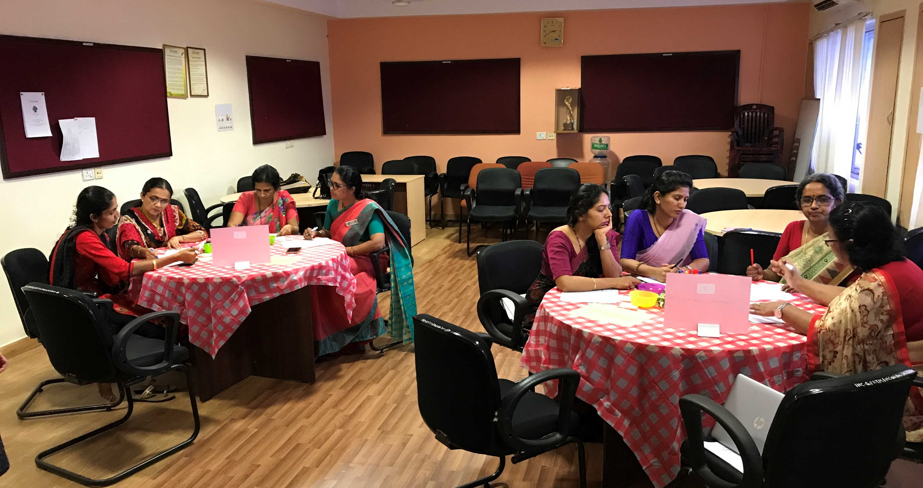
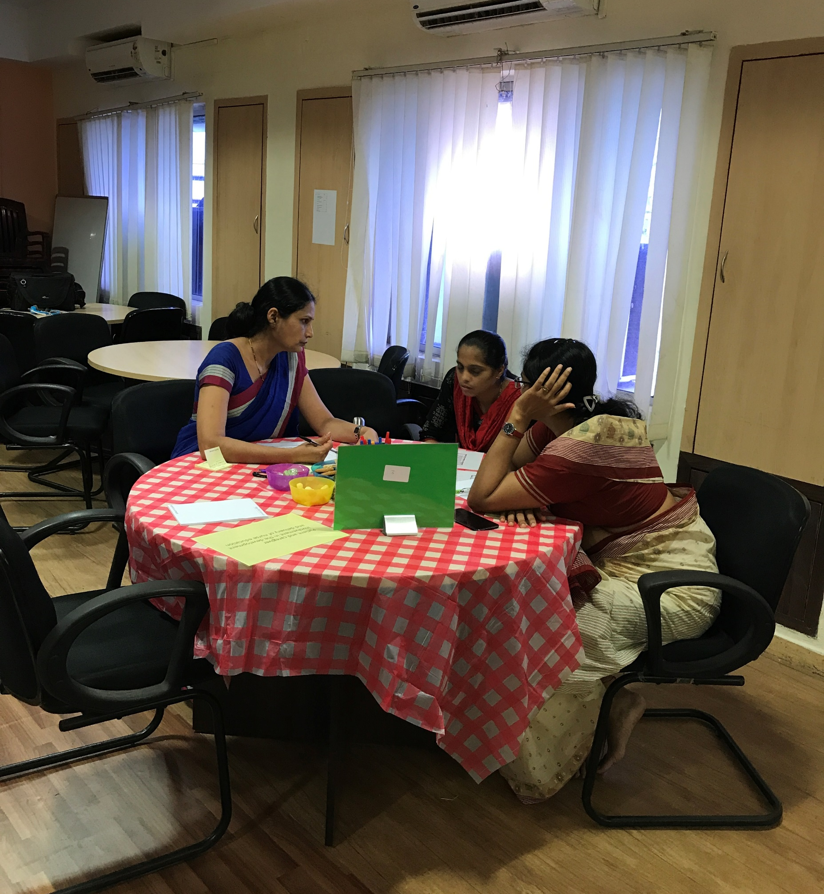
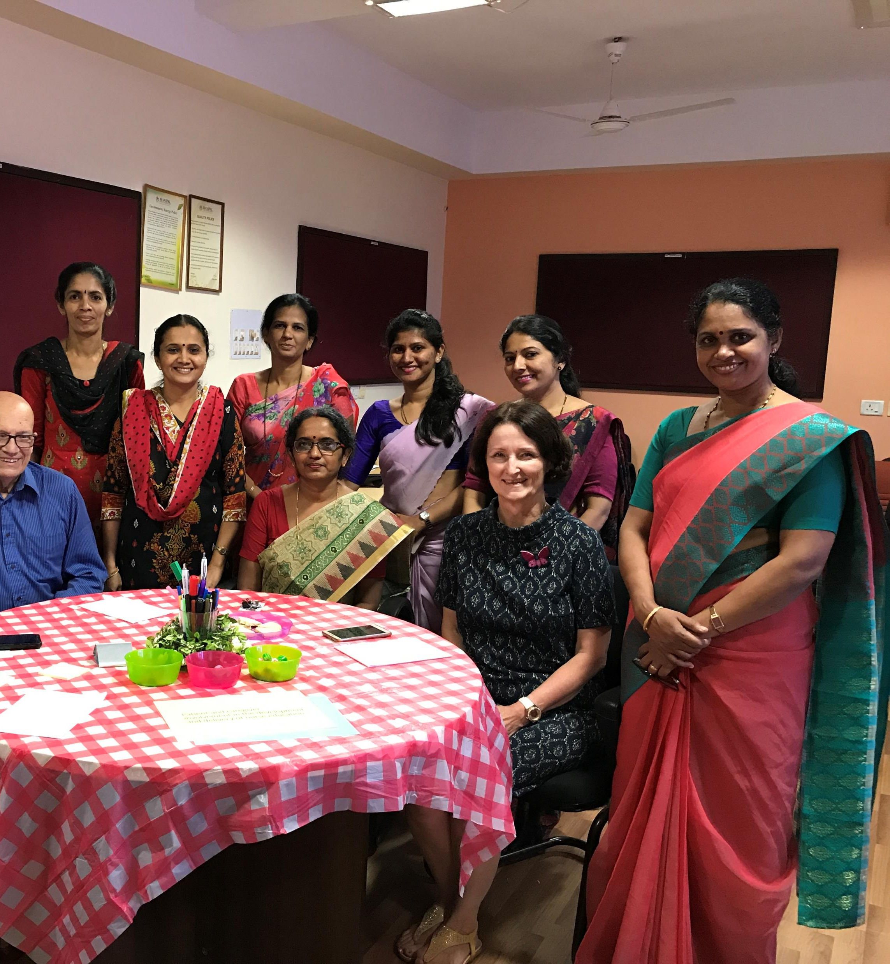
A pilot study took place with Nurse educators

Slide 8
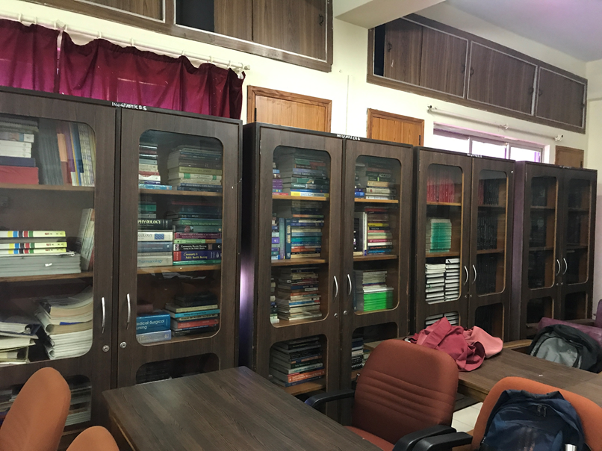
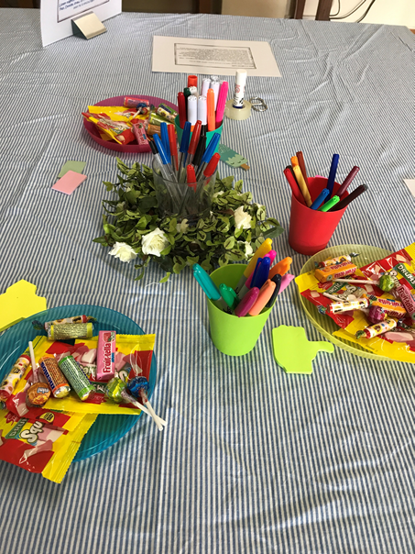
Second visit to India and data collection
All data collection took place in library
Heat and flying table cloths
Notes:
My second visit to India was for my doctoral research into the involvement of patients and care givers in student nurses educational programmes in India. The research took place at Manipal College of Nursing in India. It is ranked as the third top nursing college in the country. Following ethical approval from Chester and Manipal University, recruitment began for participants . This was undertaken by the international office from Manipal University. Inclusion criteria was for student nurses, any gender, over 18 years with fluent English. Participant information sheets were sent to the international office at Manipal university. The sample requested aimed for 16 participants for World Café focus groups and 4-6 students for semi structured interviews. Students responded to the request and two world café groups were undertaken with 8 students at each and five students were then interviewed. Interviews were audio taped. Following this first year students were invited to respond to two open questions anonymously . Consent forms were provided for all activities and anonymity ensured of all data ; plus participants made aware that they could withdraw their consent at any time.
The World café focus groups took place in the library in the college of nursing. The room was very hot and ceiling fans made the red table cloths fly in the air. Luckily one of the nurse professors provided blue striped material instead to cover the tables. Art supplies and confectionery were in plentiful supply on the tables.

Slide 9
World café groups
Student nurses
Art based methods
Notes:
Two focus groups were held with 8 student nurses in each, but sitting four to a table with a separate table leader on each table.
Spot the nurse professor in attendance in the first photo ; however she was busy marking work so did not effect the group dynamics .
Students responded to each of the 20 minute time slotted four questions, and they represented their answers in both text and art based representation. Sharpies the more expensive felt tips were favourites and prior to starting the group, students were shown simple ways to draw people as referred to by Dr Anna Passila.

Slide 10
Art based and written methods
One group wrote lots
Other group drew lots
Notes:
Participants in the first world café focus group wrote lots of text and utilised less drawing based methods than the second group. This could have also been influenced by my reiterating to the second group that they could write / draw on the whole size of the paper. Each table in each world café group was issued with two pieces of flip chart paper per questions

Slide 11
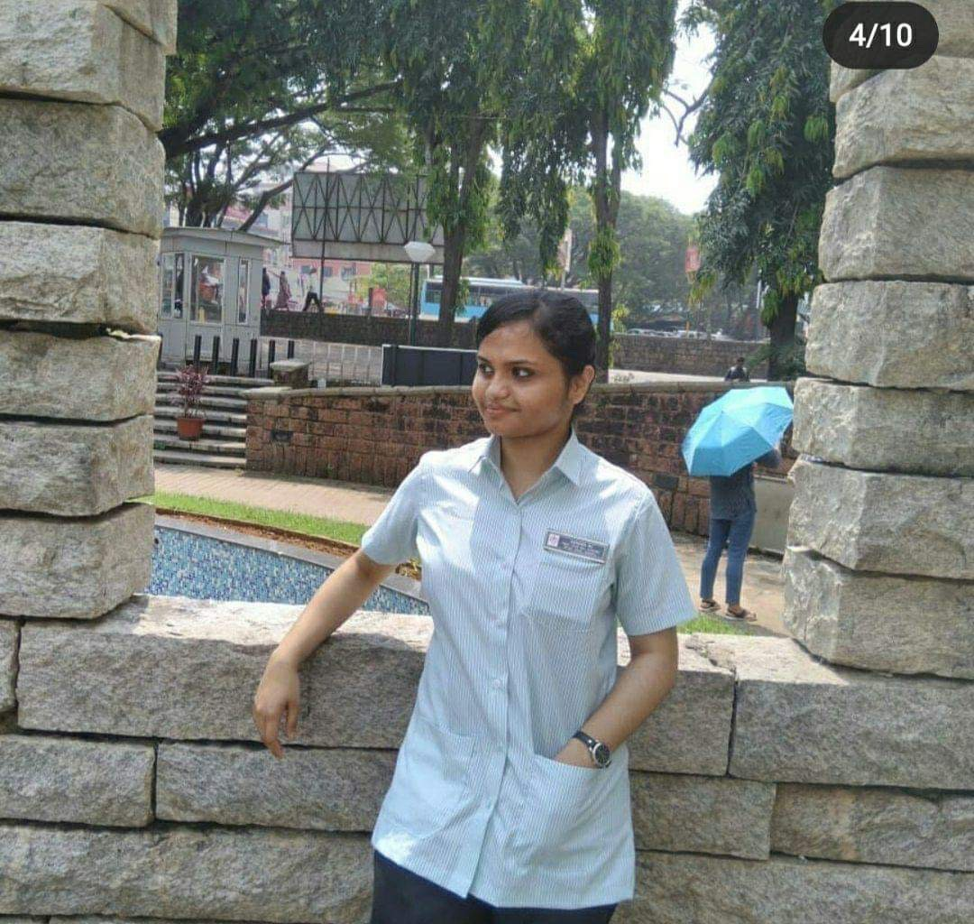
Individual interviews – audio taped
5 Interviews – semi structured – all female participants from years 2-4 nursing students

Slide 12
Data analysis
Inductive content analysis
Transcription
Art based analysis issues
Coding
Themes sourced from sub categories, main category
Critical friend review

Slide 13
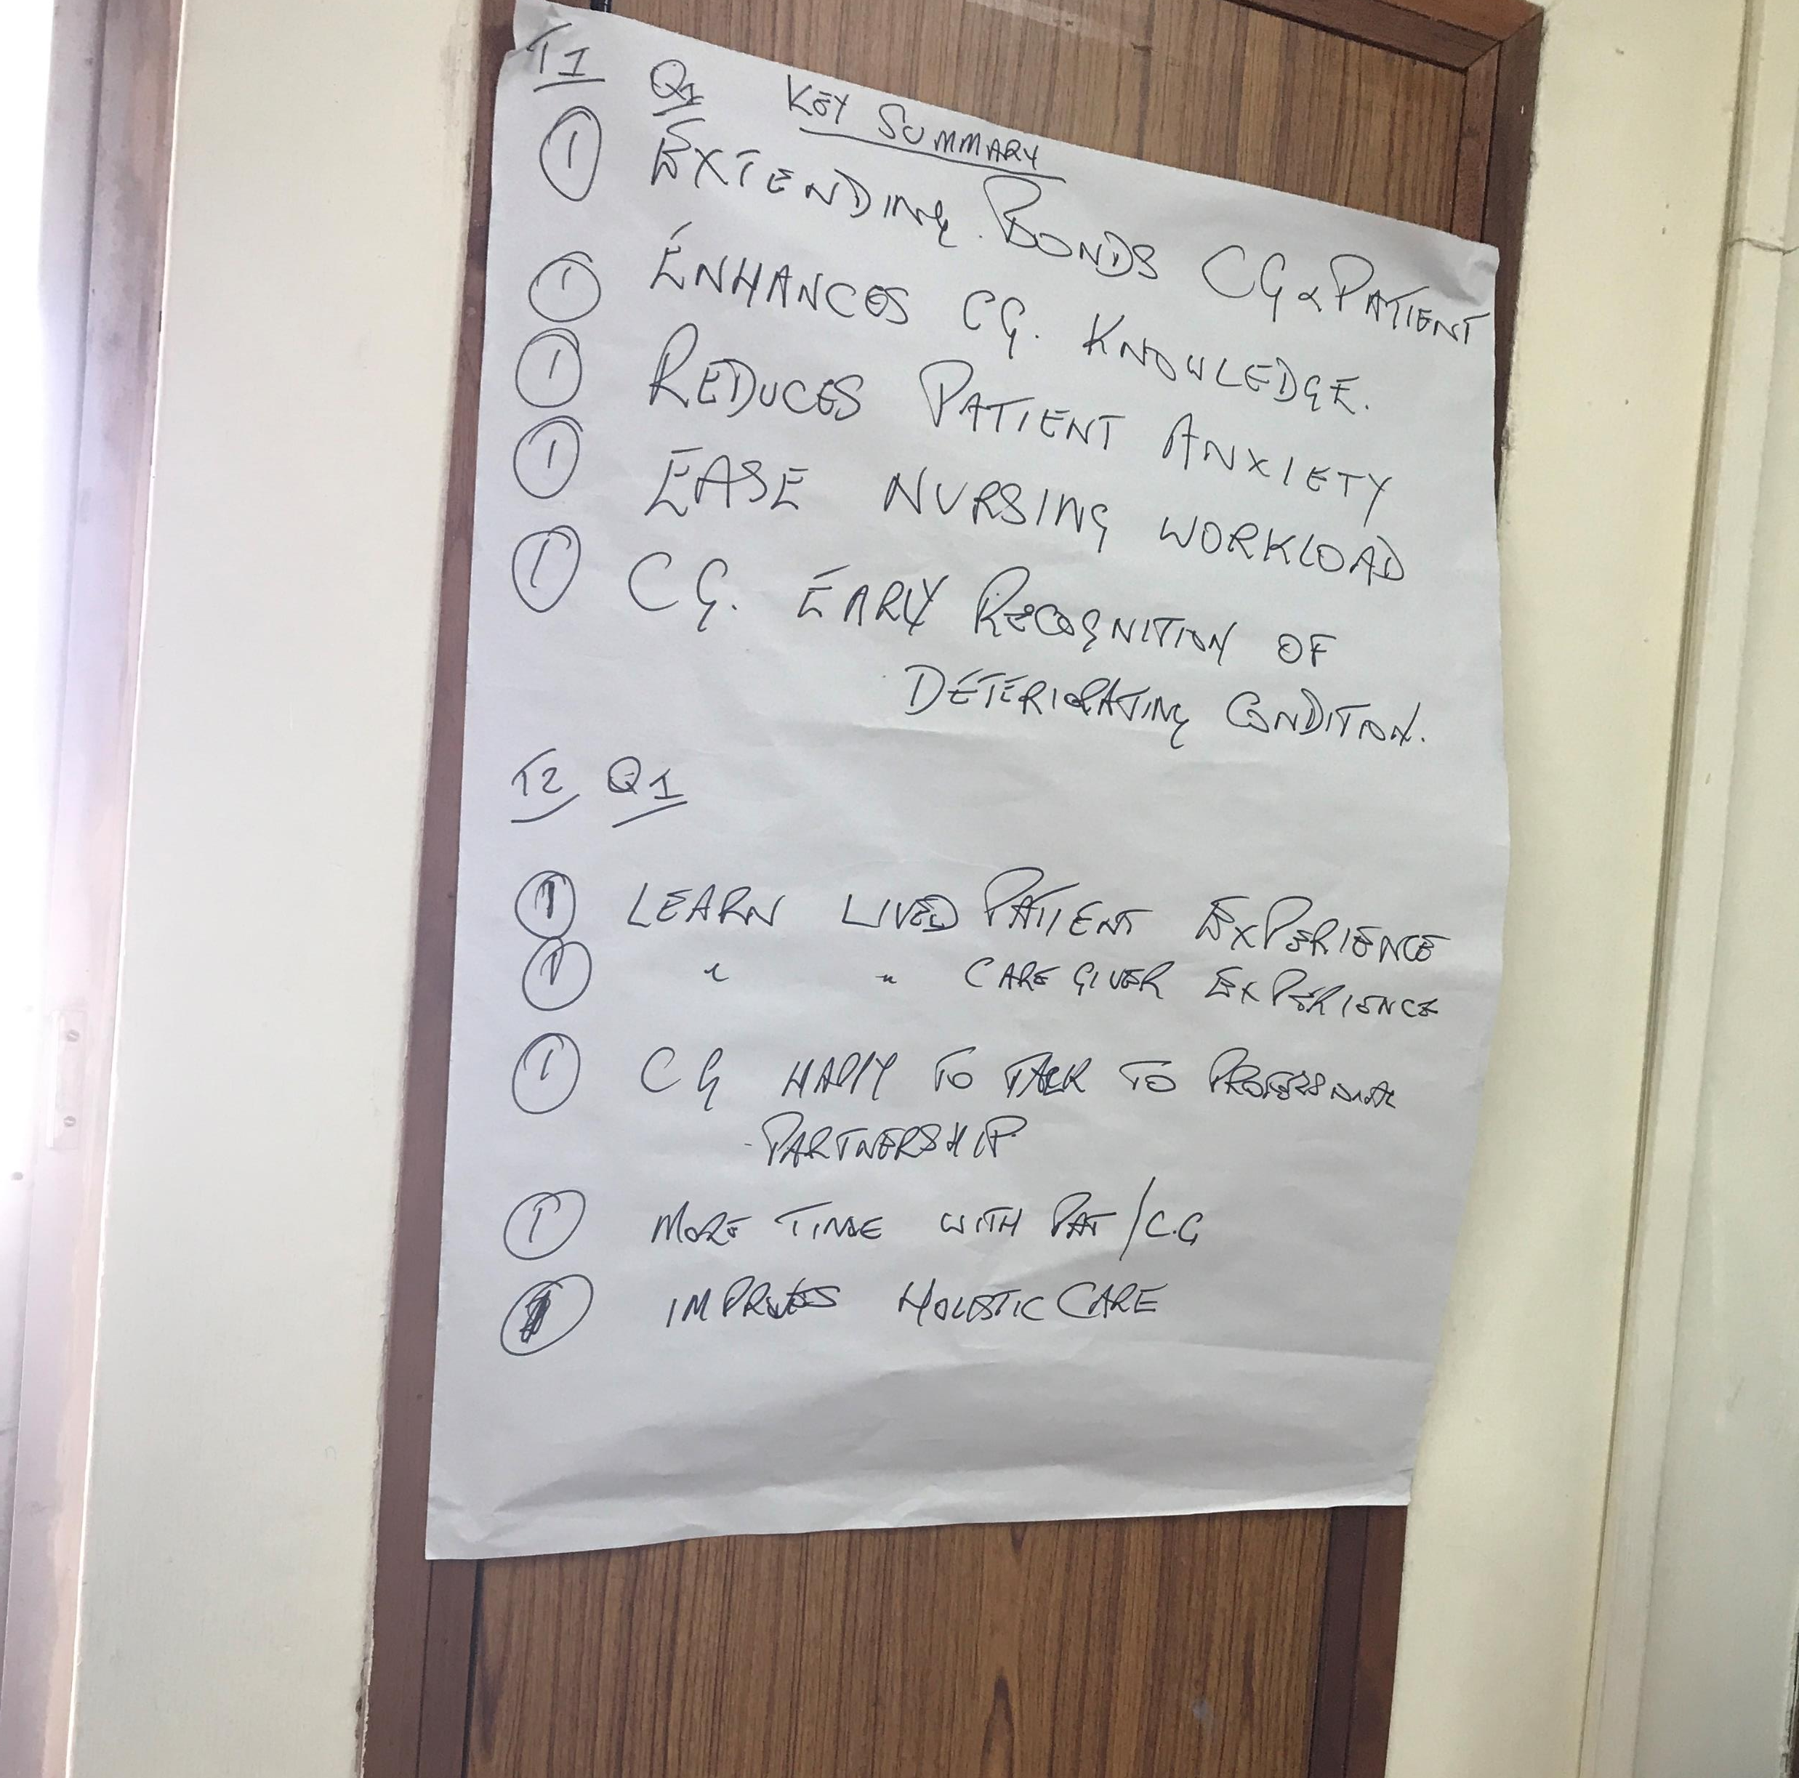
The role of the helper/ critical friend
Timekeeper in focus groups
Collated key points from group leaders at the end of each question
Reviewed main themes and art-based scenario interpretation

Slide 14
The Lived experience or simulation
First year nurses
Equal responses to question
Notes:
First year student nurses had only been at the university for 8 weeks prior to my arrival. I was able to speak to the whole group about my research . 82 were present and they had experienced a simulated patient exercise . I posed a question to the students re Did they feel like this was a real patient ?
They were given post its to respond anonymously if they wanted ; all did and results were exactly 50: 50 . So one size does not fit all .

Slide 15
Findings - Themes
Involvement – Care givers
Identity – Nurse - Patient – Care giver
Conscientizacao - Praxis – Reflection on Action – Reflection in Action – Transformation

Slide 16
Involvement model
As adapted from Houston & Rothschild(1978), Zaichkowsky(1986) & Andrews et al,(1990).
Involvement
Personal
Patients and care givers
Product
Student nurse
Situation
Student nurse education

Slide 17
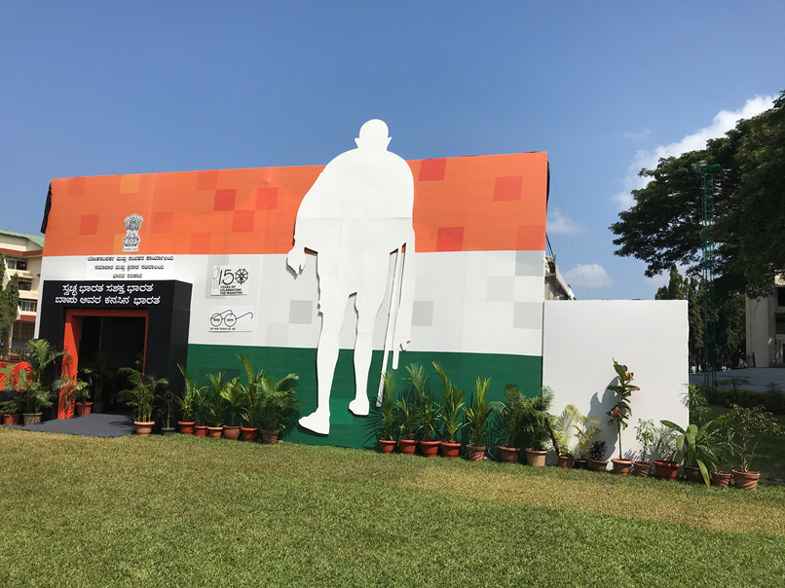
Filial Piety and the influence of Gandhi
150 year exhibition
Gandhi celebrated
Notes:
During my visit, it coincided with the 150th anniversary year of Gandhi. In the grounds of the university at Manipal was an exhibition about his life. On entering the exhibition, I was aware that there were students manning every stand, their admiration of Gandhi was palpable. What did he mean to them, I enquired? They replied, “He was a great man, a man of peace, a true communicator to his people. “Gandhi was a man of his time and place, with a philosophical and religious background, facing a specific political and social situation (Jahanbegloo,2013 p13). The issue that resonates with me is his “lived experience”. Communication theorists see the art of communication as one which is about sharing meaning, this is exactly what Gandhi did (Fiske,1990). Gandhi was an “effective communicator, fearless and eloquent with his words” (Mishra et al,2017 p.388).
Family members in India, assume the values of ‘filial piety’; and undertake the role of “care giving” (an unpaid carer) without question, as part of a filial obligation. Gandhi stated this is potentially “unique and alien as compared to the developed world” (Jagannathan, 2014, p356). Families graciously take on this duty, it is not viewed as an onerous duty, and not a burden (ibid). Accordingly I was anxious to explore how communication and caring skills are passed on to student nurses, whether it is through ‘lived experience’, education or other means

Slide 18
Communication and co production in education
Multiple chances to embrace
Naturalistic communication
Notes:
The shift in care during the Covid 19 pandemic in the UK has been informative in many ways. Despite relatives being unable to be in the hospital with the patient, there have been many innovative communication experiences reported. Staff have requested small knitted hearts to be made by the public, one of these is given to the relative and one to the patient; to indicate a bond. Staff enrobed in PPE have made photographs of themselves to stick onto their gowns. The use of technology, iPads and telephone via face time has enabled final moments of communication to be shared across families, from a hospital bedside to a family home. These examples of communication enhance the reality of how potentially naturalistic communication, between the professional and patient, could be utilised in student nurse education. Gidman (2013) noted that by students listening to patients’ stories, transformative learning took place due to these direct interactions. Clarke et al, (2003) explored the benefit of staff developing person centred care by them directly sharing stories with patients. Care givers in India are naturalistically in the ward environment. They are delivering care and sharing their experience and knowledge of their family member with the attendant nurse. Potentially these experiences enable the nurse to develop sensitivity and awareness of the patient as an individual, and therefore become more person centred in their approach (Farley and Widmann,2001). These naturalistic situations could be utilised to a greater extent in student nurse programmes by allowing the family to become involved in debriefing the student on their listening and communication skills. In tandem with the family and or the patient taking part in a more formalised assessment process. In this way formal learning processes involving patients and their carers could be initiated. This could be mirrored across other educational programmes as well.

Slide 19
Caregivers always present, integral to care in health settings – harness this
Teacher leave those kids alone
Freirean pedagogy - education is a series of questioning ,It is important to recognise and acknowledge humanity
Transformation is possible, if grounded in the reality of the social, economic and political circumstances
Self reflection helps the student understand the world they live in
Praxis (Action /Reflection)
Student nurses have the ability to set conditions for a new life by transforming nature and themselves

Slide 20
Implication for practice
Harness naturalistic opportunities to engage in dialogue with patients and their families
Weave history taking, case studies from practice throughout the educational programmes
Reflect understanding of case studies to patients and families , enable patients to assess students listening skills
Build a portfolio of reflections, which develop over time to show reflection on action, reflection in action and any transformational change that has resulted from this

Slide 21
References in notes pages
Clarke, A. Hanson, E, J. Ross, H. (2003) Seeing the person behind the patient: enhancing the care of older people using a biographical approach. Journal of Clinical Nursing 12 (697-706)
Costa,A.Kallick ,B.(1993) Through the lens of a critical friend. Educational Leadership 49-51
Farley, C. Widmann, S. (2001) The value of birth stories. International Journal of Childbirth Education 16 (3) 22-26
Fiske ,J . (1990) Introduction to communication studies . Routledge , London
Freire, P. (1968). Pedagogy of the oppressed (M. B. Ramos, Trans.) New York, NY: Continuum.
Gidman, J. (2013) Listening to stories: Valuing knowledge from patient experience. Nurse Education in Practice 13 192- 196
Jahanbegloo, R. (2103) The Gandhian Moment. Harvard University Press, ProQuest eBook Central
Jagannathan A. (2014) Family caregiving in India: Importance of need-based support and intervention in acute care settings. J Postgrad Med; 60:355-6.
Kadi - Hanifi. (2014). Engaging students and staff with educational development through Appreciative inquiry. Innovations in Education and Teaching International, 51 (6), 584-594.
Mishra, J. Nargunde, S (2017) Role of Gandhi as a Communicator. International Journal of Engineering and Technical Research (0) 2454 – 4698 (p) Vol 7, Issues – 12, December

