Slide 1
Teaching academics about active learning
Dr. Bianca Fox, Nottingham Trent University
Prof. Valentina Marinescu, UB
Associate prof. Silvia Branea, UB

Slide 2
Professional development at UB
New CPD offer
First year when a short course of this kind was delivered

Slide 3
About the course
3-week short course for academics working at the University of Bucharest
Aims:
- Communicating research results to a wider audience.
- Promoting research and scholarship.
- Creating a personal brand.
50 registered participants

Slide 4
Course structure
Week 1- Creating a digital profile
Week 2- Networking and promoting own research/scholarship on social media
Week 3- Digital competencies- Creating a video abstract

Slide 5
Active Learning Strategies that worked!!!
Designing activities that promote discussion and collaboration.
Teaching through live demonstrations.
Encouraging problem-based learning through the use of short scenarios and case studies.
Using the muddiest point technique to encourage providing feedback.
Using technology to encourage participation.

Slide 6
Examples of activities used
Identify a researcher in your field who has a recognizable brand.
Look at these 3 websites and choose the one you like best. What did you like about each website? Add your explanation to this Jamboard
Create a website to promote your work, using the wix.com platform
Identify 3 reasons to join a professional network.
Identify 2 professional networks in your field.
Compare two book proposals. Which one would you approve for publication?
Explore these 2 video abstracts and identify the ideal structure for a video abstract.
Record a 2-minute video abstract for one of your papers (or future papers) and share it with your peers.

Slide 7
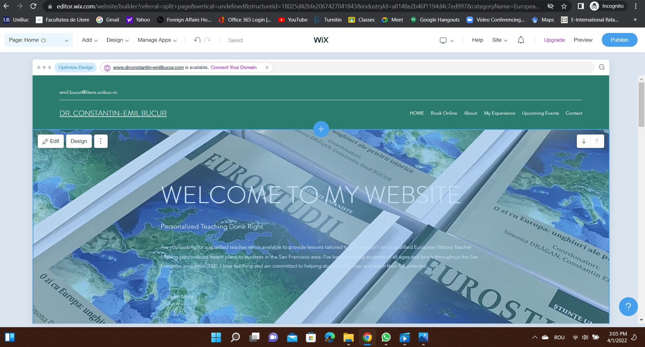
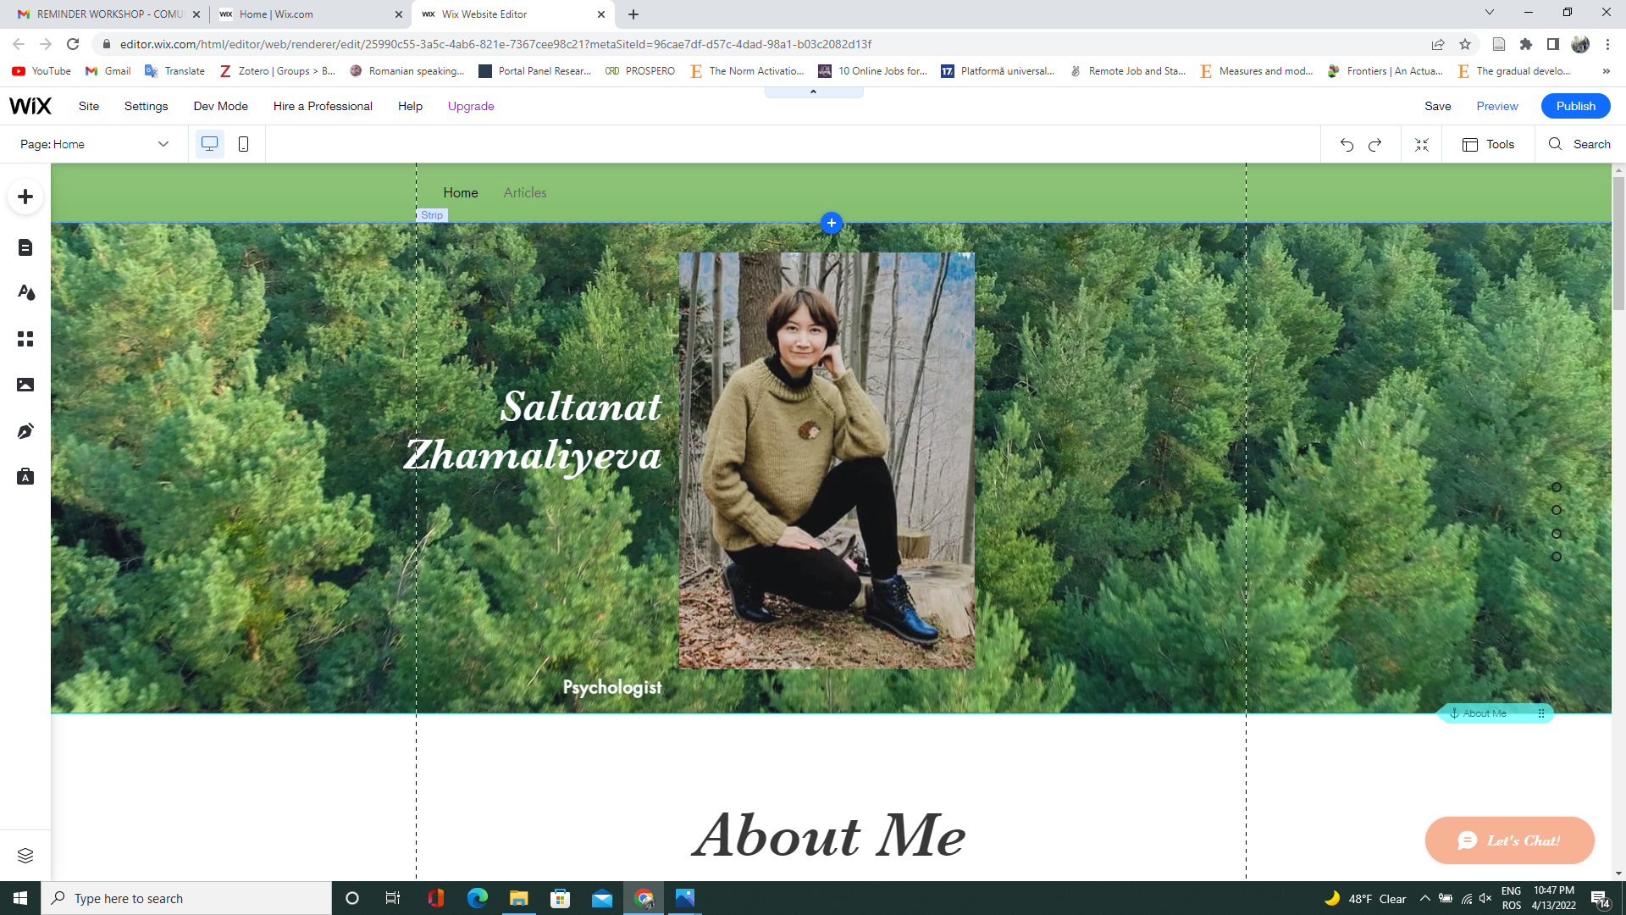
Examples of participant outputs

Slide 8
Challenge
How do we introduce active learning to lecturers from other international contexts that have never experienced active learning before?

Slide 10
Thank you!
Get in touch!
bianca.fox@ntu.ac.uk

