Slide 1

Values in D&T
D&T Subject Pedagogy
Matt McLain
© 2021
Attribution 4.0 International (CC BY 4.0)
This work is licensed under a Creative Commons Attribution 4.0 International License.
Notes:
ATTRIBUTION (BY). You must give appropriate credit, provide a link to the license, and indicate if changes were made. You may do so in any reasonable manner, but not in any way that suggests the licensor endorses you or your use.
https://creativecommons.org/licenses/by/4.0/
You are free to:
Share — copy and redistribute the material in any medium or format
Adapt — remix, transform, and build upon the material for any purpose, even commercially.
The licensor cannot revoke these freedoms as long as you follow the license terms.

Slide 2

Pre-session Reading
Discussion on:
Martin, M. (2021). Values in design and technology. In A. Hardy (Ed.), Learning to teach design and technology in the secondary school: a companion to school experience (4th Edition). Abingdon, UK: Routledge.
What stood out to you? Do you have any questions or comments?

Slide 3
The engine of D&T
“Values and value judgements are ‘the engine’ of design and technology. Judgements about what is possible and worthwhile initiate activity; judgements about how intentions are to be realised shape the activity; and judgements about the efficacy and effects of the product influence the next steps to take. Value judgements, reflecting people’s beliefs, concerns and preferences, are ubiquitous in design and technology activity”
(Layton 1992, p. 36)

Slide 4
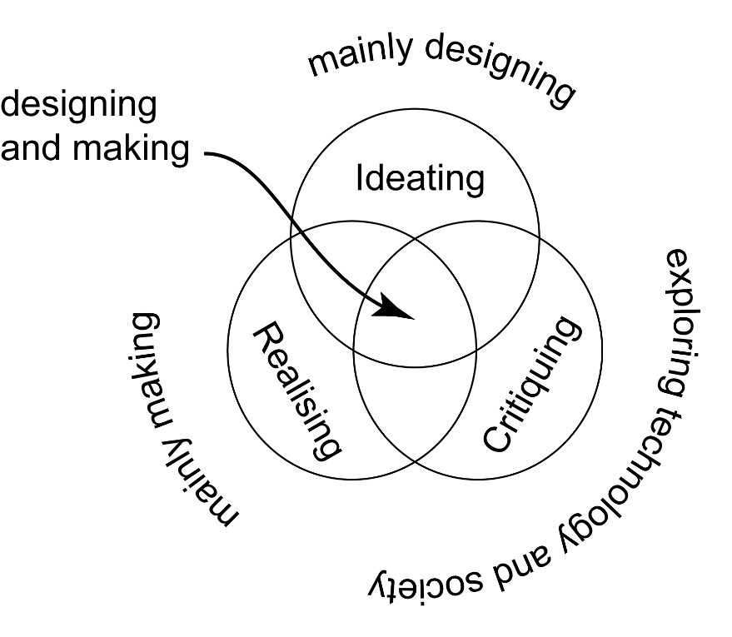
More than Evaluation
ES
Values and valuing align closely with the critiquing D&T fundamental, and the exploring technology and society (ETS) pedagogical approach.
Evaluation and values share the same linguistic root, but values should be more open-ended and promote divergent thinking:
  evaluation in schools is often more ‘contained’ in the school D&T curriculum
Acronyms, like ACCESS FM, CAFÉ QUE, etc. are useful scaffolds, but can be limiting and arbitrary if pupils don’t move on from them.
Notes:
Exploring Technology and Society (ETS)
Description:
There are some similarities to activities that have been labelled investigate, disassemble and evaluate activities (IDEA), but also embrace wider aspects of critiquing the impact of technology and society on each other.
Benefits:
ETS activities provide opportunities for learners to focus on the impact of technology and society, and the mediating role of design. A focus on critiquing enables pupils to explore issues and values, as well as simply analysing or evaluating products and systems.
Limitations:
Focusing on solely on issues of technology and society may inhibit designing and making activities, particularly where pupils are not supported to make decisions on next steps. An over emphasis on ETS activities could limit design and technology to a cerebral social science.

Slide 5
The Signature Pedagogy Framework
Recap on…
Surface Structure: “…concrete, operational acts of teaching and learning…”
Restrictive
Expansive
Deep Structure: “…how best to impart a certain body of knowledge…”
Exploring Technology & Society
Mainly Making
Designing & Making
Mainly Designing
Implicit Structure: “…attitudes, values, and dispositions…”
Realising
Critiquing
Ideating

Slide 6
What is missing?
Right material for the job?
Improved performance?
Innovative solution?
Different kinds of values in D&T
Technical
Economic
Aesthetic
Social
Environ-mental
Moral
Spiritual
Religious
Effective use of resources?
Maximising added value?
Culturally sensitive/ appropriate?
Respectful?
Pleasing to handle?
Attractive to look at?
Human beings’ relation with nature / the world?
Connectedness?
Sanctity of life?
Social justice?
Equality of sex, gender, race, etc.?
Regard for the disadvantaged?
Ecologically benign?
Sustainable development?
(Layton 1992, p. 36)

Slide 7
Values and Questioning
How we discuss, discover and explore values…

Slide 8
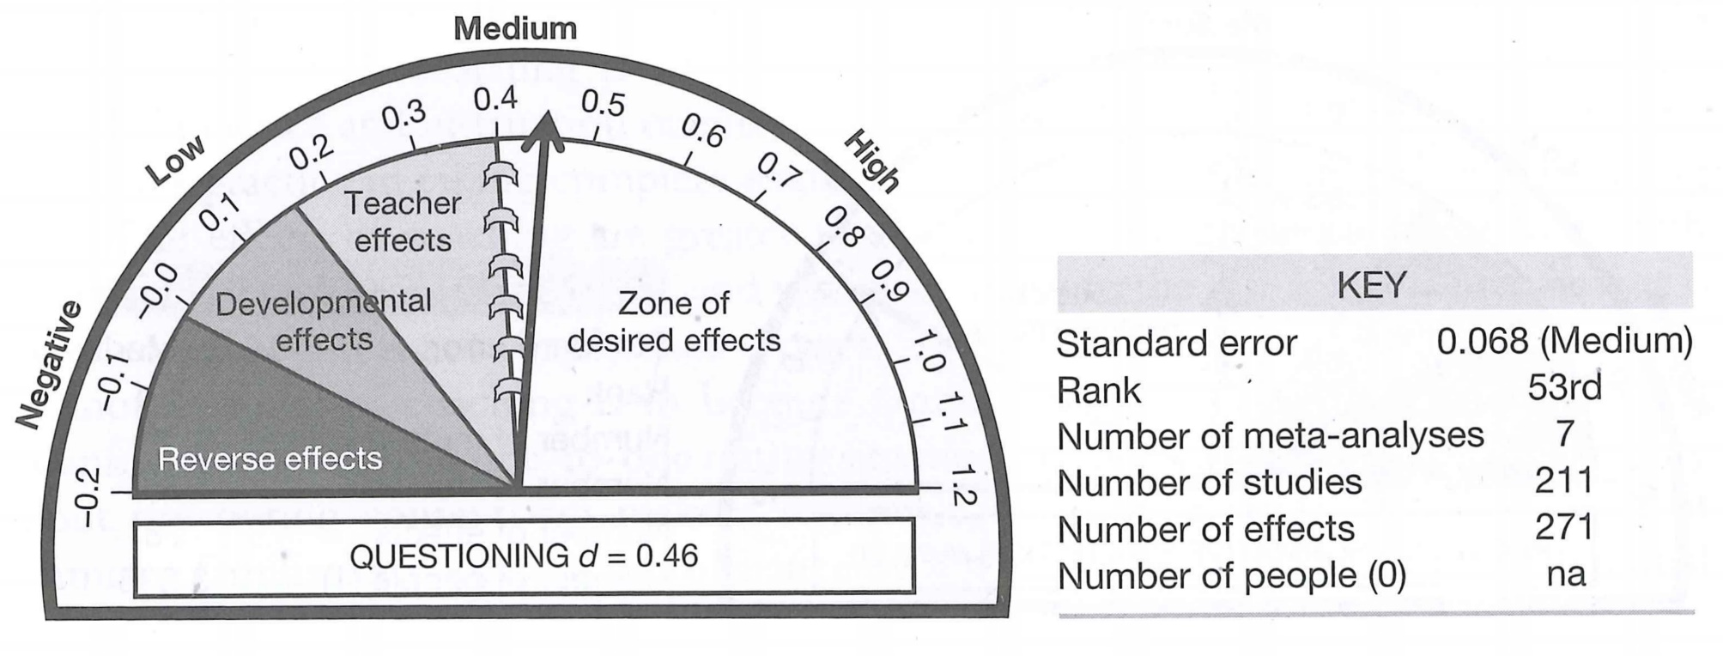
Why questioning?
It has a measurable impact on learning
“Training in questioning matters. [A research team] found that the questioning skills examined in studies were very open to change through training.”
(Hattie, 2009)
(Hattie 2009: 182-183)

Slide 9
Types of questions
Convergent (‘drilling down’):
Closed (factual, single word response – e.g. Yes/No)
Managerial (classroom management)
Rhetorical (to emphasise a point)
Probing (clarifying, awareness, focusing)
Divergent (‘opening out’):
Open (range of possible responses, interpretive)
Referential (where the asker doesn't know)
Prompting (refocusing, redirecting, scaffolding)
Exploring (discursive, divergent, application)

Slide 10
Using The Affective Domain ( )
Receiving Phenomena (e.g. awareness, receptive etc.)
Responding to Phenomena (e.g. active participation, compliance etc.)
Valuing (e.g. acceptance/commitment, internalisation etc.)
Organization (e.g. resolving conflicts, constructing a value system etc.)
Internalizing values (e.g. self-control/regulation, consistent etc.)
(Krathwohl, Bloom and Masia, 1973)
(Krathwohl, Bloom and Masia, 1973)

Slide 11
A tried and tested method
Socratic questions
Clarification questions
Questions about an initial question or issue
Assumption questions
Reason and evidence questions
Origin or source questions
Implication and consequence questions
Viewpoint questions
For example questions, see Intel (2007)

Slide 12
Questioning and dialogue
In this context, it is more about pupils (and the teacher) asking and answering questions, than teacher questioning (as a formative assessment).
Starting points of foci can include:
  Artefacts (including pupils’ products, existing products, cultural artefacts, etc.);
  Design problems (including difficulties, challenges, opportunities, etc.);
  Contexts (including locations, scenarios, needs/wants, limitations, etc.);
  … and so-called‘Wicked’ problems, etc.

Slide 13
Recap: Wicked Problems
"Wicked problems are challenges (or situations) that are difficult or impossible to solve, often due to changing, complex and/or competing demands. They are problems that appear to resist solutions and tend to be contextual, involving tensions and complicated social or systemic relationships. Examples include environmental problems where a solution to one factor can have negative effects on others, but taking no action also has negative effect.”
See https://canvas.ljmu.ac.uk/courses/56956/pages/pedagogies-for-critiquing-in-design-and-technology
(McLain, 2021, p.233)

Slide 14
A few strategies for Questioning and Dialogue on Values in D&T
Using frameworks like the Affective Domain or Socratic Method
D&T acronyms, like ACCESS FM, CAFÉ QUE, SCAMPER, etc.
‘W5’ (who, what, when, where, why?)
‘Five Whys’ (ask ‘Why?’ to the each response)
Some generic approaches:
Individual mini-whiteboards (impermanent responses)
‘Hot seating’ (Q&A ‘in character’)
‘Think, pair, share’ (pair/group work, focusing on an issue)
Worksheets (non-verbal response to questions)
Interactive voting systems (using mobile devices)

Slide 15
Valuing and the Environment
What impact does designing and making have on our local and global ecosystems?

Slide 16
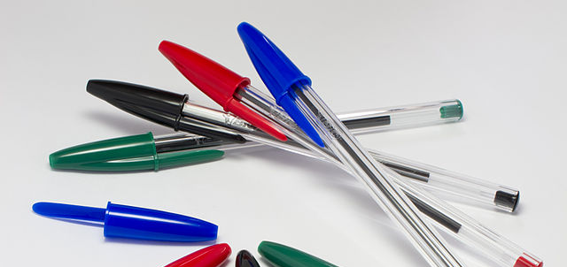
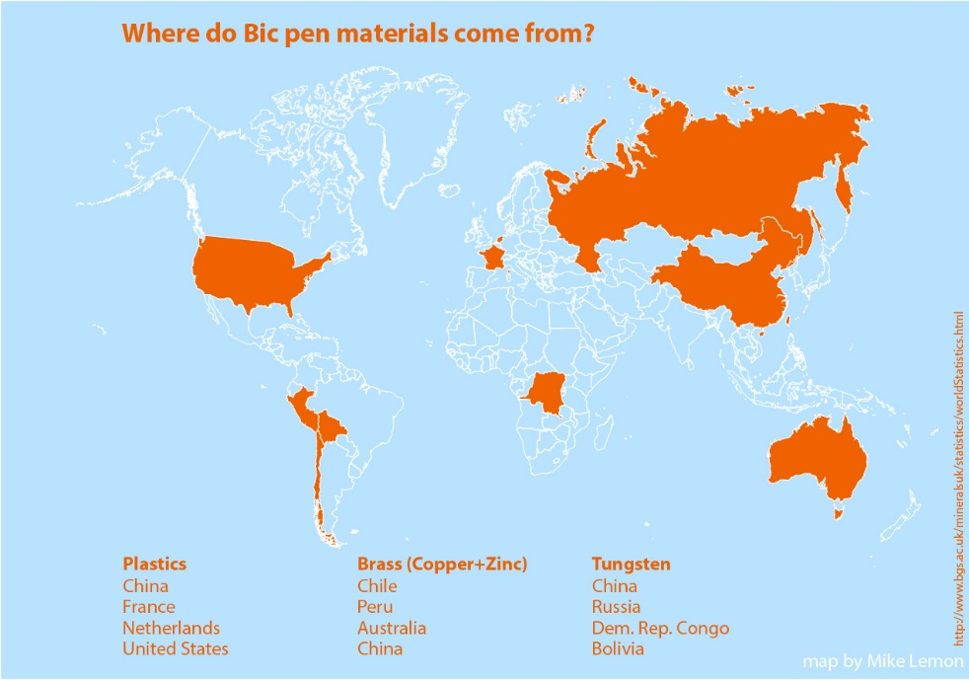
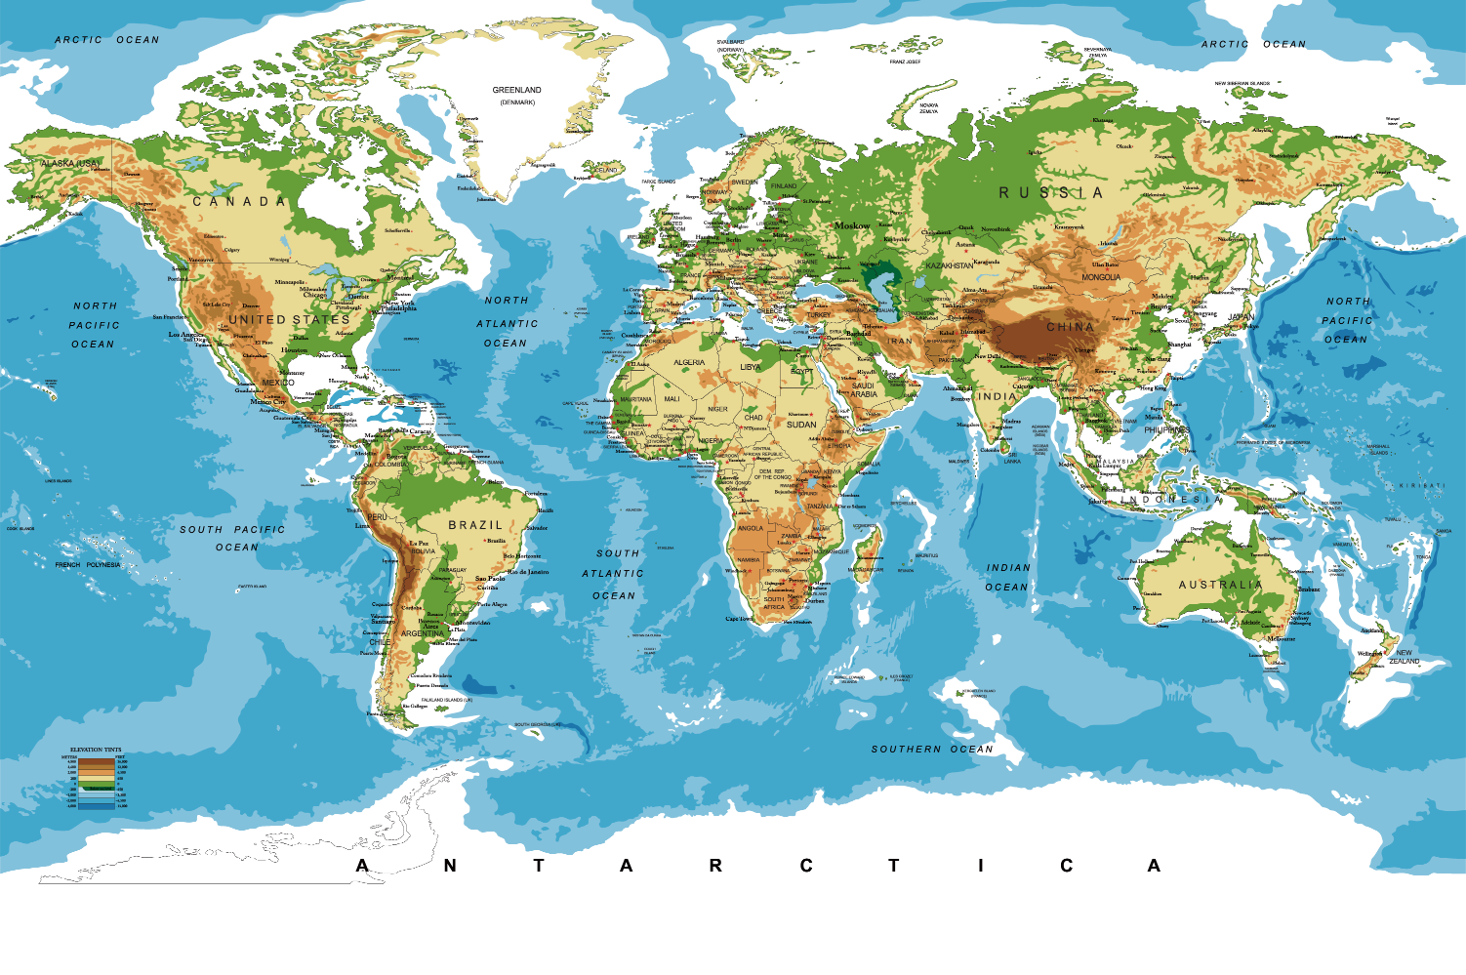
Where do the materials in a Bic biro come from?
https://u.osu.edu/bicpens/02-raw-materials/
This Photo by Unknown Author is licensed under CC BY-NC

Slide 17
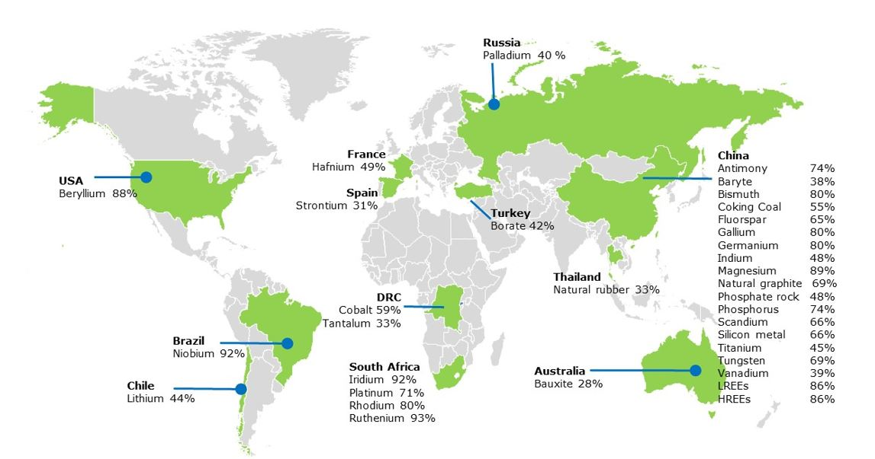
Critical Raw Materials (CRMs)
From: https://ec.europa.eu/jrc/en/news/jrc-assesses-critical-raw-materials-europe-s-green-and-digital-future

Slide 18
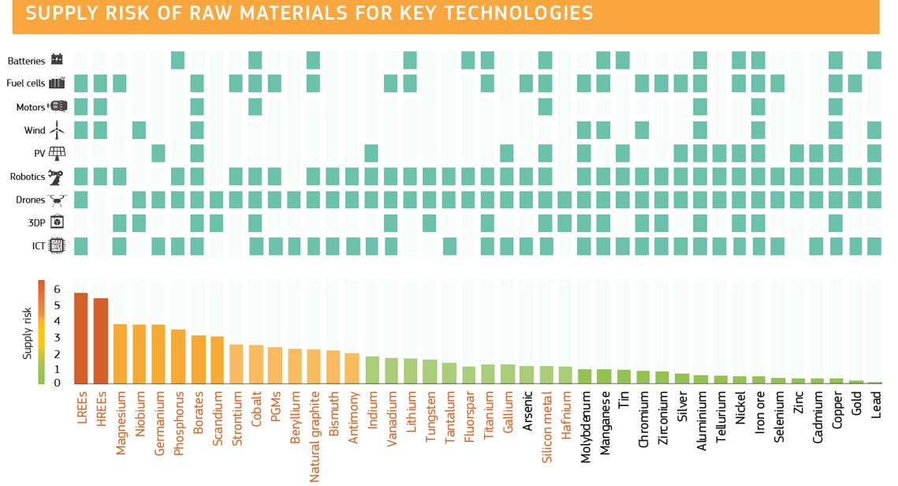
What CRMs get used in?
From: https://ec.europa.eu/jrc/en/news/jrc-assesses-critical-raw-materials-europe-s-green-and-digital-future

Slide 19
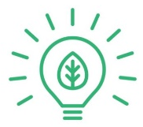


The 6 Rs
Rethink: Do we make too many products? Design in a way that considers people and the environment.
Refuse: Don’t use a material or buy a product if you don’t need it or if it’s bad for people or the environment.
Reduce: Cut down the amount of material and energy you use as much as you can.
Reuse: Use a product to make something else with all or parts of it.
Recycle: Reprocess a material or product and make something else.
Repair: When a product breaks down or doesn’t work properly, fix it.
(Practical Action, 2021)
Notes:
Symbols adapted from https://theveganreview.com/the-6-rs-of-sustainability-what-does-sustainable-really-mean/

Slide 20
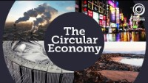
The circular Economy
(EMF, 2019)

Slide 21
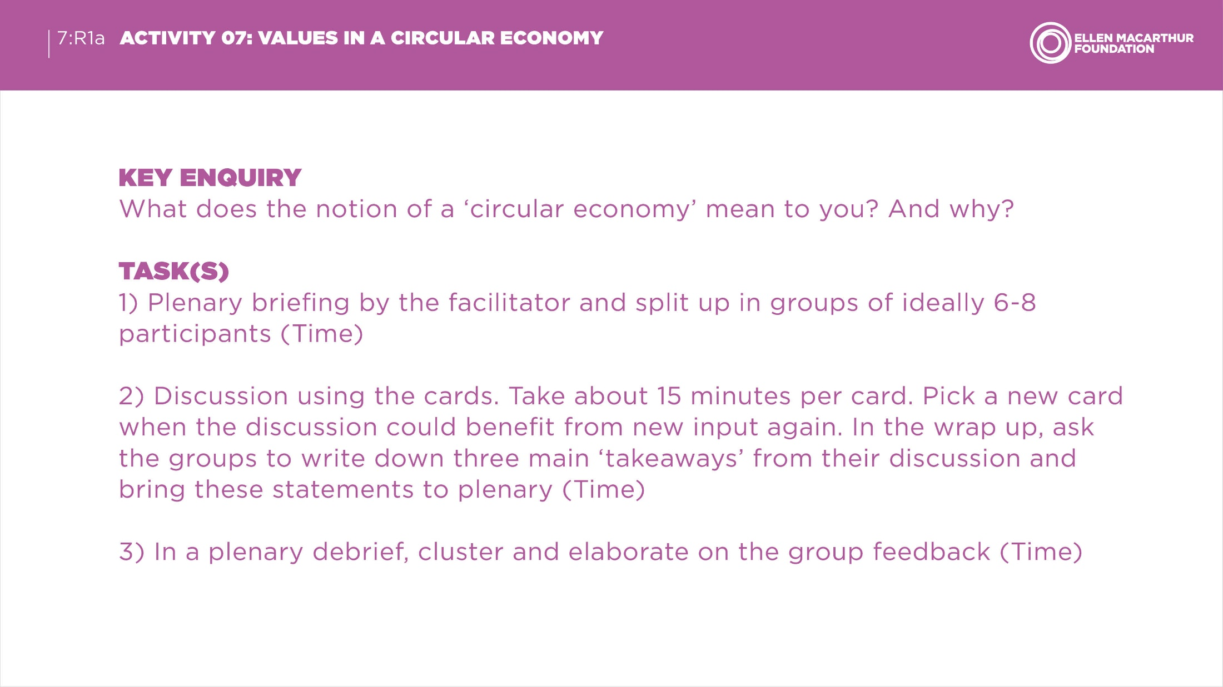
Ellen MacArthur Foundation Task

Slide 22

Discuss: What is the impact of not teaching sustainable design?

Slide 23
Valuing and the Fashion industry
What do our choices say about what we value?

Slide 24
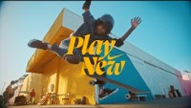
What values can you spot?

Slide 25
Discuss: What does our choices of products say about us?

Slide 26


What other values have we missed

Slide 27
Highly Recommended Reading
Petrina, S. (2000). The political Ecology of Design and Technology Education: An Enquiry into Methods. International Journal of Technology and Design Education, 10(3), pp.207-237. DOI: 10.1023/A:1008955016067
ABSTRACT: At the beginning of this new century, design and technology educators face a serious dilemma: Practice conventional modes of design and technology, which have consumed proponents in Canada, England, Germany, and the US, or model design for sustainable lifestyles. Our conventional design, problem solving and technological methods embody a liberal, political ecology and in effect, these methods – our practices – are not sustainable. Using the political ecology of Nike shoes as an example, I describe ecological footprints, resource streams, and wakes as effective metaphors for sustainable practice. In contradistinction to technocentric methods, I argue for modelling ecocentric processes rooted in political ecology and cultural studies. Attending to the political ecology of design and technology means nothing less than remodelling the design of lifestyles and reducing production and consumption in our practice. Keywords: cultural studies, design, design and technology education, ecodesign, ecopedagogy, Nike, political ecology, problem solving

Slide 28



Resources for Values in D&T
Ellen MacArthur Foundation – circular economy
  How we make Stuff – website based on a pop-up book
Practical Action – sustainability
Your Turn: make your mark in design – design thinking

Slide 29
References page 1 of 2
Ellen MacArthur Foundation (n.d.). Teaching Resources [webpage]. Available at https://ellenmacarthurfoundation.org/resources/education-and-learning/teaching-resources [accessed 29/11/2021]
Ellen MacArthur Foundation (2019). Humans Changed the Face of the Earth, Now We Rethink Our Future | Ellen MacArthur Foundation [video]. Accessed at https://ellenmacarthurfoundation.org/topics/circular-economy-introduction/overview [accessed 29/11/2021]
Hattie, J. (2009). Visible Learning: a synthesis of over 800 meta-analyses relating to achievement. Oxon, UK: Routledge.
Intel (2007). Designing Effective Projects: Questioning - The Socratic Questioning Technique [electronic document]. Retrieved from https://www.intel.com/content/dam/www/program/education/us/en/documents/project-design/strategies/dep-question-socratic.pdf [accessed 29/11/2021]
Krathwohl, D. R., Bloom, B. S., & Masia, B. B. (1973). Taxonomy of Educational Objectives, the Classification of Educational Goals. Handbook II: Affective Domain. New York: David McKay Co., Inc.

Slide 30
References page 2 of 2
Layton, D. (1992). Values in design and technology. In C. Budgett-Meakin, ed. Make the Future Work: Appropriate Technology – A Teachers Guide, Harlow, Essex: Longman.
Martin, M. (2021). Values in design and technology. In A. Hardy (Ed.), Learning to teach design and technology in the secondary school: a companion to school experience (4th Edition). Abingdon, UK: Routledge.
Practical Action (2021). 6Rs: Rethink, Refuse, Reduce, Reuse, Recycle, Repair [webpage]. Available at https://practicalaction.org/schools/6-rs/ [accessed 29/11/2021]

