Slide 1
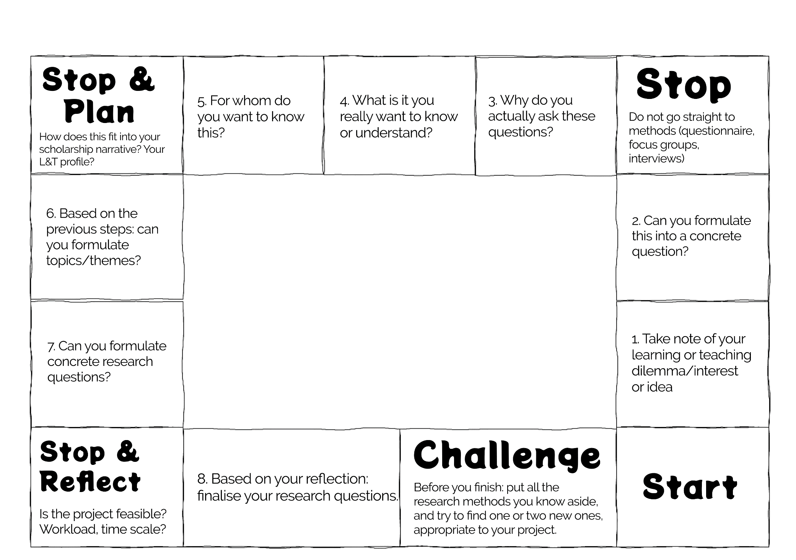
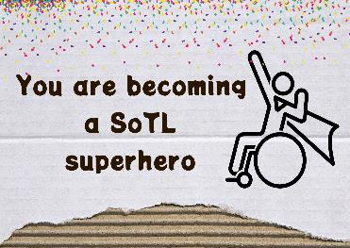
Questionopoly: How to get to your SoTL research question, and prevent yourself from going down the rabbit hole
Drag and drop one of the motivational cards from the centre of the board over each field you have finished
CC BY ND 4.0 Nathalie Tasler

