Slide 1
Students as Partners co-creating innovative scholarship: Reflections on achievements using the 4M framework
Sue Beckingham, Sheffield Hallam University
Research in Distance Education Conference #RIDE2021

Slide 2
‘Students as Partners co-creating innovative scholarship: Reflections on achievements using the 4M framework’
This presentation will share the outcomes (what the students gained) and the outputs (co-created resources) of a Students as Partners initiative which began by looking at how social media could be used in learning and teaching within their own course. Initially set up as an extracurricular short term project in 2017, it continued and has evolved over four years.
Adopting the 4M framework reflections on achievements will be considered using the following set of lenses: micro (individual); meso (departmental); macro (institutional); and mega (broader [higher] education community).

Slide 3
Students as Partners (SaP)
Cook-Sather et al (2014:6-7) define a student-faculty partnership as a:
“Collaborative, reciprocal process through which all participants have the opportunity to contribute equally, although not necessarily in the same ways, to curricular or pedagogical conceptualization, decision making, implementation, investigation, or analysis."

Slide 4
Types of SaP roles
Consultant: sharing and discussing valuable perspectives on learning and teaching.
Co-researcher: collaborating meaningfully on teaching and learning research or subject based research with staff.
Pedagogical co-designer: sharing responsibility for designing learning, teaching and assessment.
Representative: student voices contributing to decisions in university settings
(Bovill et al 2015:3)

Slide 5
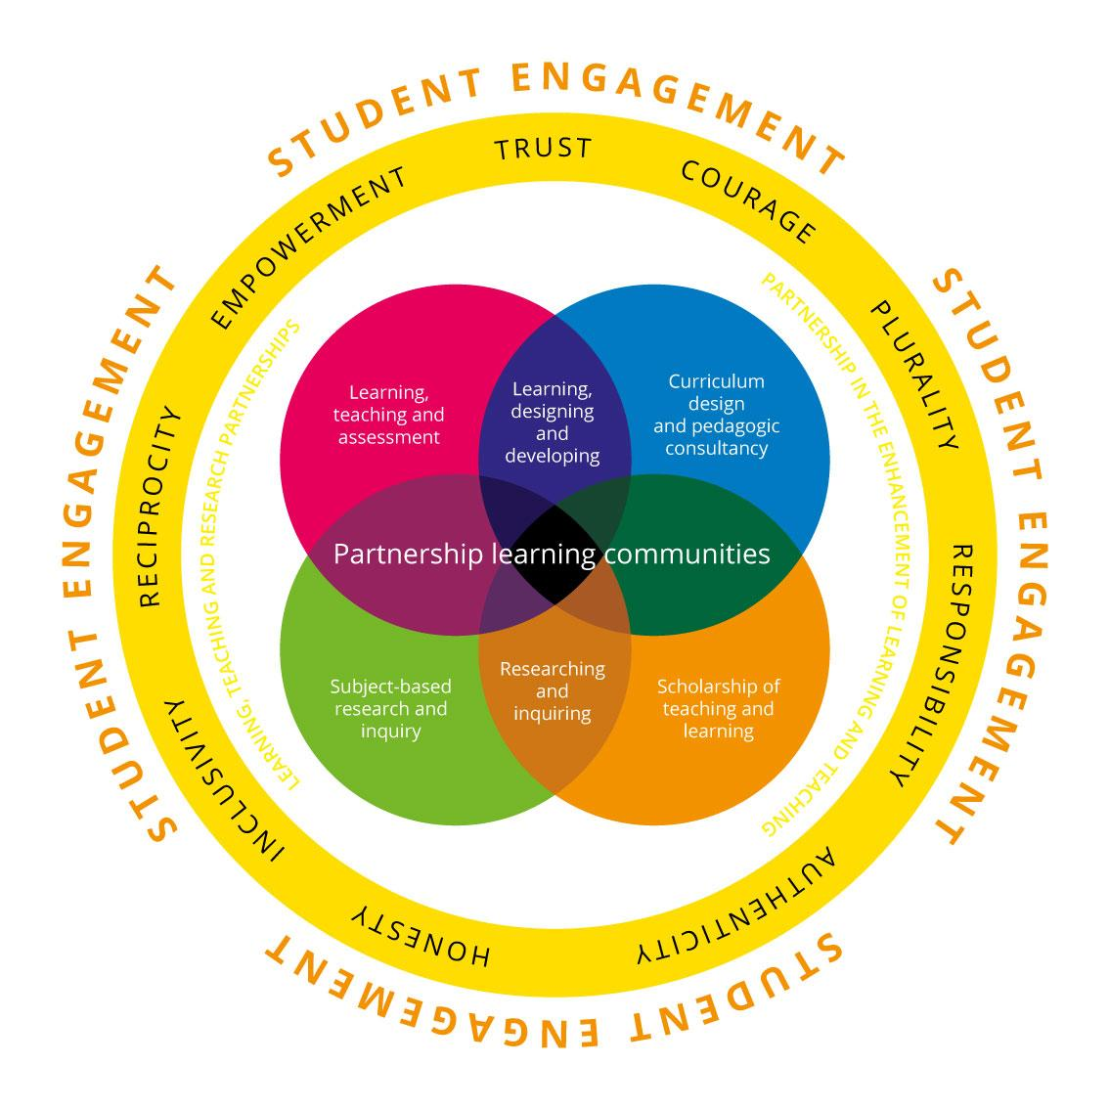
HEA Framework for partnership in learning and teaching
HEA 2014

Slide 6
Students as Partners Values
authenticity | all parties have a meaningful rationale for investing in partnership, and are honest about what they can contribute and the parameters of partnership
inclusivity | partnership embraces the different talents, perspectives and experiences that all parties bring, and there are no barriers (structural or cultural) that prevent potential partners getting involved
reciprocity | all parties have an interest in, and stand to benefit from, working and/or learning in partnership
empowerment | power is distributed appropriately and all parties are encouraged to constructively challenge ways of working and learning that may reinforce existing inequalities
trust | all parties take time to get to know each other, engage in open and honest dialogue and are confident they will be treated with respect and fairness
challenge | all parties are encouraged to constructively critique and challenge practices, structures and approaches that undermine partnership, and are enabled to take risks to develop new ways of working and learning
community | all parties feel a sense of belonging and are valued fully for the unique contribution they make
responsibility | all parties share collective responsibility for the aims of the partnership, and individual responsibility for the contribution they make
(HEA 2014 cited by Healey et al 2014)

Slide 7
The 4M Framework
(Friberg, 2016)
Used as a lens to consider how the Scholarship of Learning and teaching (SoTL) was disseminated

Slide 8
The 4M Framework
Micro
Individual level
Personal reasons for engaging in SoTL
Meso
Department level
Importance of ongoing collegial and leadership support
Macro
Institutional level
Beyond the institution
Mega
Making connection across disciplinary boundaries
Discipline and interdisciplinary, national and international impact
Adapted from Simmons and Taylor (2019) and Simmons (2020)

Slide 9
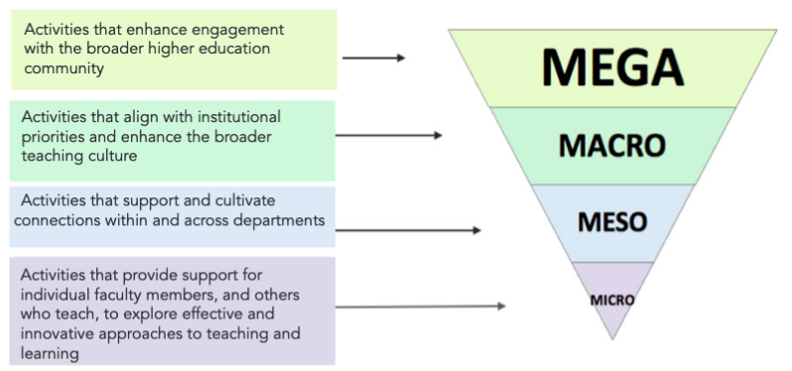
https://teaching.utoronto.ca/sotl/scholarship-of-leading/sl-introduction/

Slide 10
A Students as Partners Case Study
https://blogs.shu.ac.uk/socmedhe
Through the 2nd conference #SocMedHE16 students could apply for free places

Slide 11
SMASH = 'Social Media for Academic Studies at Hallam'
SMASH is a ‘students as partners’ project which considers the potential of social media for learning.
The aim of this student-led special interest group was to relook at the affordances digital and social media tools can provide in learning and teaching.

Slide 12
Exploring new approaches
"While mobile technology is not and never will be an educational panacea, it is a powerful and often overlooked tool – in a repertoire of other tools – that can support education in ways not possible before” (UNESCO 2013)
Unique benefits of mobile learning include:
anytime/anywhere learning, personalised learning, active learning, bridging of formal/informal learning, inclusive learning, and can improve communication and interaction.

Slide 13
Planning achievable outputs
“Scholarship [including SoTL] entails an artefact, a product, some form of community property that can be shared, discussed, critiqued, exchanged, built upon.”
Lee Schulman (1993)

Slide 14
Students as Partners
Co-developed an initial framework:
Helping staff to identify and use social media tools for communication and collaboration within and beyond the classroom (Learning Activities).
Helping students and staff to identify and use relevant social media tools to curate and organise information relating to learning (Organising Learning).
Helping students to prepare digital portfolios to openly share outcomes and projects to develop a professional online presence (Showcasing Learning).

Slide 15
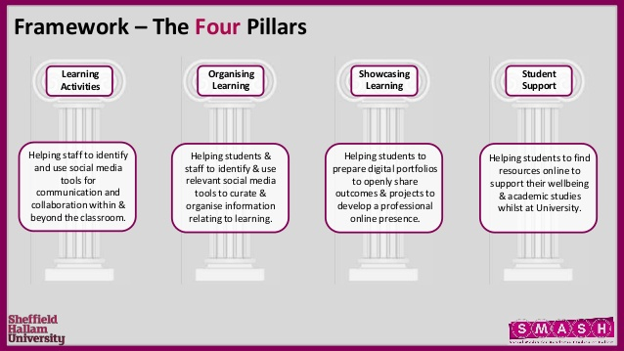
Students as Partners
Co-developed a 4th pillar

Slide 16
Reflecting on achievements using the 4M framework
micro
mega
meso
macro

Slide 17
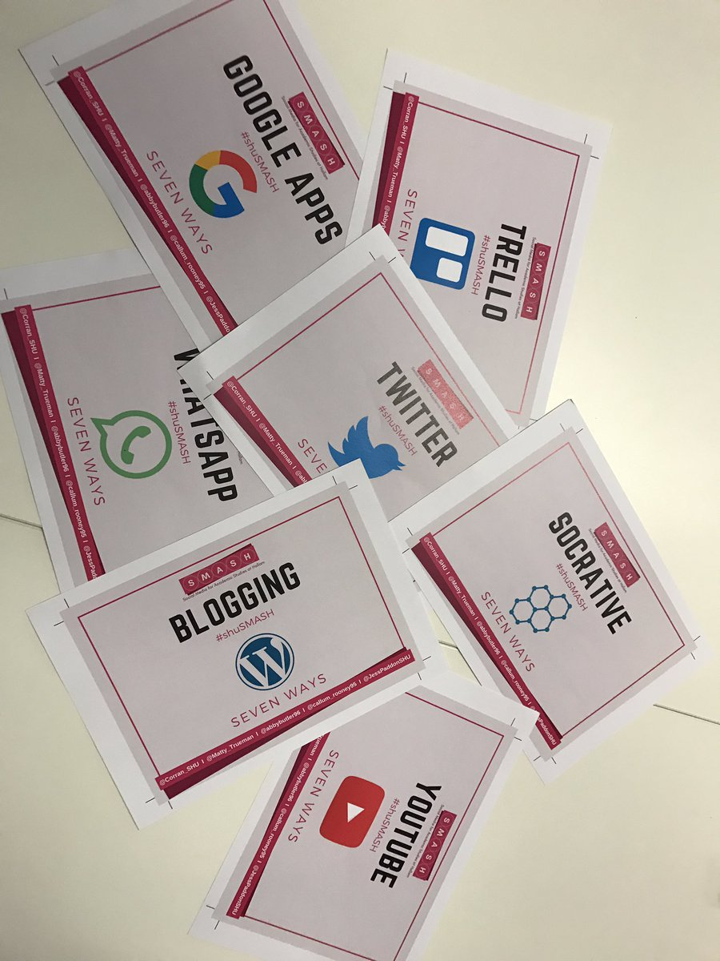
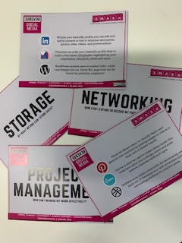
meso (departmental)
Workshops inviting staff and students
7 ways to use... [card set] https://socialmediaforlearning.com/smash/7-ways-cards/
Reverse social media [card set]
https://socialmediaforlearning.com/smash/reverse-social-media-card-set/

Slide 18
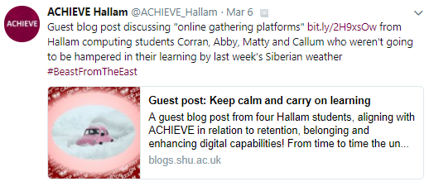
macro (institutional)
Learning through disruption
2018 #TheBeastFromTheEast
First guest post for the University blog
Notes:
https://blogs.shu.ac.uk/narrowingthegaps/2018/03/04/guest-post-keep-calm-and-carry-on-learning/

Slide 19
macro (institutional)
Co-presenting with students:
Social Media for Learning Conference, Sheffield Hallam University #SocMedHE17

Slide 20
macro (institutional)
Guest blog posts:
A Remote Learning Guide written by Students for Students: How to ensure your remote learning experience is effective, supportive and fun.
A student toolkit to help you tackle remote learning written by students for students
8 ways students and staff can engage in remote collaboration
Learning through the disruption of COVID

Slide 21
macro (institutional)
Guest blog posts:
A Remote Learning Guide written by Students for Students: How to ensure your remote learning experience is effective, supportive and fun. https://socialmediaforlearning.com/2020/03/31/guest-post-2-a-remote-learning-guide-written-by-students-for-students-how-to-ensure-your-remote-learning-experience-is-effective-supportive-and-fun-shusmash/
A student toolkit to help you tackle remote learning written by students for students https://socialmediaforlearning.com/2020/03/22/guest-post-a-student-toolkit-to-help-you-tackle-remote-learning-written-by-students-for-students/
8 ways students and staff can engage in remote collaboration https://socialmediaforlearning.com/2019/02/02/student-guest-post-8-ways-students-and-staff-can-engage-in-remote-collaboration/
Keep calm and carry on learning! https://socialmediaforlearning.com/2018/03/04/guest-post-keep-calm-and-carry-on-learning-by-students-corran_shu-abbybutler96-matty_trueman-callum_rooney95/

Slide 22
mega (broader [higher] education community)
Co-presenting at conferences:
Change Agents Conference, University of Winchester #CAN18
Social Media for Learning Conference, Edge Hill University #SocMedHE19
BETT Conference 2020, London ExCel [Invited speakers] #BETT2020

Slide 23
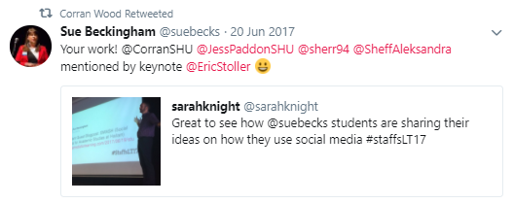
mega (broader [higher] education community)
The SMASH work cited by others

Slide 24
mega (broader [higher] education community)
Co-publishing with students
Beckingham, S., Wood, C., Paddon, J., Butler, A., Trueman, M. and Rooney, C. (2019) A SMASHing approach for developing staff and student digital capabilities within a Community of Practice. Journal of Educational Innovation, Partnership and Change, 5(1) 'Championing Student-Staff Partnerships in an Age of Change.'
Further publications
Beckingham, S. (2020) Co-creating Learning Experiences with Students as Partners. Journal of Social Media for Learning, 1(1), pp 70-77, 2019 SocMedHE Conference Edition. https://doi.org/10.24377/LJMU.jsml.vol1article394
Beckingham S. (2019) SMASH: Social Media for Academic Studies at Hallam. [Case Study 4.3 pp 52-53] In P. Kahn and L. Anderson Developing Your Teaching Towards Excellence 2nd Edn. Abingdon: Routledge

Slide 25
micro (individual)
Developing Digital Capabilities
“I’ve gained experience surrounding the use of social media to enhance learning and efficient collaboration” Callum
“I’ve learnt the benefits of multiple social media technologies and how they can benefit learning.” Abby
“Over the past two years, I have learnt about the flexibility of social media, how it can be used in education from many different directions & ultimately, how to work in a team of diverse people.” Corran
“I’ve learnt how to create engaging content using digital tools such as Canva for my social media campaigns” Matty
“I’ve learnt how to overcome communication obstacles throughout this year, and the sheer amount of research on social media there is to be done” Jess

Slide 26
“Greater digital knowledge gained through discussion and companionship” Matty
“Developing a rapport with team members from different backgrounds through digital platforms” Callum
micro (individual)
“Enhancing learning through partnerships with other students ” Abby
“Using apps such as Skype allow us to meet virtually in any location, allowing us to keep flexible with our studies” Corran

Slide 27
Overall achievements

Slide 28
The value of a virtual community of practice (VCoP)
Key themes:
Peer learning - the significance of helping others learn;
Confident communication - learning to utilise different media to suit the situation and task at hand;
Companionship and teamwork - taking ownership and supporting each other to work collaboratively;
Transferable skills - recognition that these skills can be applied in the workplace.
(Beckingham et al 2019)

Slide 29
An open educational resource
https://socialmediaforlearning.com/smash/

Slide 30
Thank you for listening.
Any questions

Slide 31
References
Beckingham, S. (2020) Co-creating Learning Experiences with Students as Partners. Journal of Social Media for Learning, 1(1), pp 70-77, 2019 SocMedHE Conference Edition. https://doi.org/10.24377/LJMU.jsml.vol1article394
Beckingham, S., Wood, C., Paddon, J., Butler, A., Trueman, M. and Rooney, C. (2019) A SMASHing approach for developing staff and student digital capabilities within a Community of Practice. Journal of Educational Innovation, Partnership and Change, 5(1) 'Championing Student-Staff Partnerships in an Age of Change'. Available from: https://journals.studentengagement.org.uk/index.php/studentchangeagents/article/view/923/pdf
Bovill, C., Cook-Sather, A., Felten, Millard, L. and Moore-Cherry, N. (2015) Addressing potential challenges in co-creating learning and teaching: overcoming resistance, navigating institutional norms and ensuring inclusivity in student-staff partnerships. Higher Education. http://dx.doi.org/10.1007/s10734-015-9896-4
Cook-Sather, A., Bovill, C. and Felten, P. (2014) Engaging Students as Partners in Learning and Teaching. San Francisco: Jossey-Bass.
Friberg, J. (2016) Might the 4M Framework Support SoTL Advocacy? The SoTL Advocate Blog.
https://illinoisstateuniversitysotl.wordpress.com/2016/07/11/might-the-4m-framework-support-sotl-advocacy/

Slide 32
References cont.
HEA (2014) Framework for partnership in learning and teaching. Higher Education Academy. Available from: https://www.advance-he.ac.uk/guidance/teaching-and-learning/student-engagement-through-partnership
Healey, M., Flint, A. and Harrington, K. (2014) Engagement through partnership: students as partners in learning and teaching in higher education. Available from: https://www.advance-he.ac.uk/knowledge-hub/engagement-through-partnership-students-partners-learning-and-teaching-higher
Shulman, L. S. (1993) Teaching as Community Property: putting an end to educational solitude. Change 25, pp 6-7. Available at: https://doi.org/10.1080/00091383.1993.9938465
Simmons, N. (2020). The 4M framework as analytic lens for SoTL’s impact: A study of seven scholars. Teaching & Learning Inquiry, 8(1), 76-90. https://doi.org/10.20343/teachlearninqu.8.1.6
Simmons, N., & Taylor, K. L. (2019). Leadership for the scholarship of teaching and learning: Understanding bridges and gaps in practice. The Canadian Journal for the Scholarship of Teaching and Learning, 10(1), 1-18. https://doi.org/10.5206/cjsotl-rcacea.2019.1.7995
UNESCO (2013) UNESCO policy guidelines for mobile learning. Available at:
http://unesdoc.unesco.org/images/0021/002196/219641e.pdf
Wuetherick, B. & Yu, S. (2016). The Canadian teaching commons: The scholarship of teaching and learning in Canadian higher education. New Directions in Teaching & Learning. https://doi.org/10.1002/tl.20183

