Slide 1
Using creative play to stimulate digital reflective practice and double loop learning Sue Beckingham | @suebecks Sheffield Hallam University

Slide 2
Van Vliet, V. (2012)

Slide 3
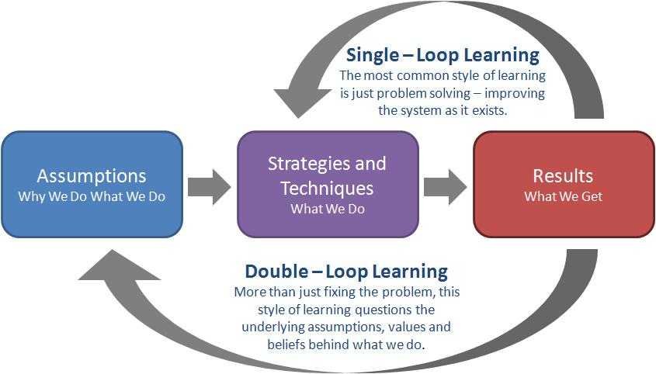
Bryant 2009

Slide 4
Action Learning Questions
What am I trying to do?
What is stopping me from doing it?
What can I do about it
Who knows what I am trying to do?
Who else can do anything to help?
Bryant 2009

Slide 5
Double Loop Reflective Practice
Reflect
Summarise
Feedback
'single loop learning'
Adjust
Revise Action Plan
'double loop learning'

Slide 6
Activity 1: Lego Serious Play
BUILD
Reflect
Summarise
Feedback
'single loop learning'
Adjust
Single loop learning

Slide 7
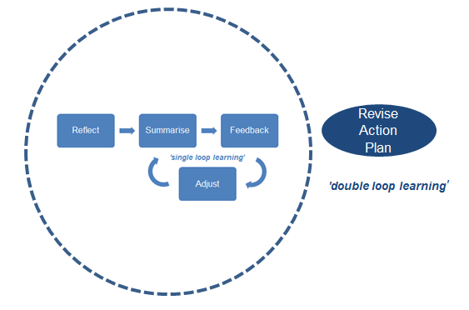
Activity 2: Digital Artefact
Creating digital artefacts using a phone or tablet
Double loop learning

Slide 8
A quick intro to LSP
Lego Serious Play (LSP) can be used to engage discussions around topics such as barriers and enablers of effective teams, and skills development. Participants use the bricks to build metaphorical representations and share stories based on these. It provides an effective way for self-expression that is non-threatening way and opens up opportunities to learn from each other

Slide 9
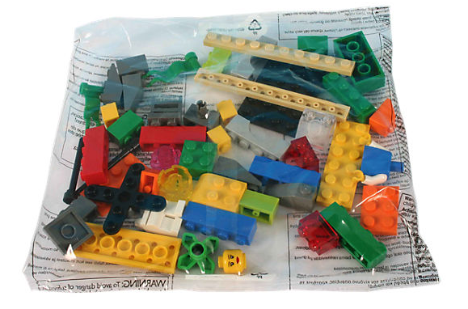
You will need
Identical packs of Lego
Mobile phone or tablet
Take photos or video clips as you go along

Slide 10
LSP warm up
Everyone builds and everyone shares
Build a tower

Slide 11
LSP task 1
Build a model that tells a story about a team you have worked in where you felt valued. What did this look like?

Slide 12
LSP task 2
Build a model that tells a story about a skill you feel contributes to good team work.

Slide 13
LSP task 3
Build a model that tells a story about a skill you feel need to develop as a member of an effective team.

Slide 14
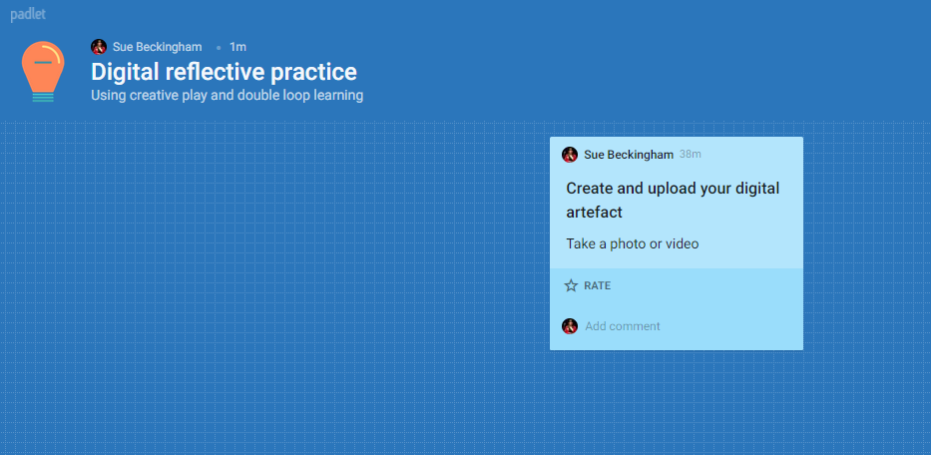
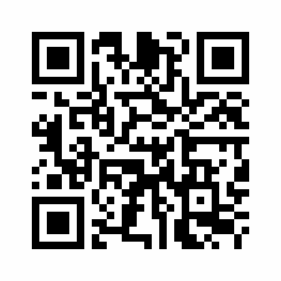
Digital space: Padlet
https://padlet.com/suebecks/digitalreflectivepractice
or scan this
QR code
Notes:
QR code generator https://www.qr-code-generator.com/

Slide 15
Digital space: Padlet
Double click the screen to add your artefact
Options to:
Rate, like and score
Leave comments
https://padlet.com/

Slide 16
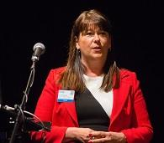
Sue Beckingham | @suebecks
National Teaching Fellow and Principal Lecturer at Sheffield Hallam University with a research interest in the use of social media in education.
Blog: http://socialmediaforlearning.com/
LinkedIn: linkedin.com/in/suebeckingham

