Slide 1
Digital Re-Innovation: Technovation for Learning
Sue Beckingham | @suebecks
Keynote at Keele Digital Festival 2018 #Keeledigifest

Slide 2
Defining | Innovation
The Latin origin of innovation or
'innovare', which means 'to make something new'
To make something new' refers to replacing old concepts or products with new ones, continually updating and improving them.

Slide 3
Innovation
To make something new one has to:
Generate or realise a new idea (invention and creativity)
Develop this idea into a reality or product (realisation)
Implement and market this new idea (implementation)
Mentz 2006

Slide 4
Defining | Technical Innovation
When introducing a concept such as technology into the meaning of innovation, and defining the term 'Technological Innovation', the following changes occur:
Generate or realise a new idea, based on technology, capability or knowledge (Invention)
Develop this into a reality or product (realisation)
Diffuse, implement and market this new idea, technology, capability or knowledge (implementation)
Mentz 2006

Slide 5
Re|framing innovation
Re-innovation, an extension of innovation, is renowned for its potential in creating competitive advantage with reduced cost and time implications.
It is defined as the part of new product development which studies the extension of existing innovations, which can only happen after the first generation of a new product is launched.
Being built upon early successful products, re-innovative products are created through applying new platforms, new components, or new configurations with breakthrough technologies to its previous products or manufacturing processes.
Cheng and Shiu (2008)

Slide 6
RE-innovation
RADICAL innovation
INCREMENTAL innovation
Re-innovation is based on a previously successful new product which was or is on the market; using breakthrough technologies to generate a new product through new platforms, new components, new configurations, or new manufacturing processes.
A radically new product involves an entirely new product category which relies on technology never used in the industry before; which had impact on or causes significant changes in the whole industry; and which is totally new to the market.
An incremental new product can be defined as products that provide new features, benefits, or improvements through the existing technology to the existing market. (improvements within a same platform)
Practical examples include the Apple iPhone (breakthrough technologies within new platforms), and early mobile phone with built-in digital camera (new components within new platforms).
Practical examples include a digital camera (from a traditional camera), PCs, CD (from tapes), Windows systems (from DOS).
Practical examples include the pixel of a digital camera being improved from 2 mega bites to 4 mega bites or the life of battery in laptops being improved from 2 hours to 6 hours
Re‐innovation is combining the existing with the new
Adapted from Cheng and Shiu (2008)

Slide 7
Rethink | innovation
Innovation is the creation of a viable new offering
innovation is not just invention
innovations have to earn their keep
very little is truly new innovation
innovations extend beyond products
Keeley et al (2013)

Slide 8
10 types of | innovation
1. PROFIT MODEL
2. NETWORK
3. STRUCTURE
4. PROCESS
5. PRODUCT PERFOMRANCE
6. PRODUCT SYSTEM
7. SERVICE
8. CHANNEL
9. BRAND
10. CUSTOMER ENGAGEMENT
Keeley et al (2013)

Slide 9
Benefits of | re-innovation
Most studies of the management of the technological innovation process cover the range of activities that culminate in the commercial introduction of a new product. In certain sectors of industry, however, especially those characterised by extended product lifecycles, continued competitiveness depends on vigorous and continuous product improvement, i.e. on the process of ‘re‐innovation’ to satisfy evolving user requirements.
Two key characteristic patterns of re‐innovation identified in this research.
The first characteristic pattern is re‐innovation combining the existing with the new. Two brief case studies are presented. In both cases, the manufacturer and customer gained significant benefits from this re‐innovation strategy. For the manufacturer there were reduced development and testing costs, scale and learning curve benefits, distributed inventories of spares and servicing experience. For the customer there were familiarity benefits and reduced entry risks associated with proven reliability of parts and sub‐systems.
The second, and more general pattern of re‐innovation is based on the concept of the ‘robust design’. This is a basic design which has sufficient inherent technological slack or flexibility to enable it to evolve into a significant design family of variants. Product design families offer the producer economies of scale in R&D, manufacturing, marketing and sales and servicing. They offer the user learning from experience, the enhanced possibility of user‐inspired modifications, a wider range of price/ performance packages and rapid adaptations to changing environments. Robust designs can effectively combine economies of scale with economies of scope; they are strategically more flexible than leanly configured designs which satisfy only transient user requirements.
Rothwell and Gardiner 1989

Slide 10
Innovation | mostly fails
"Innovation mostly fails. It doesn't need to. You shouldn't let it.
Innovation almost never fails due to a lack of creativity. it's almost always because of a lack of discipline.
The most certain way to fail is to focus on products. Successful innovators use many types of innovation"
Keeley et al 2014

Slide 11
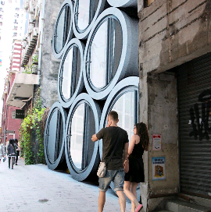
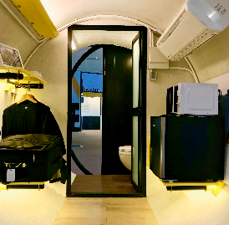
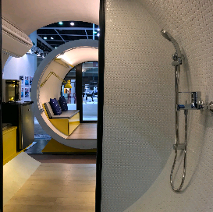
Living in a box or | an O Pod
Notes:
https://youtu.be/3aZhWV1fN7Y and http://www.jameslawcybertecture.com/?section=projects&id=1087

Slide 12
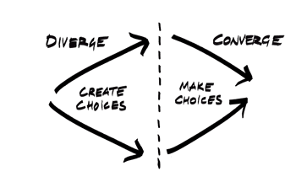
Divergent | vs convergent thinking
divergent thinking—the exploration of new choices and alternative solutions
Brown 2011
blue sky thinking
imagination
innovate
generate new ideas
judgement
testing
evaluating
decision making
Notes:
Source: https://ssir.org/articles/entry/why_social_innovators_need_design_thinking

Slide 13
Design thinking | seek divergent views
"When deciding on a course of action, people in organizations often push far too quickly for a convergence of opinion. As a result, they miss the chance to draw on the different intuitions and perspectives that their colleagues undoubtedly have.
Instead, start by listening to those who have serious concerns about a proposed course of action. Soliciting divergent views up front can lead not just to alternative answers to a given question, but to new ideas for reframing the entire question. It can also help create genuine alignment around the decision that you eventually reach."
Nilsson and Paddock 2014
Notes:
Source: https://ssir.org/articles/entry/social_innovation_from_the_inside_out

Slide 14
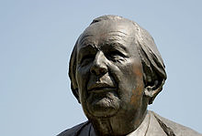
Empowering | active thinking
Constructivism is about construction - to construct is to be active, hence constructivism is about actively involving and engaging learners.
Fisher et al 2014
Jean Piaget 1896-1980 - Founder of constructivism

Slide 15
Situating | constructionism
"Constructionism--the N word as opposed to the V word--shares constructivism's connotation of learning as 'building knowledge structures' irrespective of the circumstances of the learning. It then adds the idea that this happens especially felicitously in a context where the learner is consciously engaged in constructing a public entity, whether it's a sand castle on the beach or a theory of the universe...
If one eschews pipeline models of transmitting knowledge in talking among ourselves as well as in theorizing about classrooms, then one must expect that I will not be able to tell you about my idea of constructionism. Doing so is bound to trivialize it. Instead, I must confine myself to engage you in experiences (including verbal ones) liable to encourage your own personal construction of something in some sense like it. Only in this way will there be something rich enough in your mind to be worth talking about. "
Papert and Hidel 1991
Notes:
Papert, S. and Harel, I. (1991) Situating Constructionism - Chapter 1. In Constructionism. Ablex Publising Corporation. Available at: http://web.media.mit.edu/~calla/web_comunidad/Reading-En/situating_constructionism.pdf

Slide 16
Situating | constructionism
Constructionism is not just learning-by-doing, but engaging reflexively and socially in the task. Both the creation process and the produced artefacts ought to be socially shared.
Papert and Hidel 1991

Slide 17
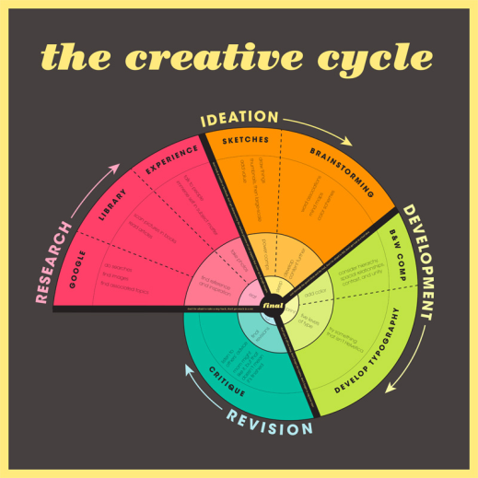
The | creative cycle
Notes:
Source: http://www.codywallis.com/?category=design&page=processposter

Slide 18
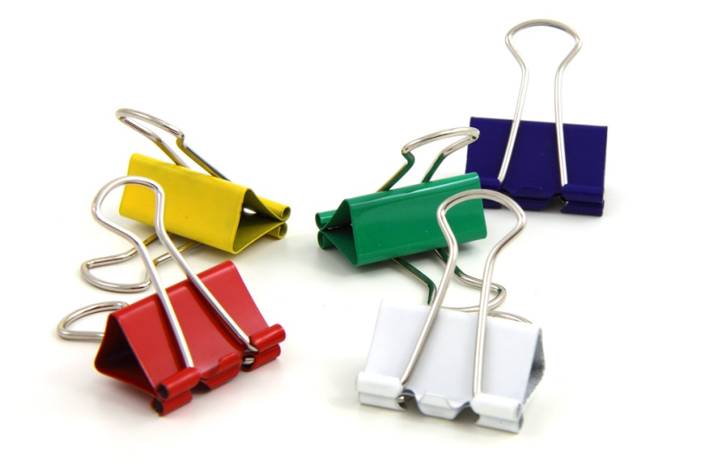
The binder clip | challenge

Slide 19
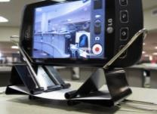
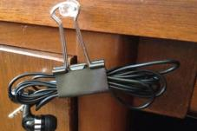
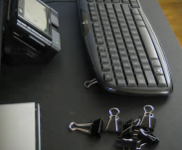
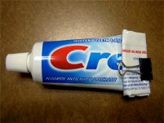
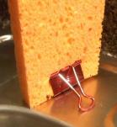
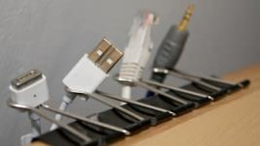
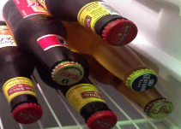
DIY | innovations
Credit: https://lifehacker.com/5927857/top-10-diy-miracles-you-can-accomplish-with-a-1-binder-clip

Slide 20
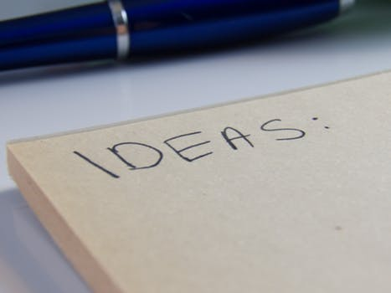
Developing | new ideas

Slide 21
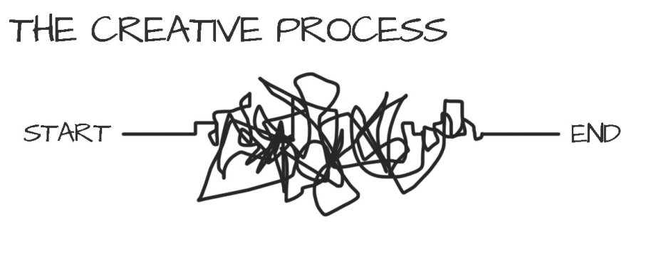
The | creative process
....is | messy
Notes:
Source: https://thevirtualinstructor.com/blog/the-creative-process

Slide 22
Creating | digital fusions

Slide 23
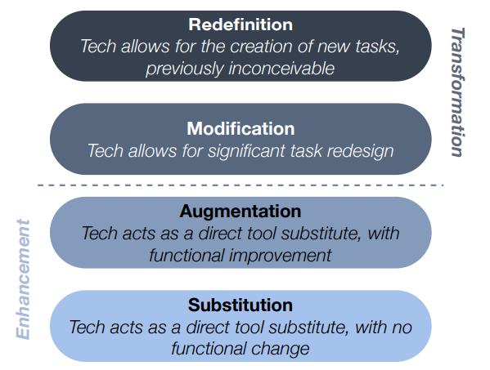
SAMR | enhancement > transformation
Puentedura 2014
Notes:
Source: http://www.hippasus.com/rrpweblog/archives/2014/06/29/LearningTechnologySAMRModel.pdf

Slide 24
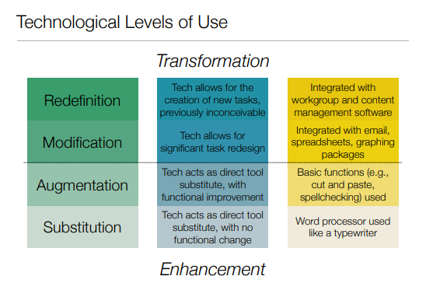
SAMR | Technological levels of use
Puentedura 2004
Notes:
http://hippasus.com/resources/tte/puentedura_tte.pdf

Slide 25
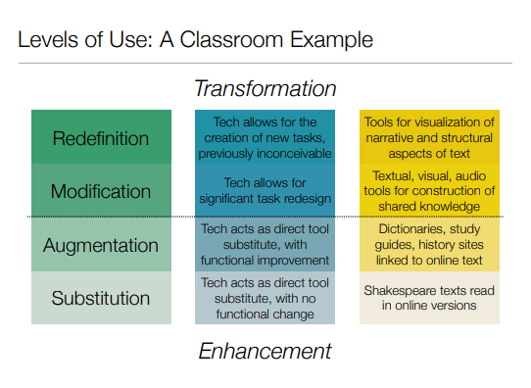
SAMR levels of use Classroom examples
Puentedura 2004
Notes:
Source: http://hippasus.com/resources/tte/puentedura_tte.pdf

Slide 26
Technological | avenues to innovation
Visualization and Simulation
Social Computing
Digital Storytelling
Educational Gaming
Puentedura 2004

Slide 27
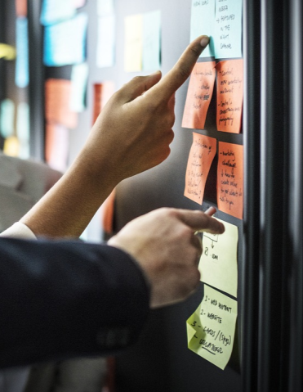
Digitising | ideas

Slide 28
Digitally | storytelling

Slide 29
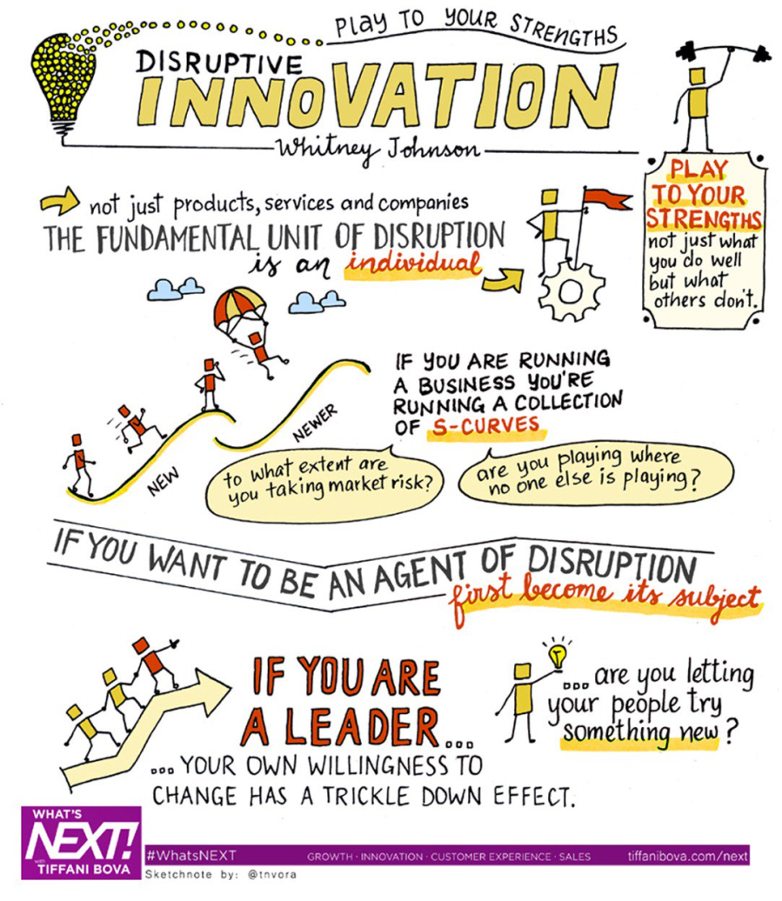
Digital | sketch notes
https://twitter.com/landryst/status/1001416360260333569

Slide 30
Idea | jar
Idea Jar

Slide 31
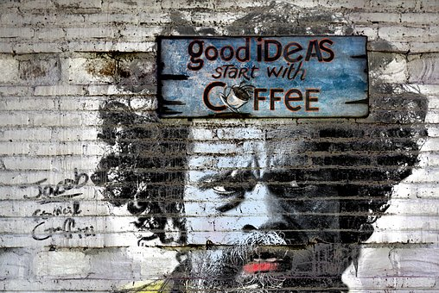
Idea | wall

Slide 32
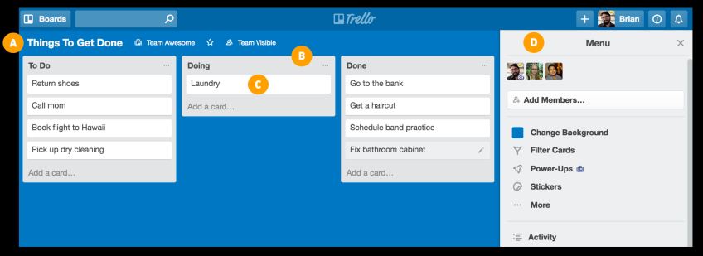
Digital | team communication
https://trello.com/guide/collaborate.html

Slide 33
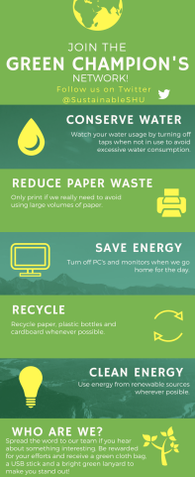
Digital | infographics
2nd year student applied projects

Slide 34
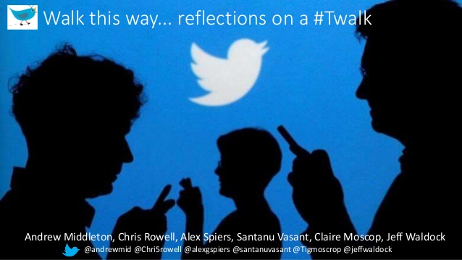
Digital | #twalks
Middleton et al (2018) https://www.slideshare.net/amiddlet50/twalk-this-way-85940036

Slide 35
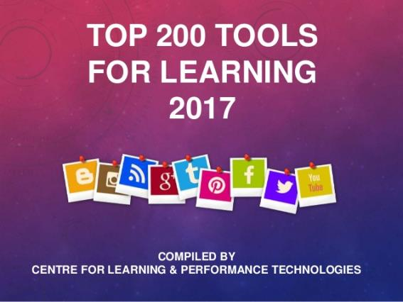
Popular | technovations for learning
Jane Hart 2017 http://c4lpt.co.uk/top100tools/
Based on votes from 2174 learning professionals from 52 countries in the 11th annual survey

Slide 36
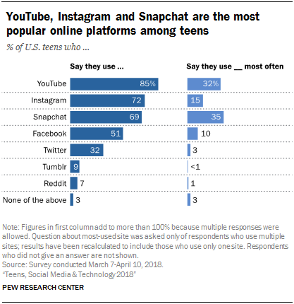
Step changes | Move over Facebook?
YouTube, Instagram and Snapchat are the most popular online platforms among US teens. 95% of teens have access to a smartphone, and 45% say they are online 'almost constantly'
Teens, Social Media & Technology (Pew Research Centre 2018) https://pewrsr.ch/2kCW352

Slide 37
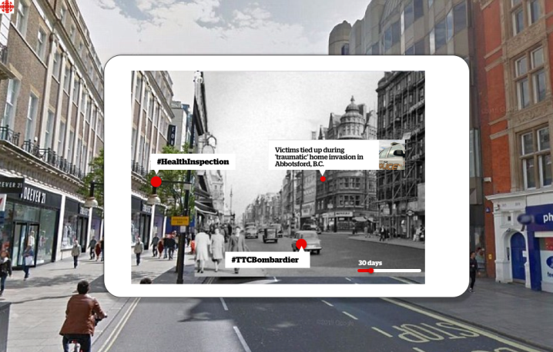
Underutilised | technovations?
Augmented Reality
Notes:
https://medium.com/cbc-digital-labs/innovation-sprint-series-how-were-experimenting-with-augmented-reality-81970fa48718

Slide 38
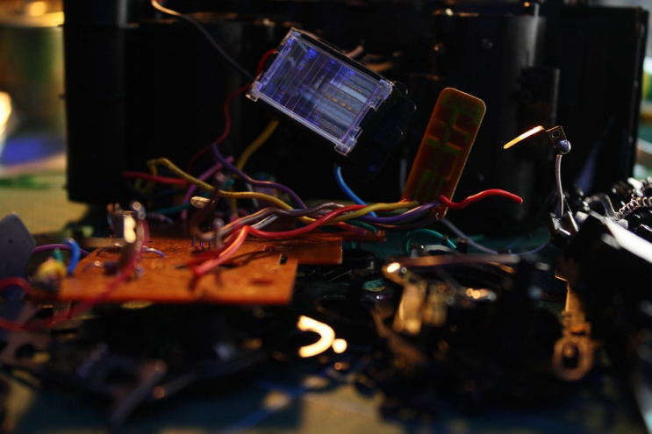
Digital | disruption

Slide 39
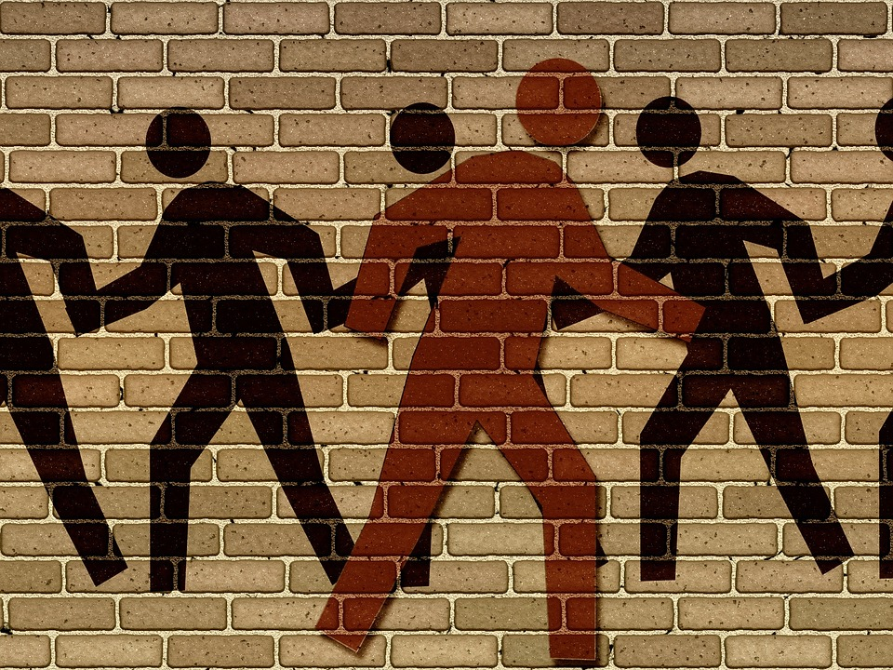

Slide 40
Doing things | differently

Slide 41
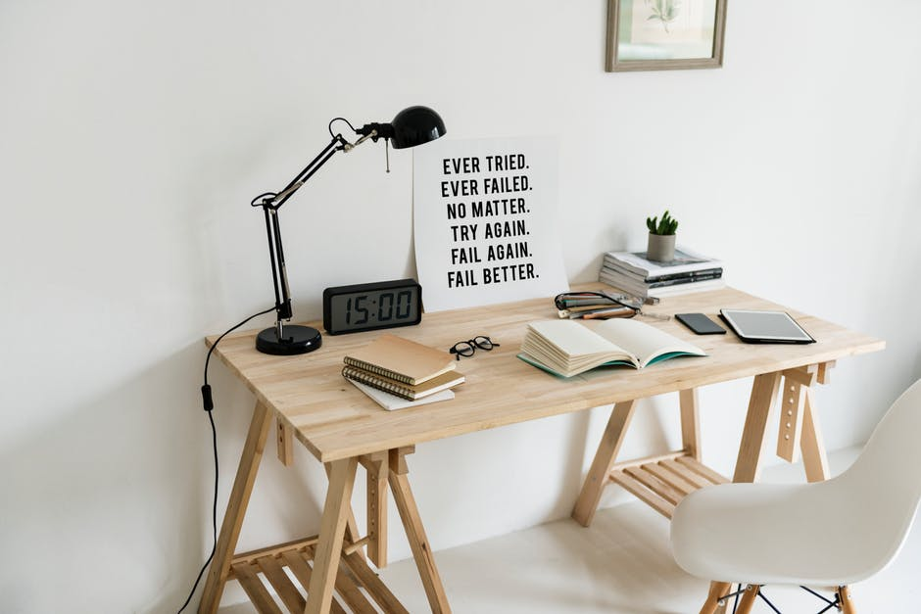

Slide 42
Celebrate | digital inspiration

Slide 43
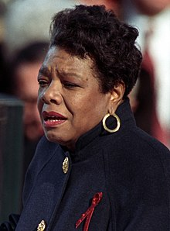
Create | new paths
"If you are going down a road and don't like what's in front of you, and look behind you and don't like what you see, get off the road. Create a new path!"
Maya Angelou 1928-2014

Slide 45
References
Cheng, C..J. and Shiu. E. C. C. (2008) Re-innovation: The construct, measurement, and validation. Technovation 28(10) pp 659-666. Available at: https://doi.org/10.1016/j.technovation.2007.08.002
Fisher, A., Exley, K. and Ciobanu, D. (2013) Using Technology to Support Learning and Teaching. London: Routledge.
Keeley, L., Walters, H., Pikkel, R. and Quinn, B. (2013) Ten Types of Innovation: The Discipline of Building Breakthroughs. Hoboken, New Jersey: John Wiley and Sons.
Mentz, J. C. (2006). Developing a Competence Audit for Technological Innovation. Doctoral dissertation, University of Pretoria, Pretoria. Available at: https://repository.up.ac.za/handle/2263/30490
Papert, S. and Harel, I. (1991) Situating Constructionism - Chapter 1. In Constructionism. Ablex Publising Corporation. Available at: http://web.media.mit.edu/~calla/web_comunidad/Reading-En/situating_constructionism.pdf
Puentedura, R. (2006). Transformation, technology, and education [Blog post]. Available at: http://hippasus.com/resources/tte/
Rothwell, R. and Gardiner, P. (1989) The strategic management of re-innovation. R&D Management, 19 (2) pp 147-160. Available at: https://onlinelibrary.wiley.com/doi/abs/10.1111/j.1467-9310.1989.tb00635.x

Slide 46
Keynote Speaker at Keele Digital Festival
https://www.keele.ac.uk/academicdevelopment/learningteaching/keeledigitalfestival/

