Slide 1
‘Blogging as a professional tool’
Sue Beckingham | @suebecks
National Teaching Fellow
Principal Lecturer at Sheffield Hallam University

Slide 2
Why engage with blogs as a professional tool?
Blogging can help academic writing
Reading others' blogs can open up new perspectives
Reflect on your own development
Connect with thought leaders
Provide a forum to critically discuss new ideas

Slide 3
"In this new landscape, the academic of today has many options for communicating the findings of their research: whether to discuss ideas and results in a blog post, upload a working paper before submitting it to a journal, or to use social media to share their findings on the big story of the day."
Introducing the Impact of LSE Blogs project
Arrebola and Mollett 2016

Slide 4
Blogging vs a Website
Adapted from Mollett et al 2017:75
Blog | Website
Regularly updated Interactive, community building Commentary and insight More informal Very easy to publish new content East to do at low cost | Static One-way Transactional information or news Often formal Dedicated CMS, Gatekeeper Quality = Cost

Slide 5
Blogging...
can help you to establish writing as a routine
allows you to experiment with your writing 'voice'
helps you to get to the point
points you to your reader
requires you to be concise
allows you to experiment with forms of writing
helps you to become a more confident writer
Pat Thomson 2015
https://patthomson.net/2015/12/07/blogging-helps-academic-writing/

Slide 6
3 Rules of Academic Blogging
Pick the right platform
Write whatever you want
Write for the sake of writing
David Perry 2015
https://www.chronicle.com/article/3-Rules-of-Academic-Blogging/234139

Slide 7
Types of Academic Blogs
Self reflective
Multi-author blogs (MABs)
How to guidance
Discipline focus
Promotion of publications
Learning and teaching (pedagogic research)

Slide 8
Getting started:
Choose a blogging platform
Give your blog a name
Consider buying your own domain name
Design your blog using a simple theme
Add an about me page

Slide 9
Platforms:
Blogger, WordPress, Tumblr, Wix, Weebly, WikiSpaces or Google Sites.
LinkedIn, Medium, Facebook.

Slide 10
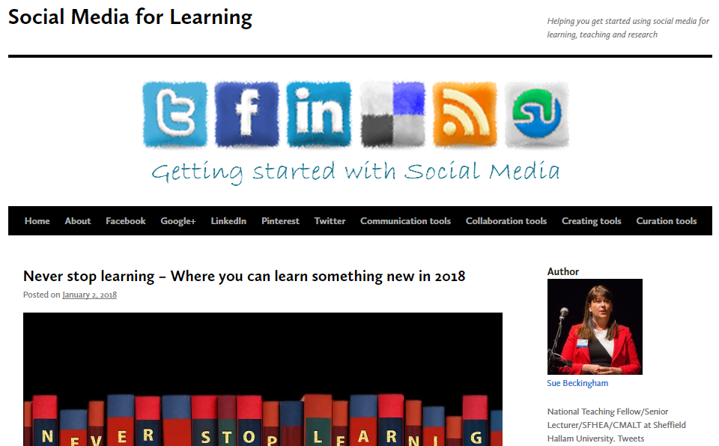
https://socialmediaforlearning.com/

Slide 11
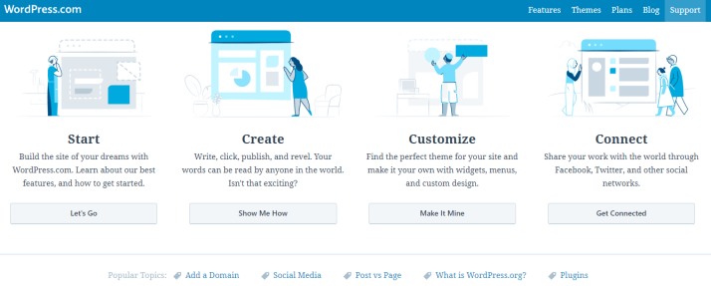
Use the blog tool help guides
https://en.support.wordpress.com/

Slide 12
Structuring your posts
Give each post a compelling title
Chunk content under sub headers
Make use of bullet points
Use images (preferably your own or those with Creative Commons licences https://search.creativecommons.org/)
Embed YouTube videos or infographic posters

Slide 13
Engaging your audience:
End your post with a call to action (to encourage reader comments, questions and discussion)
Enable comments (that you can screen first)
Engage with comments left by readers (or delete the undesirables)

Slide 14
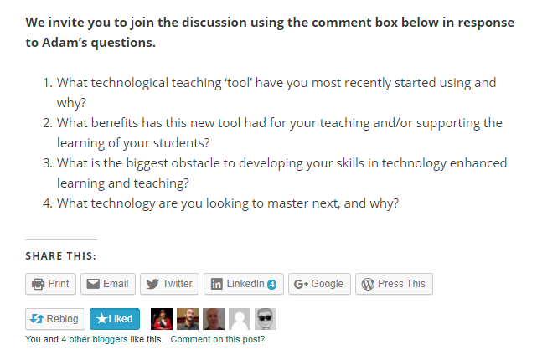

Slide 15
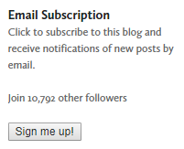
Engaging your audience:
Link your blog to your Twitter account (to auto tweet new posts)
Add social media sharing buttons
Allow users to sign up for email alerts

Slide 16
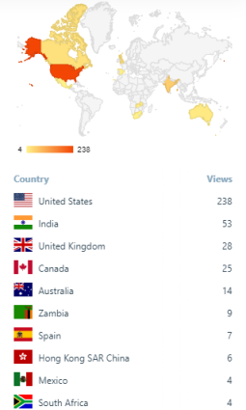
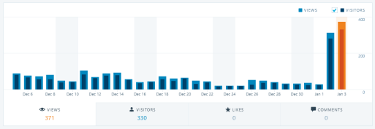
Monitor engagement using free analytics within the blog

Slide 17
http://blogs.lse.ac.uk/impactofsocialsciences/2017/05/31/introducing-the-impact-of-lse-blogs-project/

Slide 18
Blogs to explore
Social Media for Learning https://socialmediaforlearning.com/
The SEDA Blog: Supporting and Leading Educational Change
https://thesedablog.wordpress.com/
Reflecting Allowed https://blog.mahabali.me/
Learning with 'e's: My thoughts about learning technology and all things digital http://www.steve-wheeler.co.uk/
Technology Enhanced Learning Blog http://www.dontwasteyourtime.co.uk/
LSE Impact Blog http://blogs.lse.ac.uk/impactofsocialsciences/

Slide 19
References
Mollett, A., Brumley, C., Gilson, C. and Williams, S. (2017) Communicating your research with social media. London: Sage
Perry, d. (2015) 3 Rules of academic blogging
https://www.chronicle.com/article/3-Rules-of-Academic-Blogging/234139
Thomson, P. (2015) Blogging helps academic writing
https://patthomson.net/2015/12/07/blogging-helps-academic-writing/

Slide 20
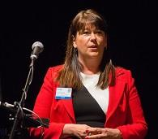
Sue Beckingham | @suebecks
National Teaching Fellow and Principal Lecturer at Sheffield Hallam University with a research interest in the use of social media in education.
Blog: http://socialmediaforlearning.com/
LinkedIn: linkedin.com/in/suebeckingham

