Slide 1
Co-creating learning experiences with students
Sue Beckingham Principal Lecturer and National Teaching Fellow, Sheffield Hallam University
Invited Speaker Pedagogy and Pancakes at University of Lincoln July 2020
Notes:
Co-creating learning experiences with students
In this talk I will share some examples of where I have worked in partnership with students on co-created initiatives that have enabled us to explore the use of social media for learning and teaching.
https://chrisheadleand.com/pedagogy-and-pancakes/

Slide 2
Student learning experiences
Notes:
Outside of teaching what learning experiences can students engage in?

Slide 3
Co-curricular vs Extra-curricular
Generally speaking, co-curricular activities are an extension of the formal learning experiences in a course or academic program, while extracurricular activities may be offered or coordinated by a school/college/university but may not be explicitly connected to academic learning.
Notes:
https://www.edglossary.org/co-curricular/

Slide 4
Extra-curricular: Student Union
Sports
Societies
Volunteering
Mentoring

Slide 5
Extra-curricular: Paid roles
PAL (peer assisted learning) schemes
Digital Champions
Student Ambassadors

Slide 6
Co-curricular
Co-curricular activities are usually voluntary and are not graded for academic credit. They have connections with the course of study being undertaken.
Examples include:
visits to organisations
attendance at talks/events
participating in debates/competitions
presenting at conferences.

Slide 7
Student roles adopted in co-creation of learning and teaching
Co-researcher
Consultant
Pedagogical co-designer
Representative
Bovill et al 2015
Notes:
When leveraging students'voices to co-create learning experiences it opens new opportunities

Slide 8
A typology of student roles adopted in co-creation of learning and teaching
Consultant: sharing and discussing valuable perspectives on learning and teaching
Co-researcher: collaborating meaningfully on teaching and learning research or subject based research with staff
Pedagogical co-designer: sharing responsibility for designing learning, teaching and assessment
Representative: student voices contributing to decisions in university settings
Bovill et al 2015:3

Slide 9
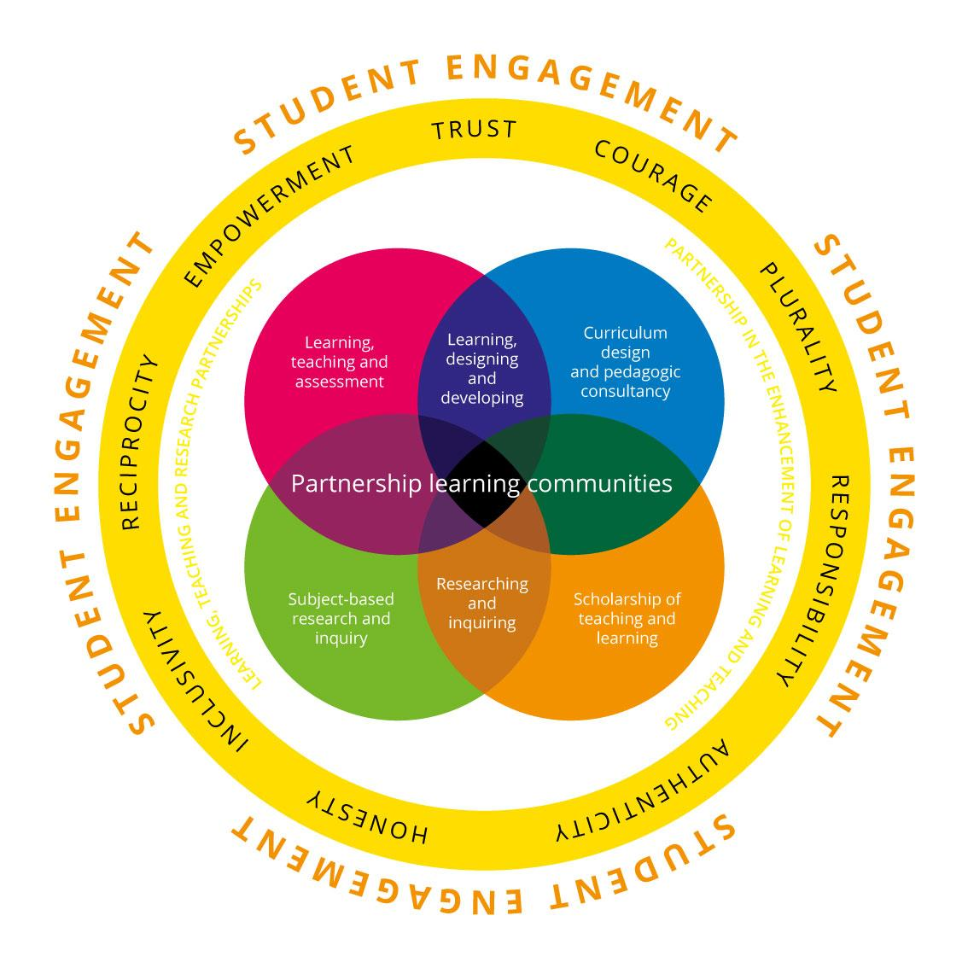
Partnership learning communities
Learning designing and developing
Researching and inquiring
Advance HE 2015

Slide 10
Personal Case Studies

Slide 11
Context: The impact of social media

Slide 12
https://wearesocial.com/digital-2020

Slide 13
Data never sleeps Version 7.0
https://www.domo.com/learn/data-never-sleeps-7
Notes:
Together with Alison Purvis and Helen Rodger we put together some guides on: How to use social media responsibly, Managing your digital footprint and Using social media for learning for staff to use with students.

Slide 14
Social Media Guidance
http://go.shu.ac.uk/socialmedia

Slide 15
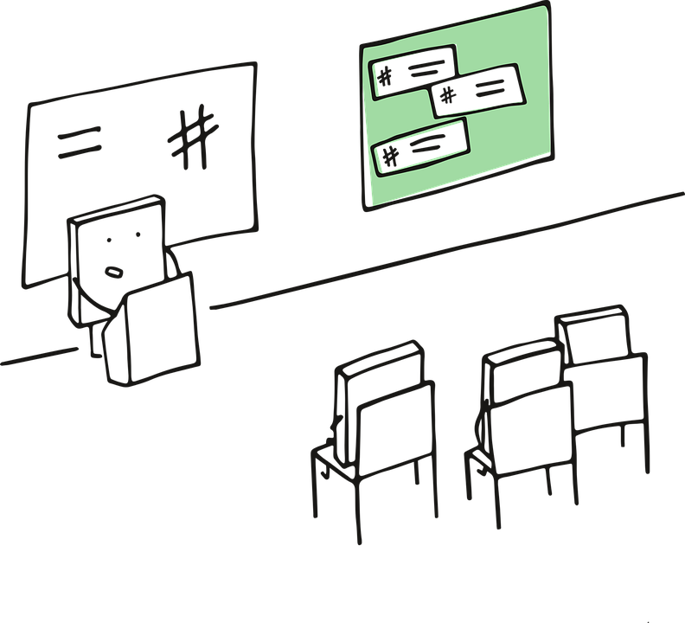
Used in class discussions about using social media responsibly

Slide 16
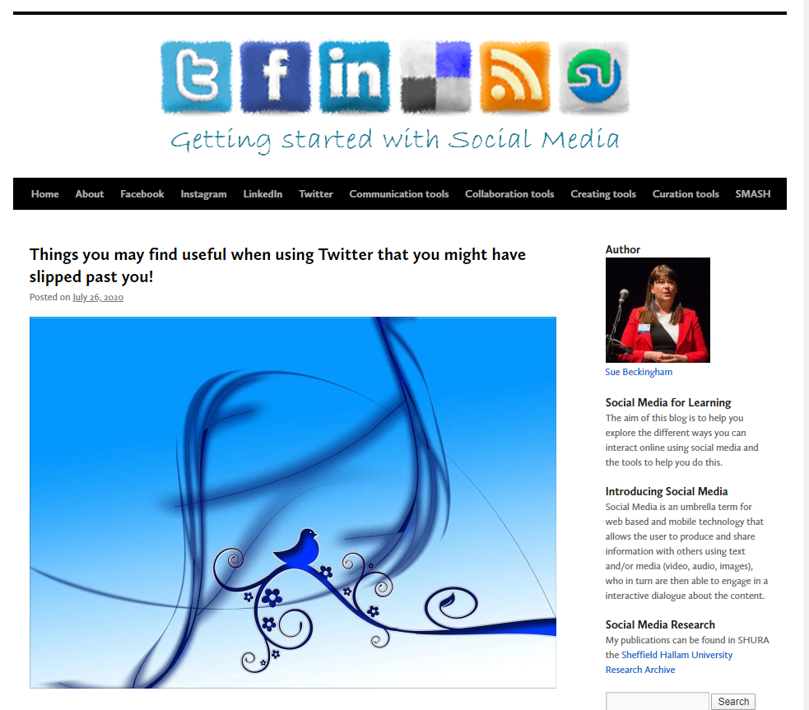
https://socialmediaforlearning.com/

Slide 17
Case Study 1
Tutor led experience

Slide 18
The Tutor perspective (Oksana)
Increase learner engagement with theoretical modules by forging stronger links between theory and creative practice
Promote a stronger engagement with University life, by bringing the students into contact with several stakeholders and services, and enabling the students to participate as expert media producers
Expand opportunities for employability development and client-based work

Slide 19
The Client perspective (Sue)
Brief: Create a 2 minute visual artefact (animation or film) that will portray the importance of using social media responsibly
Discussion: The whole class were involved in the Client led seminar on ‘The importance of responsible use of social media and the value of developing a professional online presence’.

Slide 20
The project
Part 1 (mandatory)
Part 2 (optional)
Following the Client brief the students on the module had 1 week to prepare and in pairs pitch their ideas to the Client.
The Client gave immediate formative feedback.
Students developed their proposed visual artefact over 2 weeks, gave a short presentation to the Client and once again received feedback.
Students were then invited to develop this work further and give a further presentation showing their artefact to a panel.
The Client and panel gave feedback and then shortlisted 4 winning projects
These 4 groups then polished their artefacts further and presented their final work at the L&T Conference.

Slide 21
"The most important thing that I learnt throughout the client project was the how crucial it was to have a detailed plan of what must be done and when. The key was to have perfect time management."
"In this client project I have learnt how to show my work, confidently to a large audience."

Slide 22
"The most important thing that I learnt throughout the client project was the how crucial it was to have a detailed plan of what must be done and when. The key was to have perfect time management."
"In this client project I have learnt how to show my work, confidently to a large audience."

Slide 23
Case Study 2
Co-led experience

Slide 24
So what is SMASH?
SMASH = 'Social Media for Academic Studies at Hallam'
SMASH is a ‘students as partners’ project which considers the potential of social media for learning.

Slide 25
Students as Partners
The focus of this student-led special interest group began by looking at the affordances digital and social media tools can provide in and out of the classroom; as a means to organise learning; to support learning and to showcase learning.
Notes:
Through our collaboration together we decide on the focus of the research we wanted to undertake, the outcomes we hoped to achieve, and planned the actions needed to undertake these.

Slide 26
Continuity
2016-17
2017-18
2018-19
2019-20
Founding Members
Jess, Corran, Ola and Sher
Co-developed the three pillars model and first Guest blog post
Team expanded
Corran, Jess + Abby, Matty and Callum
Co-developed SMASH branding and resources, and led workshops. Presented at #SocMedHE17 and #CAN18
New members
Jess, Matty, Callum + Joe, Amy and Ola
Developed new card resources, guest blog post and led workshops
Current team
Matty + Kai, Curtis and Gag
Extending the framework and resources. Presented at SocMedHE19 and #BETT20

Slide 27
Framework – The Four Pillars
Learning Activities
Organising Learning
Showcasing Learning
Student
Support
Helping staff to identify and use social media tools for communication and collaboration within & beyond the classroom.
Helping students & staff to identify & use relevant social media tools to curate & organise information relating to learning.
Helping students to prepare digital portfolios to openly share outcomes & projects to develop a professional online presence.
Helping students to find resources online to support their wellbeing & academic studies whilst at University.

Slide 28
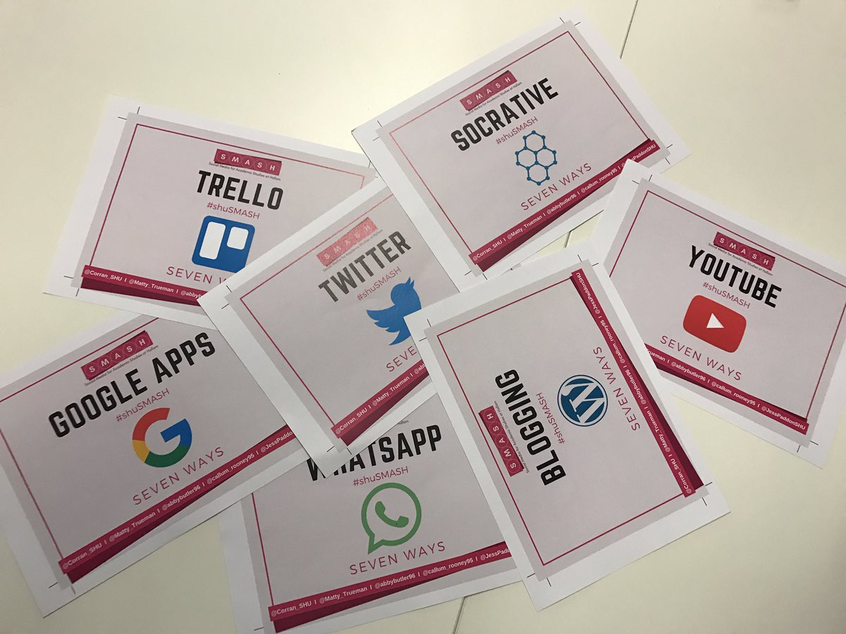
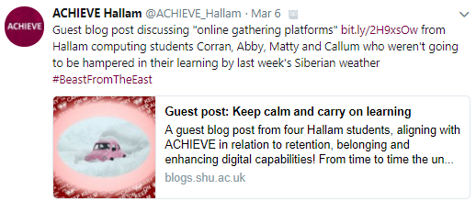
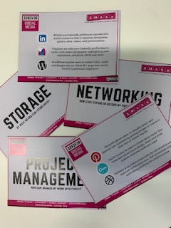
Resources
CARD ACTIVITY
BLOG POSTS
CARD ACTIVITY
7 Things you can use… *[add social media tool] in learning and teaching
Guest blog post for Sheffield Hallam University and Social Media for learning blog
Reverse Social Media What do we want to achieve and how can social media help
All have been given a Creative Commons License
Notes:
https://socialmediaforlearning.com/2019/02/02/student-guest-post-8-ways-students-and-staff-can-engage-in-remote-collaboration/
https://socialmediaforlearning.com/2018/03/04/guest-post-keep-calm-and-carry-on-learning-by-students-corran_shu-abbybutler96-matty_trueman-callum_rooney95/
Tweet by @ACHIEVE_Hallam: https://twitter.com/ACHIEVE_Hallam/status/970994129705500673 Tweet by Simon Horrocks: https://twitter.com/horrocks_simon/status/943067775932796928

Slide 29
Workshops
The SMASH team have led workshops with staff and students. Using the cards, participants have engaged in conversations about how social media can be used to enhance learning and teaching; aid collaborative group work and showcase the work students are doing.

Slide 30
Guest blog post 1 in response to COVID19
Guest post: A student toolkit to help you tackle remote learning written by students for students
https://socialmediaforlearning.com/2020/03/22/guest-post-a-student-toolkit-to-help-you-tackle-remote-learning-written-by-students-for-students/

Slide 31
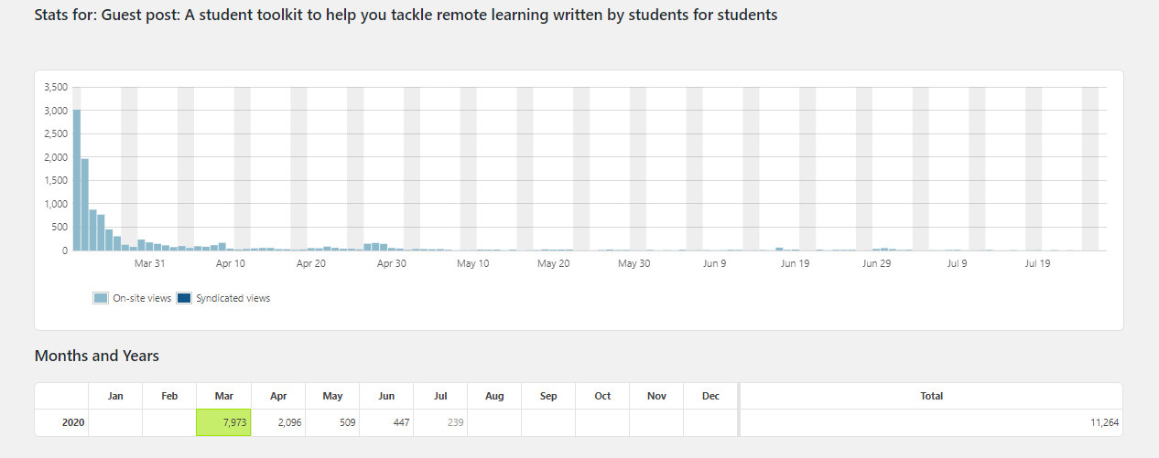
Impact

Slide 32
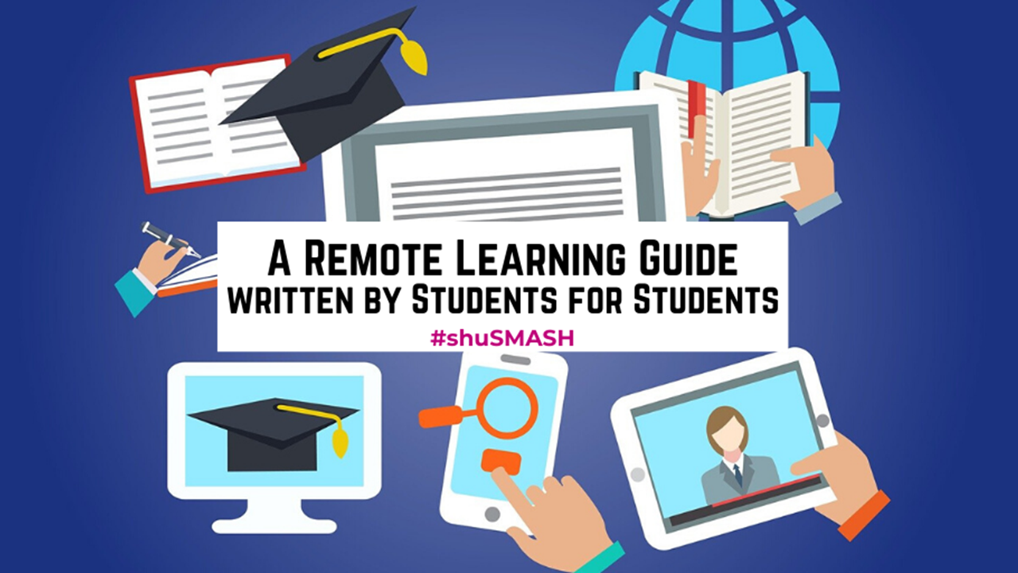
Guest blog post 2 in response to COVID19
A remote learning guide written by students for students: How to ensure your remote learning experience is effective, supportive and fun
https://socialmediaforlearning.com/2020/03/31/guest-post-2-a-remote-learning-guide-written-by-students-for-students-how-to-ensure-your-remote-learning-experience-is-effective-supportive-and-fun-shusmash/

Slide 33
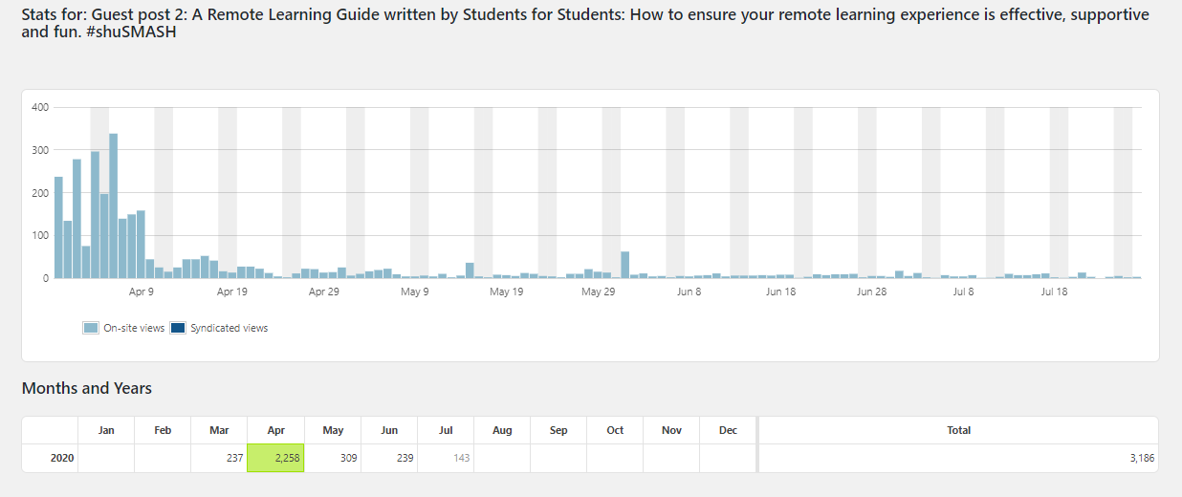
Impact

Slide 34
Outcomes from the student’s perspective
They developed a virtual community of practice (VCoP) and co-learning network.
Presented at external conferences: University of Winchester, Edge Hill University, BETT conference
Published an article: ‘A SMASHing approach for developing staff and student digital capabilities within a Community of Practice’. Journal of Educational Innovation, Partnership and Change
A dedicated space to share what they have achieved https://socialmediaforlearning.com/smash/

Slide 35
Value of a virtual community of practice (VCoP)
Key themes:
Peer learning - the significance of helping others learn;
Confident communication - learning to utilise different media to suit the situation and task at hand;
Companionship and teamwork - taking ownership and supporting each other to work collaboratively;
Transferable skills - recognition that these skills can be applied in the workplace.
(Beckingham et al 2019)

Slide 36
Student gains from this VCoP
“Developing a rapport with team members from different backgrounds through digital platforms” Callum
“Greater digital knowledge gained through discussion and companionship” Matty
“Using apps such as Skype allow us to meet virtually in any location, allowing us to keep flexible with our studies” Corran
“Using FaceTime allowed me to participate in SMASH meetings whilst I was on the other side of the country!” Jess
“Enhancing learning through partnerships with other students ” Abby

Slide 37
Students as Partners Networks
RAISE (Researching, Advancing and Inspiring Student Engagement) http://www.raise-network.com/ Conference: https://raise2020.blogs.lincoln.ac.uk/ Twitter: @RAISEnetwork
Change Agents’ Network https://can.jiscinvolve.org/wp/ Conference: https://bcucanconference.wixsite.com/jisc Twitter: @CANagogy

Slide 38
Students as Partners Journals
International Journal for Students as Partners https://mulpress.mcmaster.ca/ijsap/
Journal of educational innovation, partnership and change https://journals.studentengagement.org.uk/
Student Engagement in Higher Education Journal http://www.raise-network.com/journal/

Slide 39
References
C. Bovill, A. Cook-Sather, P. Felten, L. Millard, and N. Moore-Cherry (2015) Addressing potential challenges in co-creating learning and teaching: overcoming resistance, navigating institutional norms and ensuring inclusivity in student-staff partnerships. Higher Education. http://dx.doi.org/10.1007/s10734-015-9896-4
HEA. (2015). Students as partners. Retrieved from https://www.heacademy.ac.uk/enhancement/themes/studentspartners

